Slide 1

Model-Driven Risk Analysis
The CORAS Approach
Ketil Stølen, SINTEF & UiO
FOSAD 2011

Slide 2


Acknowledgments
The research for the contents of this tutorial has partly been funded by the European Commission through the FP7 project SecureChange and the FP7 network of excellence NESSoS

Slide 3
Overview
Part I Introduction – Risk management and the CORAS approach
Part II Example-driven walkthrough of the CORAS method
Part III Change Management

Slide 4
Part I: Introduction
Risk Management and the CORAS Approach

Slide 5
Overview of Part I
What is risk?
What is risk management?
Central terms
What is CORAS?
Main concepts
The CORAS process
Risk modeling
Semantics
Likelihood reasoning
The CORAS tool
Further reading

Slide 6
What is Risk?
Many kinds of risk
  Contractual risk
  Economic risk
  Operational risk
  Environmental risk
  Health risk
  Political risk
  Legal risk
  Security risk

Slide 7
Definition of risk from ISO 31000
Risk: Effect of uncertainty on objectives
  NOTE 1 An effect is a deviation from the expected — positive and/or negative
  NOTE 2 Objectives can have different aspects (such as financial, health and safety, and environmental goals) and can apply at different levels (such as strategic, organization-wide, project, product and process)
  NOTE 3 Risk is often characterized by reference to potential events and consequences, or a combination of these
  NOTE 4 Risk is often expressed in terms of a combination of the consequences of an event (including changes in circumstances) and the associated likelihood of occurrence
  NOTE 5 Uncertainty is the state, even partial, of deficiency of information related to, understanding or knowledge of an event, its consequence, or likelihood

Slide 8
What is Risk Management?
Risk management: Coordinated activities to direct and control an organization with regard to risk
[ISO 31000:2009]

Slide 9
Risk Analysis Involves
Determining what can happen, why and how
Systematic use of available information to determine the level of risk
Prioritization by comparing the level of risk against predetermined criteria
Selection and implementation of appropriate options for dealing with risk

Slide 10
Terms
Asset
Vulnerability
Reduced risk
Threat
Risk
Need to introduce risk treatment

Slide 11
Terms
Internet
Infected PC
Unwanted incident
Computer running Outlook
Vulnerability
- Infected twice per year
Infected mail send to all
contacts
V
Risk
Worm
Threat
Install virus scanner
Treatment

Slide 12
Risk Analysis Using CORAS

Slide 13
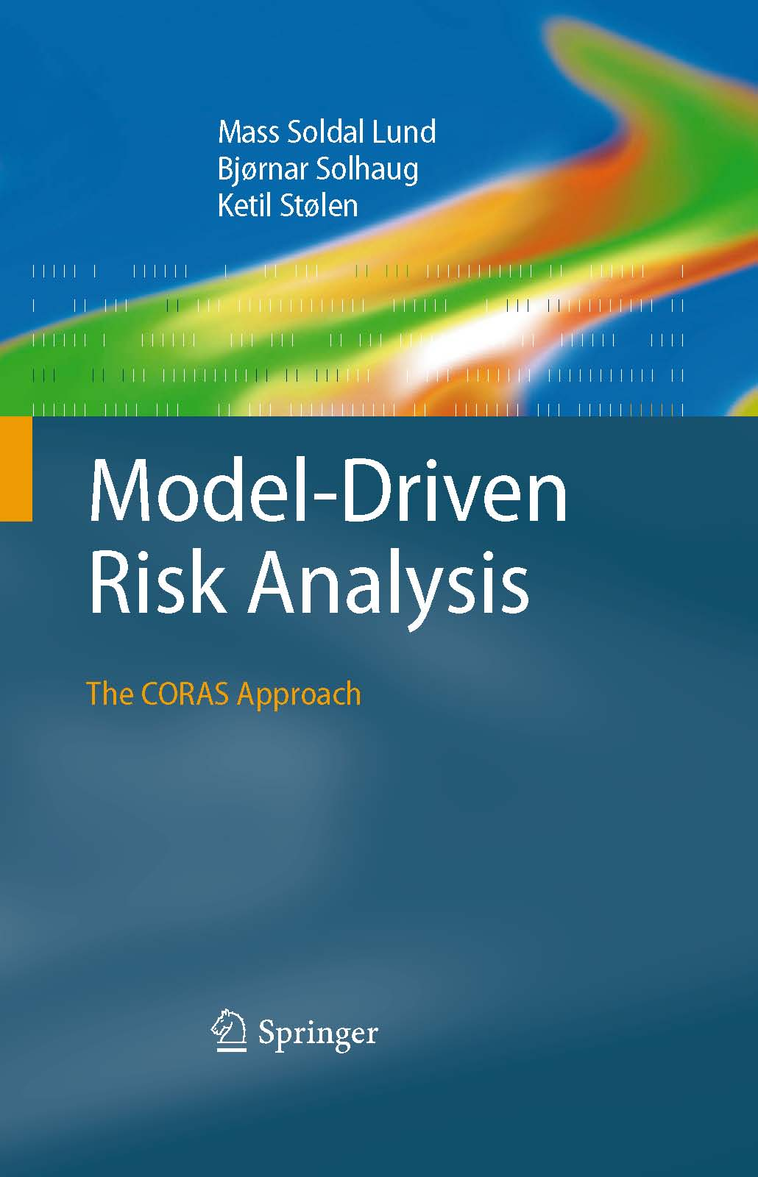
Overview
What is CORAS?
Main concepts
Process of eight steps
Risk modeling
Semantics
Calculus
Tool support
Further reading

Slide 14
What is CORAS?
CORAS consists of
  Method for risk analysis
  Language for risk modeling
  Tool for editing diagrams
Stepwise, structured and systematic process
  Directed by assets
  Concrete tasks with practical guidelines
  Model-driven
    Models as basis for analysis
    Models as documentation of results
Based on international standards

Slide 15
Main Concepts
Vulnerability
Party
Asset
Threat
Treatment
Unwanted incident
Likelihood
Risk
Consequence

Slide 16
Definitions
Asset: Something to which a party assigns value and hence for which the party requires protection
Consequence: The impact of an unwanted incident on an asset in terms of harm or reduced asset value
Likelihood: The frequency or probability of something to occur
Party: An organization, company, person, group or other body on whose behalf a risk analysis is conducted
Risk: The likelihood of an unwanted incident and its consequence for a specific asset
Risk level: The level or value of a risk as derived from its likelihood and consequence
Threat: A potential cause of an unwanted incident
Treatment: An appropriate measure to reduce risk level
Unwanted incident: An event that harms or reduces the value of an asset
Vulnerability: A weakness, flaw or deficiency that opens for, or may be exploited by, a threat to cause harm to or reduce the value of an asset

Slide 17
Exercise I
How would you represent risk in your favorite modelling language/formal notation/approach?

Slide 18
Process of Eight Steps
Preparations for the analysis
Customer presentation of the target
Refining the target description using asset diagrams
Approval of the target description
Risk identification using threat diagrams
Risk estimation using threat diagrams
Risk evaluation using risk diagrams
Risk treatment using treatment diagrams
Establish context
Assess risk
Treat risk

Slide 19
Risk Modeling
The CORAS language consists of five kinds of diagrams
  Asset diagrams
  Threat diagrams
  Risk diagrams
  Treatment diagrams
  Treatment overview diagrams
Each kind supports concrete steps in the risk analysis process
In addition there are three kinds of diagrams for specific needs
  High-level CORAS diagrams
  Dependent CORAS diagrams
  Legal CORAS diagrams

Slide 20
Example: Threat Diagram
Consequence
Asset
Likelihood
Threat
Threat scenario
Unwanted
incident
Vulnerability

Slide 21
Semantics
How to interpret and understand a CORAS diagram?
Users need a precise and unambiguous explanation of the meaning of a given diagram
Natural language semantics
  CORAS comes with rules for systematic translation of any diagram into sentences in English
Formal semantics
  Semantics in terms of a probability space on traces

Slide 22
Example
Elements
  Computer virus is a non-human threat.
  Virus protection not up to date is a vulnerability.
  Threat scenario Server is infected by computer virus occurs with likelihood possible.
  Unwanted incident Server goes down occurs with likelihood unlikely.
  Availability of server is an asset.
Relations
  Computer virus exploits vulnerability Virus protection not up to date to initiate Server is infected by computer virus with undefined likelihood.
  Server is infected by computer virus leads to Server goes down with conditional likelihood 0.2.
  Server goes down impacts Availability of server with consequence high.

Slide 23
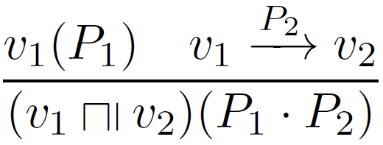
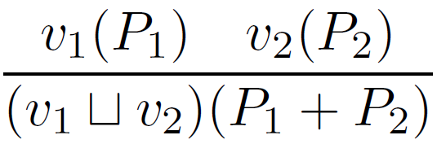
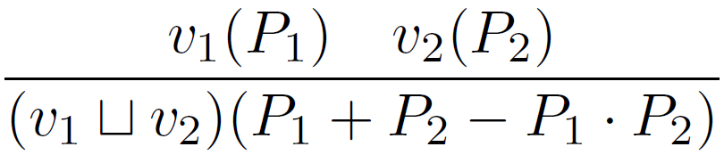
Calculus for Likelihood Reasoning
Relation
Mutually exclusive vertices
Statistically independent vertices

Slide 24
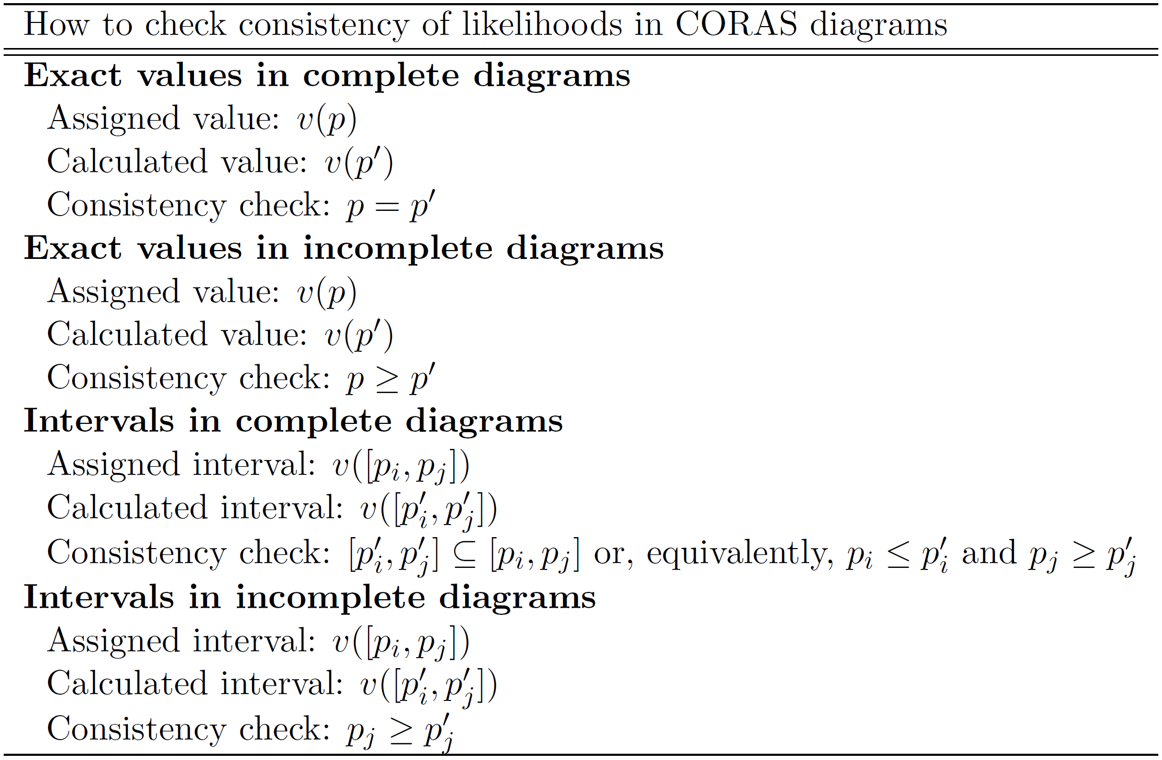
Guidelines for Consistency Checking

Slide 25
Tool Support
The CORAS tool is a diagram editor
Supports all kinds of CORAS diagrams
Suited for on-the-fly modeling during workshops
Ensures syntactic correctness
May be used during all the steps of a risk analysis
  Documents input to the various tasks
  Selection and structuring of information during tasks
  Documentation of analysis results
Download: http://coras.sourceforge.net/

Slide 26
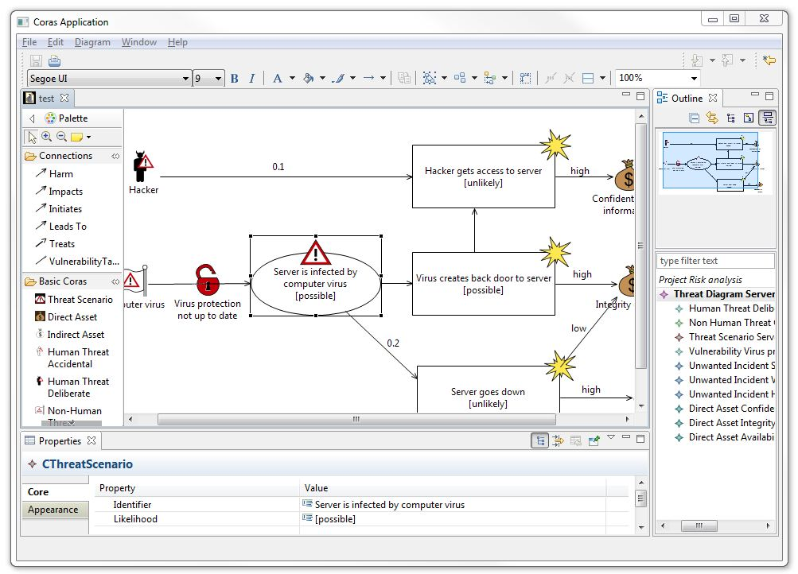
Screenshot
Pull-down menu
Tool bar
Palette
Outline
Canvas
Properties window

Slide 27
Criticism from system developers
The CORAS language is too simplistic
It is too cumbersome to use graphical icons

Slide 28
Criticism from risk analysts
What’s new with the CORAS language?
We have been using something similar for years, namely VISIO!

Slide 29
Exercise II
Discuss the statements made by the critics?
Argue why the critics are wrong.

Slide 30
Further Reading
Book:
  www.springer.com/computer/swe/book/978-3-642-12322-1
  Some chapters may be downloaded for free, including Chapter 3 which gives a Guided Tour of CORAS
Tool:
  http://coras.sourceforge.net/
  Open source
Formal semantics:
  Gyrd Brændeland, Atle Refsdal, Ketil Stølen. Modular analysis and modelling of risk scenarios with dependencies. Journal of Systems and Software, volume 83, pages 1995-2013, Elsevier, 2010.

