Slide 1

Part II: Example-Driven Walkthrough of the CORAS Method
Ketil Stølen, SINTEF & UiO
FOSAD 2011

Slide 2
Overview of Part II
The CORAS method
ATM example
Walkthrough of the 8 steps
Summary

Slide 3
The CORAS Method
Asset-driven defensive risk analysis method
Operationalization of ISO 31000 risk analysis process in 8 steps
Detailed guidelines explaining how to conduct each step in practice
Modeling guidelines for how to use the CORAS language

Slide 4
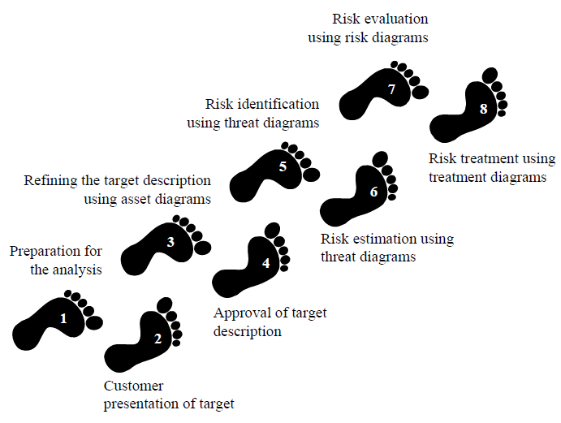
The 8 Steps of the CORAS Method
Treat risk
Assess risk
Establish context

Slide 5
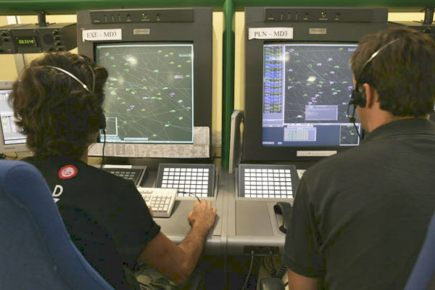
Air Traffic Management (ATM)
Aggregation of services provided by Air Traffic Controllers (ATCOs)
  Main responsibility is to maintain horizontal and vertical separation among aircrafts and possible obstacles
  Limited interaction with
  the external world
  Humans at the centre of
  the decision and work
  process

Slide 6
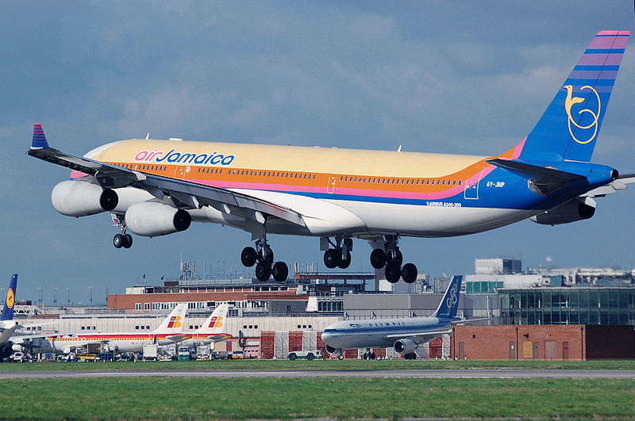
The ATM Case
Risk analysis of selected ATM services
  Arrival management
Focus on
  Information provision

Slide 7
Step 1: Preparation for the Analysis
Objectives
  Information about customer, purpose and domain of analysis
  Decide size of analysis
  Ensure customer is prepared
  Practical organization of analysis
Interaction between the customer and the analysis team
  Preferably face-to-face meeting

Slide 8
ATM Example
Customer is a national air navigation service provider
Want risk analysis with focus on
  Arrival management, esp. the role of the air traffic controllers (ATCOs) in the area control centre (ACC)
The risk analysis team and the customer decides on an analysis of 250 person-hours

Slide 9
Step 2: Customer presentation of target
Objective
  Initial understanding of what to analyze
  Focus, scope and assumptions
Interaction between the customer and the analysis team
  Present CORAS terminology and method
  Decide the goals and target of the analysis
  Decide the focus and scope of the analysis

Slide 10
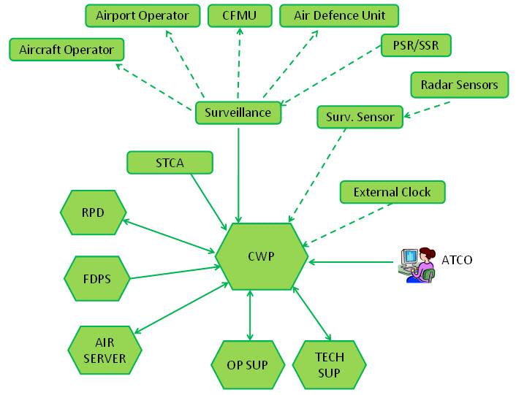
ATM Example
Customer presents the work environment of ATCOs
Customer presents the desired focus
  Information provision
  Compliance with regulations
Customer presents the desired focus
  Work processes at ACCs
  Arrival management
  ATCOs roles and responsibilities

Slide 11
Step 3: Refining the Target Description Using Asset Diagrams
Objective
  Ensure common understanding of target including scope, focus and assets
Face-to-face meeting
  Analysis team presents the target
  Asset identification
  High-level analysis

Slide 12
Target Description
The target description is the documentation of all the information that serves as the input to and the basis for a risk analysis

Slide 13
Target Description - Definitions
Asset: Something to which a party assigns value and hence for which the party requires protection
Assumption: Something we take as granted or accept as true (although it may not be so)
Context of analysis: The premises for and the background of a risk analysis. This includes the purposes of the analysis and to whom the analysis is addressed
Environment of target: The surrounding things of relevance that may affect or interact with the target; in the most general case, the rest of the world
Focus of analysis: The main issue or central area of attention in a risk analysis. The focus is within the scope of the analysis
Party: An organization, company, person, group or other body on whose behalf a risk analysis is conducted
Scope of analysis: The extent or range of a risk analysis. The scope defines the border of the analysis, in other words what is held inside of and what is held outside of the analysis
Target of analysis: The system, organization, enterprise, or the like that is the subject of a risk analysis

Slide 14
ATM Example: Target Description
The analysis team presents their understanding of the target
Target of analysis described using UML
  Conceptual overview using UML class diagrams
  Component structure using UML structured classifiers
  Activities using UML interactions (interaction overview diagrams and sequence diagrams)

Slide 15
ATM Example: Target Description
Flight Data Processing System
Aeronautical Operational Information System
Area Control Centre network
Operation room
Location of Air Traffic Controllers (ATCOs)
Adjacent
Air Traffic System
unit

Slide 16
ATM Example: Target Description
Controller Working Position of Supervisor
Supervisor
SUP is an air traffic controller (ATCO) supervising the traffic management of an ACC island

Slide 17
ATM Example: Target Description

Slide 18
ATM Example: Asset identification
Assets are the values the parties of the analysis wants to protect
Identified assets are presented in CORAS asset diagrams

Slide 19
ATM Example: High-level analysis
Threat, vulnerabilities, threat scenarios and unwanted incidents are identified in a brainstorming session
Identify biggest worries and increase understanding of focus and scope

Slide 20
ATM Example: High-level analysis
Who/what causes it? | How? What is the scenario or incident? What is harmed | What makes it possible?
Component failure; power loss | Provisioning of information to ATCO fails due to loss of CWP (Controller Working Position) | Insufficient CWP maintenance
Software error | The consolidation of data from several radar sources fails | Lack of redundant aircraft tracking systems
Component failure; radar disturbance | Malfunctioning of radar antenna; loss of aircraft tracking | Insufficient radar maintenance
Software bugs | False or redundant alerts from safety tool | Insufficient software testing

Slide 21
Step 4: Approval of Target Description
Objective
  Ensure target description is correct and complete
  Ranking of assets
  Scales for risk estimation
  Risk evaluation criteria
Face-to-face meeting
  Structured walk-through of target description
  Plenary discussion on assets, scales and criteria

Slide 22
Consequence Scales
One consequence scale for each asset is defined
  Note: Sometimes one scale applies to several assets
Consequences can be qualitative or quantitative
Scales can be continuous, discrete or with intervals

Slide 23
ATM Example: Consequence Scale
One consequence scale for each of the three assets is defined
  Two direct assets and one indirect asset
In the ATM example, one consequence scale applies to the two direct availability assets
Consequence | Description
Catastrophic | Catastrophic accident
Major | Abrupt maneuver required
Moderate | Recovery from large reduction in separation
Minor | Increasing workload of ATCOs or pilots
Insignificant | No hazardous effect on operations
The consequence and likelihood scales are partly based on requirements and advisory material provided by EUROCONTROL

Slide 24
Likelihood Scale
One likelihood scale is defined
  The scale is used for all unwanted incidents and threat scenarios
Likelihoods can be
  Qualitative or quantitative
  Probabilities or frequencies
Scales can be continuous, discrete or with intervals

Slide 25
ATM Example: Likelihood Scale
Qualitative likelihood scale in terms of frequency
Likelihood | Description
Certain | A very high number of similar occurrences already on record; has occurred a very high number of times at the same location/time
Likely | A significant number of similar occurrences already on record; has occurred a significant number of times at the same location
Possible | Several similar occurrences on record; has occurred more than once at the same location
Unlikely | Only very few similar incidents on record when considering a large traffic volume or no records on a small traffic volume
Rare | Has never occurred yet throughout the total lifetime of the system

Slide 26
ATM Example: Risk Evaluation Criteria
Consequence
 | Insignificant | Minor | Moderate | Major | Catastrophic
Rare
Unlikely
Possible
Likely
Certain
Likelihood
High risk: Unacceptable and must be treated
Medium risk: Must be evaluated for possible treatment
Low risk: Must be monitored

Slide 27
Step 5: Risk Identification Using Threat Diagrams
Objective
  Identify risk: where, when, why and how they may occur
Workshop conducted as a brainstorming session
  Involving people of different background
  Assets and high-level analysis as starting point
  Threats, threat scenarios, vulnerabilities and unwanted incidents documented on-the-fly using threat diagrams

Slide 28
ATM Example: Risk Identification

Slide 29
ATM Example: Risk Identification

Slide 30
Step 6: Risk Estimation Using Threat Diagrams
Objective
  Determine the level of identified risks
Workshop
  Involving people of different background
  Walk-through of threat diagrams
  Likelihood estimates on threat scenarios, unwanted incidents and relations between them
  Consequence estimates on relation between unwtanted incidents and assets

Slide 31
ATM Example: Risk Estimation

Slide 32
ATM Example: Risk Estimation

Slide 33
Step 7: Risk Evaluation Using Risk Diagrams
Objective
  Determine which risks are unacceptable and must be evaluated for treatment
Off-line activity
  Calculate risk levels from estimates
  Present risks in risk diagrams
Assess potential impact of identified risk
  Risks that accumulate
  Risks with respect to indirect assets

Slide 34
ATM Example: Indirect Assets

Slide 35
ATM Example: Risk Diagrams

Slide 36
ATM Example: Risk Diagrams

Slide 37
ATM Example: Risk Evaluation
Consequence
 | Insignificant | Minor | Moderate | Major | Catastrophic
Rare
Unlikely |  | R5 | R2
Possible | R4 | R1, R6 | R3
Likely
Certain
Likelihood
Risk levels are calculated using the risk matrix
The risk matrix moreover serves as the risk evaluation criteria

Slide 38
Step 8: Risk Treatment Using Treatment Diagrams
Objective
  Indentify cost effective treatments for unacceptable risks
Workshop with brainstorming session
  Involving people of different background
  Walk-through of threat diagrams
  Identify treatments to unacceptable risks

Slide 39
ATM Example: Treatment Diagram

Slide 40
Summary
CORAS is a model-driven approach to risk analysis
Language and tool support for all phases
Practical guidelines
  How to conduct the various tasks
  How to do the risk modeling
Closely based on the ISO 31000 standard

