Slide 1
MANAGING GRC SECURITY FOR SERVICES
IN SOCIO-TECHNICAL SYSTEMS
Fabio Massacci
Yudistira Asnar
Elda Paja
Fabio Massacci
http://www.disi.unitn.it/~massacci

Slide 2
ORIGINAL PLAN of Tutorial
Presentation
  Where actually Trento is and Who am I?
Motivation and Introduction (Monday)
  What GRC really is and why it matters
  Security issues and target
A GRC Methodology for managing security in services (Monday)
  The Deming Cycle: Plan, Do, Check, Act phases
Security Modelling for the “Plan” (design) phase (Tuesday)
  Socio-technical security modelling
Hands-on exercise (Wed-Thu in the evening)
  You make your own security analysis in groups of 3-4
Bash the students (Frid)
  You present the outcome of your analysis and I bash you…
But today is Wednesday…

Slide 3
NEw PLAN of Tutorial
Presentation
  Where actually Trento is and Who am I?
Motivation and Introduction (Monday)
  What GRC really is and why it matters
  Security issues and target
A GRC Methodology for managing security in services (Monday)
  The Deming Cycle: Plan, Do, Check, Act phases
Security Modelling for the “Plan” (design) phase (Tuesday)
  Socio-technical security modelling
How do you know it works?
  Suppose after this tutorial you decided this the PhD thesis you always wanted to do, how would you validate the results.

Slide 4
FOSAD TUTORIAL – Discussion FORM
What are the important dimensions that you should consider to decide if a method is good or not? (at least 5)
  …
  …
  …
  …
  …

Slide 5
FOSAD TUTORIAL – Discussion FORM - II
If you had to test the quality of your method, what kind of steps would you go through? (at least 3 steps)
  ….
  ….
  ….

Slide 6
FOSAD TUTORIAL – Discussion FORM - III
This is just to see if there is some interesting correlation between the choice of dimensions and the expectations
What is your thesis area?
What is your background?

Slide 7
PRESENTATION
Fabio Massacci
Yudistira Asnar
Fabio Massacci
http://www.disi.unitn.it/~massacci

Slide 8
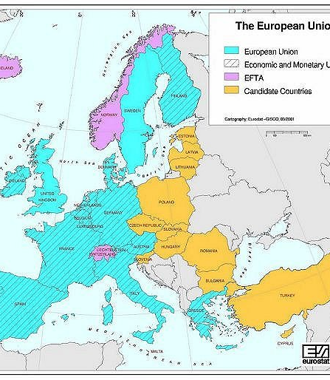
TRENTO’s LOCATION IN SPACE & TIME
1962
  Institute of Social Science is founded as locally funded Institution
1972
  becomes a private University
1982
  becomes a state University with special autonomy
2011
  University admitted as 6th core node of European Institute of Innovation and Technology (EIT) - ICTLabs
    With Berlin, Paris, Stokholm, Helsinki, Eindhoven
TRENTO

Slide 9
Fabio Massacci short bio
MSc at Roma La Sapienza
  Automated Reasoning Modal logic
Cambridge University
  L. Paulson, R. Needham & G. Bella on security protocol verification
PhD at Roma La Sapienza
  Automated Reasoning Modal logic for Security Properties
Assistant prof. University of Siena (some bits in Toulouse and Koblenz)
  Founder of IJCAR
Associate and now Full professor Prof. University of Trento
  Security Requirements Engineering and compliance with J. Mylopoulos, N. Zannone et al.
  Security-by-Contract for mobile code and now smart-cards with F. Piessens, N. Dragoni et.al
  Security Metrics with S. Neuhaus et al.

Slide 10
NonAcademic Experience
European Treasurer of Service Civil International
  NGO with consulatative status at UNESCO, Council of Europe, member of European Youth Forum
Deputy Rector for ICT Procurements and Services
  7 years…
  1 CIO and 70+ people to manage
  5+MEuro/Year budget for services (MAN, server farms) and outsourcing contracts (SAP)
  While most professors are “suppliers” of technology (by research of consultancy work) this made me one of the few “customer” of IT technology and the perspective is different…
    Ask yourself what is a company like Adobe, Apple, Google, IBM, Microsoft, Oracle, SAP etc. for you?

Slide 11

SEVEN DEGREES OF SEPARATION
Academic at University
    Great company you really want to work with to transform your ideas into beautiful products that everybody will use
Researcher in Industry
Member of Production Group
Marketing Salesman
Maintenance scapegoat
Customer’s IT Technician
Responsible for Business Unit
“The Customer” who shells money
    Vampire swallowing lots of your hardly earned money in change of ugly products that are not really what you needed
2002-2009

Slide 12
MOTIVATION AND INTRODUCTION TO GRC
Fabio Massacci
Yudistira Asnar
Fabio Massacci
http://www.disi.unitn.it/~massacci

Slide 13
Let’s Start with a Problem
Hospital San Raffaele of Milano (Italy)
  Largest private medical research hospital in Italy
Private Hospitals Manage Drug Dispensation to Patients on behalf of Health Care Authority and Claim Reimboursement Afterward
  Some drugs are very expensive: huge financial issues
  Process is highly regulated
  Many steps are run by external actors
Many privacy and security issues
  Protect patient identity
  Authenticate patients, doctors and nurses
Target is to “govern” the process, manage the risks and show compliance with law and show “we are in control”

Slide 14
What is GRC?
Governance
  policies, laws, culture and institutions that define how an organization is managed/run and drives the strategy
Risk Management
  the coordinated activities that direct and control an organization’s risks.
Compliance
  the act of adhering to regulations as well as corporate policies and procedures
Notes:
Risk is the trickiest one since can be seen as an exercise in understanding and controlling the risk of running a business
Anyone… disagrees with these?

Slide 15
GRC Examples in Drug Dispensation
Governance
Risk Management
Compliance
Security & Privacy Measures of Data Subject for Drug Dispensation
Drug Dispensation, Process is managed according the Public Health Authority
Overall Drug Claims Financial Process
Effective Deployment of Security Controls for Drug Dispensation
Trade-off between Access Control Cost and Violations Impact
Implementation of Security Controls Defined in EU Data Protection Law
Likelihood and Costs of Wrong Dispensation
Notes:
SOP – Standard Operating Procedure

Slide 16
Why GRC is Important?
Huge Markets
  Investors in North America and Western Europe will pay a premium of 14% for companies with good governance [McKinsey report]
  GRC market in 2008 at approximately $52.1 billion (and growing). Of this 4% in IT [Corporate Integrity report]
Companies Adopt GRC to
  Comply with regulations
  Avoid failing an audit
  Learn from a bad experience
  Managing risks
  Insure, improve and optimize an existing business

Slide 17
Compliance Nightmare...
Many Regulation to Show Compliance with
  Financial Areas (Sarbanes Oxley Act, German Corporate Governance Code, Basel II, Solvency II)
  Privacy-related (EU Data Protection Directives, HIPAA)
  Environmental (Title 50 (wildlife) and Title 33 (navigable water))
  Security related (Toxic Substance Control Act, ITAR, Patriot Act)
Many Standards to Show Compliance with
  COSO (Enterprise Risk Management – Integrated Framework, 2009 : Guidance on Monitoring Internal Control Systems)
  ISO (2700X on Information Security, 38500 on IT Corporate Governance, 31000 on Risk Management, 9000 and others on service quality)
  ISACA (COBIT, ValIT, Risk IT), UK OCG (ITIL v3)
  PCI-DSS, SAS 70
Back to our Drug Dispensation
  100+ local, national, and international regulations

Slide 18
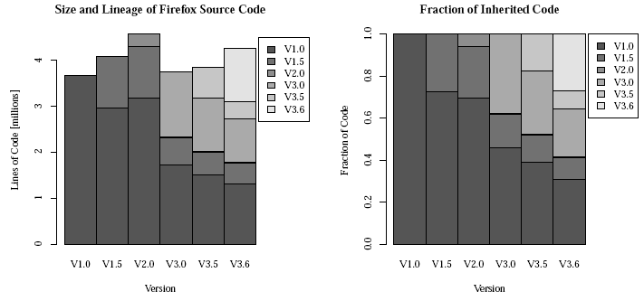
Why SERVICES?
Modern IT Systems are almost never designed from scratch
  This is a fallacy of Software Engineering
  Even true for “apparently monolitic” code
    ESSOS’10: Firefox code 30% is new but 70% is old
IT System Integrate existing systems via services
  Reusability: same business services reused for new requirements
  Interoperability: clients and services communicate and understand each other no matter what platform they run on
In order to manage changes
  Flexibility: easy to evolve application to keep up with changing business requirements

Slide 19
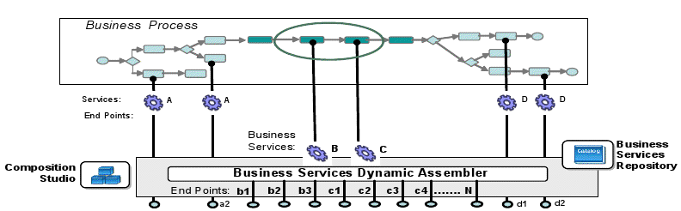
What Really Happens...
Business Processes are executed by actually invoking and passing around data from service to services
[Source: SOA on an IBM platform By Ole Rasmussen,
Microsoft Arkitekt Forum, May 2008]

Slide 20
Outsourcing ADDITIONAL CHALLENGES
Some services are outsourced to other organisations
  Reasons: cost reduction, process improvement, market structure
  ...but client retains liability if something goes wrong
Client needs to ensure the quality of its business processes – compliance, security, trust, assurance, etc.
  Controlling the processes from outside
  Require certification from the provider
Provider wants to ensure compliance internally
  Controlling the process from inside
  Certification against third party
Notes:
BPO = business process outsourcing
20

Slide 21

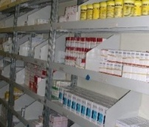
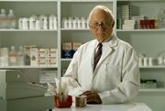




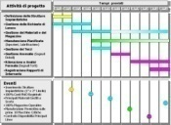
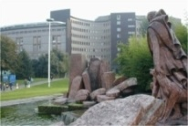




BACK TO Drug DISPENSATION TO OUTPATIENTS
Outsourcing
Drugs transport
Local Health Board
Hospital environment
Drugs Stock Management
Hospital ward
Pharmacy
Accounting
Office
Ministry of Health
Nurse
Patient
Planning & Control Direction
Medical Direction
Pharmaceutical company
Italian Drug Agency
Informative systems
Regional Healthcare Authority
External Medical Ambulatory

Slide 22



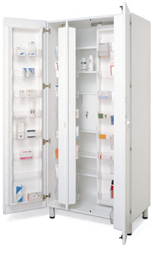
Let’s Take a sub-sample of overall Drug Dispensation
Drugs transport
Patient
Hospital Environment
Prescription
Pharmacy
Patient
Dispensation
Doctor
Nurse
Drugs Stock Management
Prescription
External Medical Ambulatory

Slide 23
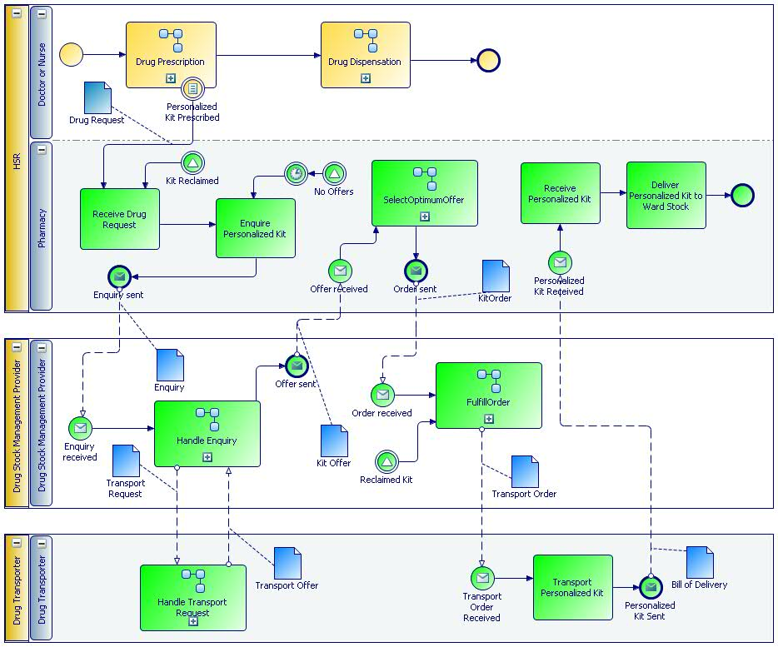
The Drug Prescription AT SERVICE LEVEL
Three Service Layers
  Multiple Outsourcing
  HSR internal processes
    Doctors and Nurses
    Pharmacy
  Drug Stock Management Provider
  Drug Transporter

Slide 24
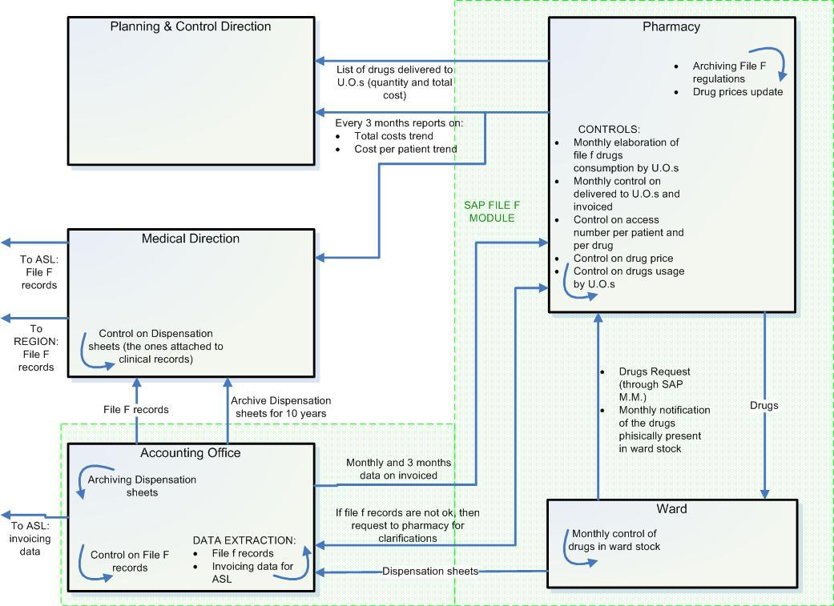
Case study: an healthcare business process

Slide 25
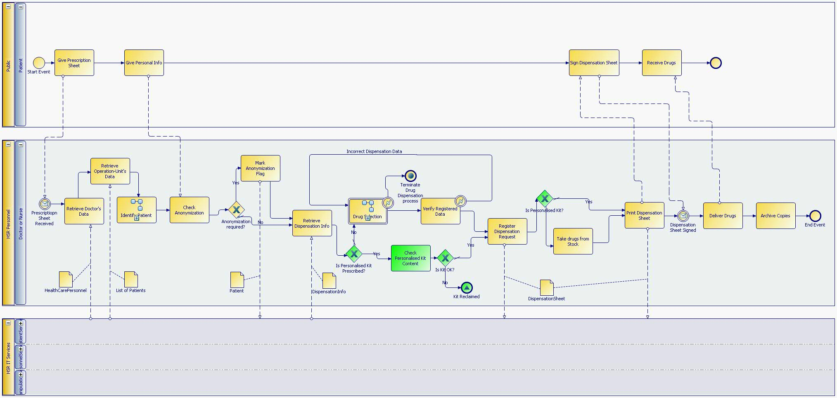

Slide 26
Why Security?
Governance cannot assume that everything will just work as planned!
  Amount of money involved can lure employees to wrong dispensation
  Cost-cutting measures may lead providers to cut corners (and save on security measures)
  Audit may show lack of control → high risk of losing the contract
Security controls are means to implement GRC
  Actually control system behavior to deliver business objectives in spite of potential misbehavior
  Provide evidence of assurance that the system is controlled
Notes:
1 well implemented security controls assure the compliance, the mitigation of risks and also facilitate the governance: e.g. assuring integrity and availability of financial documents helps the GRC strategy (see slide 5)
2 meaning that we trust that our BP is respecting the compliance and the governance issues and also is mitigating the risks involved
3 e.g. assuring compliance to the “data protection code” means also to have a more secure system

Slide 27
Some DefinitionS
Assurance
  a declaration tending to inspire full confidence; that which is designed to give confidence
(Information) Security
  Methods for protecting information from unauthorized access, use, disclosure, disruption, modification or destruction – Confidentiality, Integrity and Availability
  Methods to provide assurance
Trustworthy System
  System for which we have some assurance that it behaves as expected
Trusted System != Trustworthy System
  A system we believe it will behaves as expected

Slide 28
Back to our example
Drugs transport
Patient
Hospital Environment
Prescription
Pharmacy
Patient
Dispensation
Doctor
Nurse
Drugs Stock Management
Prescription
External Medical Ambulatory

Slide 29
Security Issues…
Questions for the Drug Dispensation Process
  How to protect the patient’s data and to be compliant with regulatory requirements although the presence of the EMA?
  How to protect the privacy of the patient although there is a provider furnishing the drugs based on the prescription sheets?
  How to ensure that the prescriptions coming from the EMA are not fakes?
  Etc.
At the end of the day
  Which actors or subsystems we should just trust?
  Which subprocesses should be subject of security controls?

Slide 30
Our Global Objectives
GRC Perspective
  Achieve business objectives
  Manage risk
  Show evidence of compliance
We must achieve it for Socio-Technical Systems
  humans or organizations play a key role for overall achievement of objectives of stakeholders, not just as “users” of a system to be
Security Perspective: the security controls
  Define the Trusted Organizational Base
    Not just the Trusted Computing Base
  Maximize the trustworthy part
  Minimize the trusted part

Slide 31
An exercise in GRC
Mother, Father and Child
  You are a mother
  Your asset is your child
  You can use the father to provide some services
  You have to balance security and cost
Only one thing is possible for you
  Bring the child to school
  Collect the child from school
What is safer for a child?
  Go back home from school alone?
  Go back with the father?

Slide 32
Mother, Father, and CHILD II
Going alone...
  upon instructions on security measures
    the child would not accept lift from unknown people (secure authentication)
    He would scream if forced (security countermeasure)
    If he doesn’t show up at planned time mother will react (security monitoring)
  Trust assumption: on screaming passers-by will react and take action
Trustworthy but very costly
  Persistent training of “user” (i.e. child)
    Do not take lift for people you don’t know
  Resistance to social engineering attacks must be trainined
    It doesn’t matter it was just a nice old man
  100% alert monitoring by mother

Slide 33
Mother, Father and Child III
The father solution is dirty cheap
  Can be quickly authenticated by the child
  No training of any kind
  No measure against social engineering
  No monitoring
The father is trusted by the mother...

Slide 34
Mother, Father and Child IV
Going alone is trusthworty and expensive
  Lots of additional security measures
Father picks you is trusted and cheap
  No security measure
The father is trusted by the mother...
  But almost all child kidnapping, beating, and killing are done by fathers or close members of the family
  Only few (<5%) done by “maniacs” unknown to the child (UN Data)
A Trusted Component is not something that is secure. It is something against which we plan no defence

Slide 35
Back to HSR
We need to decide whether a component is
  Trustworthy (we have the security controls to prove it)
  Trusted (we believe s/he/it will deliver even without controls)
Trustworthiness/Trusted features can be specific to a particular business object)
  The patient is trusted for “bring a prescription” to the pharmacy
    His primary interest is to get the drug!
  The patient is not trustworthy for “bring the original prescription” to the pharmacy
    File-F drugs are very very expensive. Change the number of boxes and you can make pots of money by taking drugs on welfare and re-selling them.

Slide 36
A General GRC Methodology
Fabio Massacci
Yudistira Asnar
Fabio Massacci
FOSAD

Slide 37
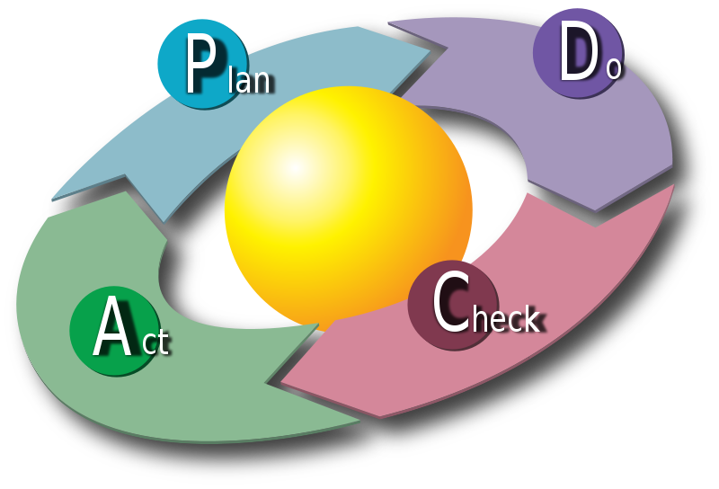

GRC Methodology
Methodological support to define the compliance policies: monitoring, assessment, and enforcement framework
Based on the Deming Cycle with emphasizing on three pillars
  Controls
  Risks
  Indicators
Control
Risk
Indicator
PDCA cycle –Karn G. Bulsuk (taken from WIKIPEDIA)
Notes:
The main actor in this methodology is MASTER analysts that aim to improve and assess continuously the level of compliance and security of business processes.
However, there are other actors that might involve
Business owners and top managements → for approving MASTER initiatives, and define the business objectives
Legal department → interpret regulatory compliance
IT Staff → identify the existing controls and verify the operability of new controls
Business Staff (as the owner of BPs) → to define important properties of BPs and possible “meaningful” indicators

Slide 38
Basic Concepts
Target System
  System subjected to GRC controls
Business Objective
  state-of-affair that an organization intend to achieve
    Hospital intends to have most outpatients’ drugs reimbursed and provide correct drugs to the correct patients
    BO is realized by means of the execution of business process
Business Process
  a series of activities to realize an organization’s business objective
Compliance Requirement from a regulatory body
    Italian Legislative Decree No. 196 - ensures that personal data are processed by respecting data subjects’ rights particularly with regard to confidentiality and the right to personal data protection
Notes:
MASTER adopts the paradigm of compliance by control and not the one by design

Slide 39
BASIC Concepts II
Risk – Uncertainty that affects negatively to the business
  Identity theft
Control Objective – statement to protect the quality-attribute of business (i.e., because of risks or required by regulatory requirements)
  Hide personal information from the reimbursement report
Control Process – a process description to achieve the control objective
  Remove personal data (Name, Tax Code) from the reimbursement report

Slide 40
Baseline
GRC Process
Do
Act
Check
Plan
Analyze Business Objectives & Processes and Compliance Requirements
Analyze Enterprise/High-level Risks
Establish Control Objectives
Design Control Processes
Verify & Test Control Processes
Review Performance/Effectiveness Controls with Indicators
Review Current Business Settings and Regulatory Requirements
Improve Existing Controls
Manage Changes
Reorganize Existing and New Controls
Specify Key Assurance Indicators
Specify Key Security Indicators
Introduce New Controls
Notes:
Outsourcing

Slide 41
Plan Phase Target
Top Managers’ Target
  Assurance that top-level policies are fully covered by controls
  Identify indicators to make sure controls achieves their objectives
Designers’ Target
  Analyze Business and Regulatory Contexts
  Establish Control Objectives
    Refine control objectives by risk analyses and control activities, as means to achieve objectives are identified
  Specify Key Assurance Indicators (KAIs)
    Measure success of controls in achieving compliance (not how effectively they are implemented)
Notes:
Establish Control Objectives based on the result of risk assessment process.
Control Objectives can be derived as risk responses against unacceptable risks to the business objectives,
or they can be derived as a consequence particular regulatory compliances/law
Example of COs:
by using the graphical workbench, MASTER analysts model the COs and associated risks. The analysis and refinement process of COs are fully supported by the workbench
To get all prescription be reimbursed by Regione di Lombardia → Business Objective
1.1. Ensure all delivered drugs are recorded
1.2. Ensure File F reports are generated correctly (according to the all delivered drugs records)
1.3. Ensure there is no “illegal” modification to the records and the File F report
1.3.1. Authenticate (and verify permission) each access to the dispensation module → it is the module that enters the delivered drugs
1.3.2. Prevent any modification to the File F report
All personal data related to the patients should not be shared for proposes other than the treatment purposes → Italian data protection
Those control objectives are refined into smaller, more detail, and more concrete COs, because:
Ease to identify the necessary Control activities
Ease the identification of KAI

Slide 42
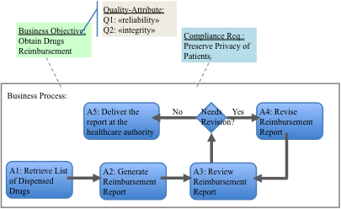
Analyze Business Processes
Important to understand which are the key important steps of the business process
  Otherwise you end up with a long list of security gadgets (eg firewall, antivirus, that are actually useless)
We assume you have done it
Notes:
We need to identify .. Who runs what??? In Y1 everything runs locally and assumed to be trustworthy

Slide 43
How to Control a Service?
Plain (= no control)
  part of the trusted organizational base
Controlled Services
  Wrap “something” around service (BP fragment) implementing the business objectives to control major risks
Who to control it
  Design time verification + deploy-time certification
  Run-time Monitoring and Enforcement
  Both
UnControlled I/O (should not exist or is trusted)
Service
Control Mechanism
Notes:
Having wrapping can help us in working with legacy system

Slide 44
HOW TO Identify Control ObjectivES?
Start from Business Objectives and Compliance Requirements
  Analyze Risks that might lead to failures
  Identify Countermeasures (Control Objectives)
  Refine process on control objectives themselves
Refine
  Complete → protect from most critical risks
  Appropriate → their achievement allows the organization to meet its business goal and to mitigate the risks
  Precise → enabling unambiguous interpretation of the level of compliance or failure with regards to the control objective
Notes:
To ensure that we have covered all relevant risks and they can be controlled and managed automatically then they need to be precised

Slide 45
Back TO DrUG Dispensation
Motivation for Control Objectives
  Implement Compliance Requirements
    Hide personal information from the reimbursement report
  Reduce Operational Risks (i.e., Business or Legal Risks)
    R1: Incomplete Data of Drug Dispensation → “reliability” of the report
    R2: New “fake” drugs added in the report → “integrity” of the report
    R3: Correlation attack done by the hospital staffs → Compliance requirementsl on privacy legislation
    R4: The courier leaks the File F reports → Compliance requirement because of outsourcing
Example of Control Objectives:
  Ensure all data is complete and correct → mitigate R1-R2
  Hide personal information from the report → mitigate legal risk
Notes:
Detail and associate them with indicators

Slide 46

Refine Control Objectives
Business Objective:
Obtain Drugs Reimbursement
Regulation:
Respect Patient’s Privacy
New CO for Improving CO Reliability
Impact
More Complete
Refining Control Relation
Control
CO 1
Risk
More Precise
New Risk
CO 2
Refining Risk Model
CO 1.1
CO 1.2
Risk
Risk
Risk
Impact
Further Refinement
Refining Control Model
More Accurate
CP 1
CP 2
CP 3
CP 4
Notes:
CO1: Ensure all data is complete and correct
CO1.1: Ensure A2 and A3 are performed by different actors
CO1.1.1: Assign A3 to an actor other than the performer of A2
CO1.1.2: Enforce blind review at A3
CO1.2: Ensure A4 and A3 are performed by different actors
CO1.2.1: Assign A3 to an actor other than the performer of A4
CO1.2.2: Enforce blind review at A3
---
CO1.3: Digitally sign the report
CO1.4: Review the audit trail by external auditors

Slide 47
SECURITY ENGINEERING PROCESS - Roles
Architectural Design Viewpoints (“System” Model)
  System Architect (the one closer to the customer…)
  Risk Analysts
    Analyse “system” model proposed by System Architect to find what can hamper (threat) the important objetives (asset/goal) of the system and propose additional security goals (or security requirements)
Engineering Design Viewpoints (Requirements Lists)
  System Engineer
  Security Engineer
    Propose security solutions that address the security requirements within the framework proposed by the System Archtect
  Requirements Engineer
Each time there is a change they need to re-synch their model
  E.g. Control objective added, new risk added etc.

Slide 48
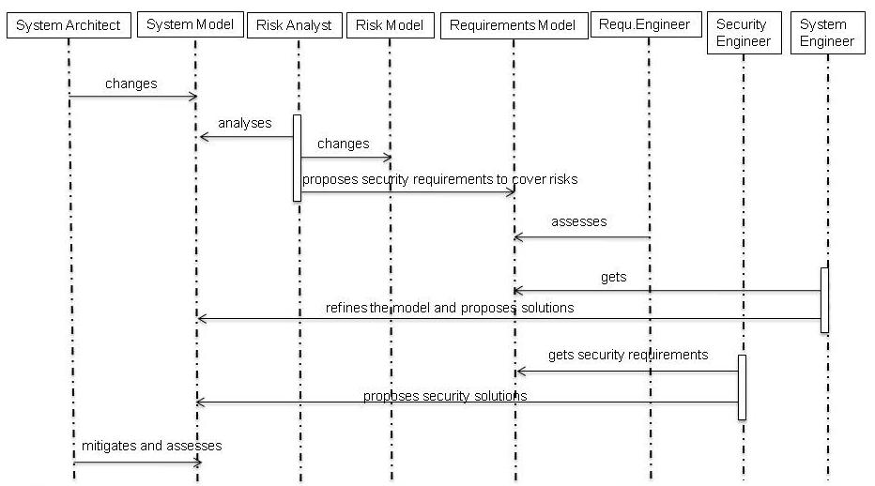
Security Engineering PROCESS - INTERACTIONS
Slide cortesy of Thales Research and Technology

Slide 49
Sample Control Objectives
CO1: Ensure all data is complete and correct
  CO1.1: Ensure A2 and A3 are performed by different actors
    CO1.1.1: Assign A3 to actor other than performer of A2
    CO1.1.2: Enforce blind review at A3
CO1.2: Ensure A4 and A3 are performed by different actors
  CO1.2.1: Assign A3 to actor other than performer of A4
  CO1.2.2: Enforce blind review at A3
...
CO1.3: Digitally sign the report
CO1.4: Review the audit trail by external auditors

Slide 50
Specify Key Assurance Indicator
Key Assurance Indicator (KAI) indicates the effectiveness of a control objective in assuring the compliance of a business process
  Answer “How compliant am I ?”
Example:
  Percentage of Drug Reimbursement
  How many reports contain incorrect reimbursement data
Indicators Specification:
  Target of Assessment – the File F report
  Collecting Entity – SAP system
  Measuring Units – records/report
    Frequency of Assessment – Monthly
    Length of Measurement – 1 month

Slide 51
KAI Can be Specified at Each Level
Regulatory Goal
  Recipient: CISO
  KAI: $$ legal expenses due to privacy lawsuits
  Relevant events emitted by: SAP system
Control Goal
  Recipient: File F section
  KAI: Number of privacy violations
  Relevant events by: File F services
Control (sub)Goal
  Recipient: File F Generation Section
  KAI: #times a patient name is not anonymized
  Relevant events by: Report generation service
  Italian Legislative Decree No. 196 personal data
  is processed by respecting data subjects’ rights
  particularly with regard to confidentiality and the
  right to personal data protection
  …
  Respect privacy in File F
  Remove personal data
  from reimbursement report
  …

Slide 52
Do PHASE
Objectives: control activities are implemented in terms of control processes and indicators
  Identify Control Activities
  Design Control Processes
  Implement Control Processes
  Specify (and implement) Key Security Indicators
Notes:
For each leaf-COs, analysts identify “at least” one control activities.
MASTER analysts can look up available solutions that have been used in the repository or knowledge-base system. Both systems can be access from the Graphical workbench
It can use some security best practices (e.g., security patterns, ISO 27002, etc) as the knowledge base of possible CAs
CO 1.3.1 → Authenticate (and verify permission) each access to the dispensation module
Control Activities → Verify credential and permission for each access (by means of access control)
Design CPs and Indicators involve:
Design MASTER Control Processes → Detailed how authentication and authorization process (in terms of BP Model)
Verify the Design of Control Processes → Converts the design into Verification Model and verify whether the CPs will satisfy COs using techniques proposed in WP3.3
Define KAIs/KSIs
KAI: How much is the percentage of drug reimbursement from the “Regione Lombardia”?
$ of delivered drugs : $ received from Regione
KSIcorrect: How many times does the “login failures” occur?
KSIcoverage: How much is the percentage of the invocation of “login service” over the number of request to the “dispensation module”?
Implement CPs and Indicators involve:
Implement the Control Processes → Coding, write MASTER policies: monitoring, signaling, and enforcement
Implement the Indicators → write assessment and monitoring policies
Test Control Processes and Indicators → test the implementations in the testbed
Deploy Control Processes and Indicators → deploy the implementations
Posteori Verification of the Design of Control Processes → take the “actual” historical traces (from A6 ETL-Datawarehouse) and try to run on the design of CP. It is useful to verify whether our design assumptions are correct with respect to the actual operation.

Slide 53
Identify Control Activity
Control Activity is a means/action to achieve a control objective (i.e., the leaf-node in the CO tree)
Type:
  Control Flow – deals with the flow of control activities’ execution
  Information Flow – addresses the flow of information
  Resource Access – controls the access to a particular resources
  Time Sensitive – describes a condition to be satisfied in a particular time
  Data Quality – ensure the quality of data
Notes:
This might cover the most of control objectives.. But I believe there are some others… niches

Slide 54
Design Control Process
Deep Dive on R2
  New “fake” drugs added in the report → “integrity” of the report
Control Activity
  Separation of Duty between A2 (Generate Report) and A3 (Review Report)
  Separation of Duty between A3 and A4 (Revise Report)
  The report must be reviewed blindly, but the report generator is held accountable for the validity of report

Slide 55
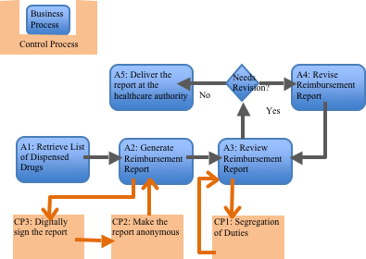
Design Control Process (2)

Slide 56
Control Implementation
[In case an organization needs to implement a control process]
Control Policies Specification
Develop Underlying Control Service/Mechanism (if necessary)
  E.g., access control service, anonymizer, etc
Configure Existing Control Service (if it has existed)
Test Control Service and Process
Deploy Control Process

Slide 57
Specify Key Security Indicator
Key Security Indicators (KSI) assess the performance of a control process
  It doesn’t tell how effective it is (we have KAIs for that)
  It only tells how well it is implemented
For each CP we need two indicators
  Correctness
  Coverage

Slide 58
Specify Key Security Indicator (2)
KSI_{correctness} – assess the correctness of the implementation of a control process
  (Sometime) control execution results in a state that differs with the state describes by the correspond CO
  E.g. frequency when the personal data exists even when the patient has requested to be anonymized
KSI_{coverage} – assess how often a control process is executed
  (Sometime) there is a transaction that manage to avoid the CP execution
  E.g., ratio of the execution of digital-signature and the generation of drug report

Slide 59
Check
Manager’s Target
  the level of security and compliance of business processes are assessed and reviewed by means of implemented indicators
Review GRC Operation
    Business Processes
    Control Processes
    Manual Controls
    Risk Assessment
    Relevancy of Control Objectives
Emerging field called “Security Analytics”
Notes:
The review process will take the report generated from A6
Business Process → aim at identifying whether the BPs are executed as we expected
KAIs are the central of this review
Control Process → aim to evaluate the performance of CPs.
KSIs are the central
It also tries to relate how CPs protect BPs, or in other words how KSIs are correlated with KAIs → effectiveness review
Manual Controls → aim to evaluate how Manual controls affect the performance CPs and identify the possibility to make the control “more” automatic.
Risk Assessment → revise the risk profile of the company based on the reports generated by risk component and compliance analysis (in A6).
Ideally, if we have a good score in KAIs and KSIs then.. It should be we have mitigated our risks.
However, this assumption needs to be verified in the real operation, because it is not necessarily always true
Relevancy of COs → new regulations might be introduced or there are significant changes in the business context

Slide 60
Visualizing Data and Indicators

Slide 61
Act
Objectives: Act on the CHECK results (i.e., assessments and recommendations) to maintain/improve the assurance
  Improve Existing Controls
    Corrective Action
    Increase the level Automation
  Introduce New Controls
    Preventive Action
    Augmentative Action
  Of course you don’t want to start from scratch
    See SecureChange project www.secure-change.org web site
Notes:
This phase of methodology aims at improving the MASTER system
To correct CPs or Indicators that behave different from the intended designs
To mitigate/prevent some new threats, that are initially not counted, from occur
To augment the existing MASTER system with a set of new control objectives (and its related CPs and indicators)

Slide 62
EMAIL
Which is the important aspect of email?
  Receiving “clean” email
Default solution
  Firewall for incoming connections
  DNS rewrite MX records of all subdomains to the central server
  Antivirus and Anti-spam on the incoming mail server
  Organizational measure: you can’t log in on the network if you don’t have a av installed on the mail client
    Should be second line of defense, but not very effective if the brand is the same: whatever the border “enterprise-strenght” filter won’t catch won’t be catched by the client either
Is that enough?

Slide 63
EMAIL II
There are TWO important aspects of email
  Receiving email and
  Sending email
Does our solution protect sending email?
  There is NO control process whatsoever around outgoing email
Outgoing email process is trusted
University scenario (Also true for Medium Companies)
  Many computers within the boundaries
  Some of them are incoming and outgoing mail server
What can happen?

Slide 64
EMAIL III
What can happen?
  Remember we are discussing the second step of the process
  What can stop you sending emails?
Suggestions from the audience

Slide 65
EMAIL IV
You can be blacklisted
  And that’s it. You can’t get out even to explain you are good guy
  Takes a huge amount of effort to be whitened again
How do you get blacklisted?
  Your internal machines send a lot of spam
Mail server are hacked and sends lots of spam
  Mail server should be managed
Normal machines are hacked and send lots of spam
  Are users trustworthy manager of their machines?
  Oops

Slide 66
EMAIL V
Plan
  Firewall on outgoing mail only from “official” mail servers
  Centralize last step of outgoing email
  Antispam/antivirus on outgoing mail messages
What is a good KAI?
What is a good KSI? (or KAI for the internal controls)

Slide 67
EMAIL VI
Plan
  Firewall on outgoing mail only from “official” mail servers
  Centralize last step of outgoing email
  Antispam/antivirus on outgoing mail messages
  KAI = #spam rin external reputations servers
  KSI/KAI = #attempted spam mail caught by centralized server
Do
  Deploy
Check
  Do we still get a lot of attempts of outgoing mails? Yes.

Slide 68
EMAIL VII
Check
  Do we still get a lot of attempts of outgoing mails? Yes
Why
  (some) managed server not really managed: started for research, teaching (or commercial) purposes and then “forgotten”
Act
  If a server is managed → there is a “manager”
  We want a name to call when there is a surge of outgoing emails
    Professors, researchers, phd students or administrative staff do NOT qualify.
  If you give us no name, or the guy doesn’t answer you are cut off from the network

Slide 69
THE PLAN PHASE: MODELLING SOCIO-TECHNICAL CONTROLS
Fabio Massacci
Elda Paja
Fabio Massacci
FOSAD

Slide 70
HOW Do We Get The Final Picture?
Business Objective:
Obtain Drugs Reimbursement
Regulation:
Respect Patient’s Privacy
Impact
Control
CO 1
Risk
CO 2
CO 1.1
CO 1.2
Risk
Risk
Risk
Impact
Further Refinement
CP 1
CP 2
CP 3
CP 4
Notes:
CO1: Ensure all data is complete and correct
CO1.1: Ensure A2 and A3 are performed by different actors
CO1.1.1: Assign A3 to an actor other than the performer of A2
CO1.1.2: Enforce blind review at A3
CO1.2: Ensure A4 and A3 are performed by different actors
CO1.2.1: Assign A3 to an actor other than the performer of A4
CO1.2.2: Enforce blind review at A3
---
CO1.3: Digitally sign the report
CO1.4: Review the audit trail by external auditors

Slide 71
MUST WORK FOR Socio-Technical Systems
GRC Systems are always Socio-Technical Systems
  humans or organizations play a key role for overall achievement of objectives of stakeholders, not just as “users” of a system to be
Key Ideas of Goal-Based Requirements Engineering
  Introduce High-level goals or concrete objectives
  of Actors describing system-to-be but other relevant partners
  and Social-relationship among them in terms of goals.
  Trust relations among them also useful to deal with security
  Reasoning identify best solution to achieve high-level goals

Slide 72
Trusted Organizational Base
Remember Trusted Computing Base?
  part of the software you assume it is secure
  You just “trust” it don’t verify it
Trusted Organizational Base
  Part of the socio-technical system you assume it is secure
  For GRC essential to understand human actors!
  System is not compliant without them into account
  So you need to model them

Slide 73
The overall process
Repeat until happy
  Modelling Process
    Construct a model of the socio-technical system
    Actors, Goals, Trust, Assignment of responsibilities, risks etc.
  Reasoning Process
    Analyze the model to see if we achieve certain qualities
      E.g. Fulfillment of strategic goals for an actor does not depend on another actor who it is not trusted to do his part of the scheme
  Refine the model
What is interesting here?
  Security Properties
  Each socio-technical system has some assets and we want to protect them
    Confidentiality of some data
    Integrity of some procedure etc.

Slide 74
Basic Methodology for Single-Actor
Modelling
Relationships amongs Assets
Events and their impact on the Assets
Reasoning
Security and Risk Analysis
Modelling
Treatments and their impact on events and assets

Slide 75
Basic Methodology for Multi-Actor
Modelling
Relationships among Actors
Relationships amongs Assets
Events and their Impact
Reasoning
Security and Risk Analysis
Modelling
Treatments and their impact on actors

Slide 76
The Modelling Process
Costruct a Model of the Socio-Technical System
  Actors Modelling
    Identify roles and their relationships (eg organizational structure)
  Goal Modeling
    For every actor identify its objectives and eventually refine them until assigned to actors that can achieve them or operationalized into activities of the business processes
  Social Relationship Modelling
    During the goal modelling process some goals are assigned/delegated to other actors.
  Identify Trust relationships
    Not only we have assigned the goal to them but do we trust them to do it?
  Etc.

Slide 77
SI* Modeling language
Diagrammatical language
  Concepts + graphical representation
Agent-oriented language
  Agent notion and related concepts are used as building concepts
  Organization/Business perspective on Security
Models are built diagrammatically
  Graphical Concepts and relations are used to draw (create) models
  Models represent both Social actors (eg., organizations, humans, institutions) and Technical systems (e.g, software/hardware systems, architectural components, etc)
Reasoning determine “Properties” of the models

Slide 78
The british encyclopedia syndrome
Serious illness affecting all first-time modeller
  Believes every concept of the modelling language must be used
  Start mammoth task with first modelling construct encountered
  quickly get exhausted
  Deliver bad results at the end.
Modelling is expensive: remember Occam’s razor!
  “Entia non sunt multiplicanda praeter necessitatem”
  Scottish Philosopher → do not introduce useless entities
Identify Target of Analysis first!
  Use only modeling concept necessary for target and
  Only those concept you will use for later stages (eg for risk analysis)

Slide 79
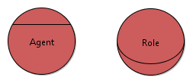

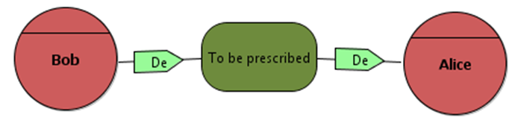

Concepts and graphical repr.
Agent/Role
Goal
Delegation
Event
…. | …..

Slide 80
Actor: agent and role
Agent is an active entity with concrete manifestations and is used to model humans as well as software agents and organizations
  Es: Bob, Alice, Dr. Paolo Rossi
Role is an abstract characterization of the behavior of an active entity within some context
  Hospital, Operational Unit, Doctor, Patient,…

Slide 81
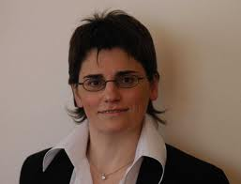
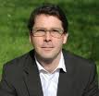
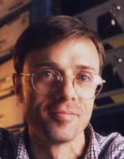
HOW MANY ROLES AND AGENTS DO YOU NEED?
“We make the point for the need of more expressive policy languages.”
Samarati expressive OR flexible OR general OR extensible = 220
--ALL of them = 38
“The proposed language must be powerful enough to specify any relevant event of a security policy and cover several layers of abstraction.”
Pretschner +OR= 34
--ALL = 11
“A more elegant and flexible approach is
to express policies in logic that handles…”
Kephart +OR= 16
--ALL = 6

Slide 82
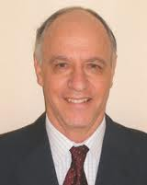
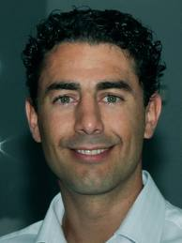
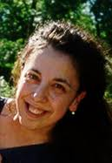

HOW MANY ROLES AND AGENTS DO YOU NEED? II
We need constraints about ROLE in the organization and the TIME of access.
You must consider Invoked SERVICES
Don’t forget LOCATION
with TRUST level and CREDENTIALS.
and USAGE!
What about “best” moment to have sex?
US Patent 11/480858 from 07/06/2006

Slide 83
HOW MANY ROLES AND AGENTS DO YOU NEED? III
Complex rules do define roles and complex criteria to dynamically assign users to them based on
  Role → too many citations
  Time of the day → 39.800 citations
    “The time-based constraint limits the policy to apply between 4:00pm and 6:00pm”
  Location → 27.300 citations
  Organization → 15.600 citations
  Task in the workflow → 12.200 citations
  Usage after access → 7.300 citations
  Credential submitted → 1.400 citations
  …
  N Best moment to have sex… → 1 patent … for the moment…

Slide 84
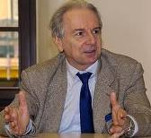
PROFESSORS AND GRANTS
How many agents and roles do I actually need?
I want a more flexible system: each professor or any how responsible should easily see and manage his funds
DB - Chairman

Slide 85
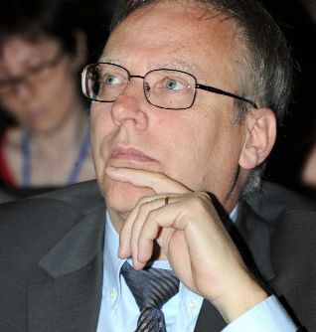
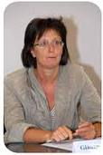
PROFESSORS AND GRANTS II
Remember I’m not a professor devising an ideal secure system I have to buy a working one with the available money
I know what DB said but this year… there’s a budget cut of 3%.
You already spent 1.5M€ on the MAN.
Max 350K€ for ERP extra add-ons
MT - CEO
Our staff is already committed to meet this year’s objectives.
I can only give you one person part-time to identify business requirements.
GM - COO

Slide 86
Professors and Grants III
How many people are needed to set up an “expressive” policy for a user?
At least 6
  Responsible for HR (sub)Unit costs 80€/h
    Assistant who knows potential salary implications 54€/h
  Responsible for Business (sub)Unit costs 80€/h
    Assistant who knows how things really works 54€/h
  IT Project Leader costs 70€/h
  Assistant who knows what’s really possible 54€/h
And they would need at least 30’ per user
  (5’ x ROLE, SERVICE, TIME, CREDENTIAL, TRUST, LOCATION, USAGE, ETC)
Minimum Policy Set-up Cost = 192€/user

Slide 87
Professors and GRANTS IV
They (the great companies you want to work with to transform your ideas into products)
  are going to bill you by the role…
The more complex the role, the more you pay
  “Price is determined by what is managed rather than the number and type of product components installed […]
  “Products may manage clients, client devices, agents, network nodes, users, or other items, and are licensed and priced accordingly.”
Just to give you some real numbers
  3.800€/role for powerful roles across ERP modules
  400€/user for “employee” (can do almost nothing)
  17-25% maintenance fee on licenses
What this actually mean?
  13 Heads of Departments + 8 Head of Division
  30 Professors with large grants >100K
  1.500 Employees

Slide 88
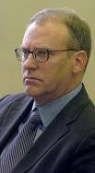
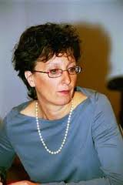
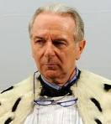
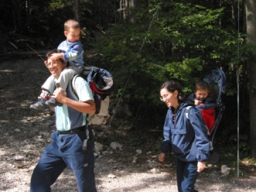
PROFESSORS And Grants V
Is this a joke? 80.000€ for licenses alone and just for access of Heads of Dept and between 600.000 € and 1.000.000 € for the rest? Plus 250K Every year?!? And software’s aside!
What? Do you want 300.000€ in human resources and this just for setting up the draft of a security policy? FIVE people?!
MT Now DG at Ministry
I see: either I buy your expressive security policy or I hire 20 new associate professors…that’s a new Department!
But I see a third option… for you…
GM Now CEO
DB Still Chairman
I understand everything but why couldn’t you just give them a flexible system?
FM Ex-Deputy

Slide 89
The Problem is… POLICY Researchers have forgotten… Arithmetics!
Is this a joke? 80.000€ for licenses alone and just for access of Heads of Dept and between 600.000 € and 1.000.000 € for the rest? Plus 250K Every year?!? And software’s aside!
What? Do you want 300.000€ in human resources and this just for setting up the draft of a security policy? FIVE people?!
MT Now DG at Ministry
I see: either I buy your expressive security policy or I hire 20 new associate professors…that’s a new Department!
But I see a third option… for you…
GM Now CEO
DB Still Chairman
I understand everything but why couldn’t you just give them a flexible system?
FM Ex-Deputy

Slide 90
Back to HSR
Drugs transport
Patient
Hospital Environment
Prescription
Pharmacy
Patient
Dispensation
Doctor
Nurse
Drugs Stock Management
Prescription
External Medical Ambulatory

Slide 91
BACK TO HSR
Which roles do we actually consider (for this process?)
  Patient
  Doctor of external ambulatory
  Nurse
  Pharmacist
  Drug Carrier
How many needs to be instantiated into system actors
  Physical Actors for which there is a corresponding actor in the system
    Remember that an actor can do something
    There is a difference between you and information about you

Slide 92
BACK TO HSR
How many needs to be instantiated into system actors
  Physical Actors for which there is a corresponding actor in the system
    Remember that an actor can do something
    There is a difference between you and information about yo
Which roles do we consider as system actor
  Patient ← not at all
  Doctor of external ambulatory ← individually or partly
  Nurse ← individually
  Pharmacist ← Individually
  Drug Carrier ← partly (as a global actor)

Slide 93
What Expressivity Actually Means
Complex rules do define roles and complex criteria to dynamically assign users to them based on
  Role → too many citations
  Time of the day → 39.800 citations
    “The time-based constraint limits the policy to apply between 4:00pm and 6:00pm”
  Location → 27.300 citations
  Organization → 15.600 citations
  Task in the workflow → 12.200 citations
  Usage after access → 7.300 citations
  Credential submitted → 1.400 citations
  …
  N Best moment to have sex… → 1 patent … for the moment…

Slide 94
How many people are needed to set up an “expressive” policy for a user?
At least 6
  Responsible for HR (sub)Unit costs 80€/h
    Assistant who knows potential salary implications 54€/h
  Responsible for Business (sub)Unit costs 80€/h
    Assistant who knows how things really works 54€/h
  IT Project Leader costs 70€/h
    Assistant who knows what’s really possible 54€/h
And they would need at least 30’ per user
  (5’ x ROLE, SERVICE, TIME, CREDENTIAL, TRUST, LOCATION, USAGE, ETC)
Minimum Policy Set-up Cost = 192€/user

Slide 95
The buck doesn’t stop there yet…
They (ADOBE, IBM, ORACLE, SAP, etc.) are going to bill you by the role…
  The more complex the role, the more you pay
    “Price is determined by what is managed rather than the number and type of product components installed […]
    “Products may manage clients, client devices, agents, network nodes, users, or other items, and are licensed and priced accordingly.”
  3.800€/role for powerful roles across ERP modules
  400€/user for “employee” (can do almost nothing)
  17-25% maintenance fee on licenses
What this actually mean?
  13 Heads of Departments + 8 Head of Division
  1.500 Employees

Slide 96
The Problem is… POLICY Researchers have forgotten… Arithmetics!
Is this a joke? 80.000€ for licenses alone and just for access of Heads of Dept and between 600.000 € and 1.000.000 € for the rest? Plus 250K Every year?!? And software’s aside!
What? Do you want 300.000€ in human resources and this just for setting up the draft of a security policy? FIVE people?!
MT Now DG at Ministry
I see: either I buy your expressive security policy or I hire 20 new associate professors…that’s a new Department!
But I see a third option… for you…
GM Now CEO
DB Still Chairman
I understand everything but why couldn’t you just give them a flexible system?
FM Ex-Deputy

Slide 97
PROFESSORS AND GRANTS II
How many agents and roles do you actually need?

Slide 98
PROFESSORS AND GRANTS III
How many agents and roles do you actually need?

Slide 99
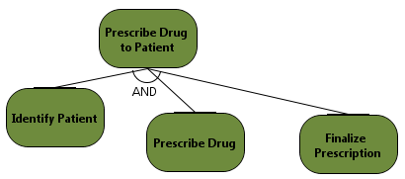
GOALS/Control Objectives
Goal is a state of affair which an actor intends to achieve
  Business goal → Prescribe a drug to the patient
  Control Objective →
  Used to capture motivations and responsibilities of actors
Can be decomposed into more detailed Objectives until operational = Control Activity

Slide 100
When we use Goal Refinement?
Here
Business Objective:
Obtain Drugs Reimbursement
Regulation:
Respect Patient’s Privacy
CO 1
Risk
CO 2
CO 1.1
CO 1.2
Risk
Risk
Risk
Further Refinement
CP 1
CP 2
CP 3
CP 4
Notes:
CO1: Ensure all data is complete and correct
CO1.1: Ensure A2 and A3 are performed by different actors
CO1.1.1: Assign A3 to an actor other than the performer of A2
CO1.1.2: Enforce blind review at A3
CO1.2: Ensure A4 and A3 are performed by different actors
CO1.2.1: Assign A3 to an actor other than the performer of A4
CO1.2.2: Enforce blind review at A3
---
CO1.3: Digitally sign the report
CO1.4: Review the audit trail by external auditors

Slide 101
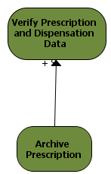
Modeling side-effects
How to capture relations among different business objectives?
  E.g., Archive Prescription sheet in the Drug Reimbursement process may help to Verify Drug Reimbursement Data in the Report Generation phase
Contribution link (between goals and tasks)
  Strong Positive (++)
  Positive (+)
  Negative (-)
  Strong Negative (--)

Slide 102
REASONING ABOUT COMPLIANCE - I
Once we have a model we can reason about it
  We can transform “What the boss wants to know” into a “formal property” of the model graph
“What the boss want to know”
  Did we covered all compliance goals with appropriate control processes?
Reasoning about Goal Satisfaction
  Is there an hyperpath with the roots in the compliance goals and all leaves ending with a control process?
Important: formal methods have to be invisible!
  Never show formal result but map result back to the graphical model
  For example mark uncovered goals in red.

Slide 103
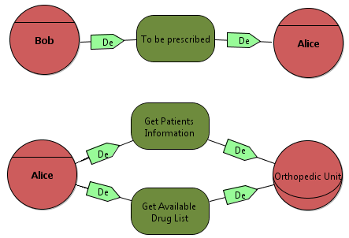
Delegation of RESPONSIBILITIES (EXECUTION)
Transfering of objectives from one actor to another
  The depender appoints another actor (the dependee) to achieve a goal or furnish a resource (dependum)
  Bob is not capable to get prescribed by his own, he depends on Alice to achieve his goal.

Slide 104
Tangible and INTANGIBLE RESOURCES
Resources can be of different kind
  Intangible resources
    Patient’s name and date of birth, the status of the drug reimboursement
  Tangible resources
    A file with the patient’s data, a printed dispensation sheet
What you can do with resources?
  Resources can be part of other resources of the same type
  Intangible resources can be made tangible
    This is the moment in which you start having security problems!
  Resources can be used to fulfill goals or can be delegated to actors

Slide 105
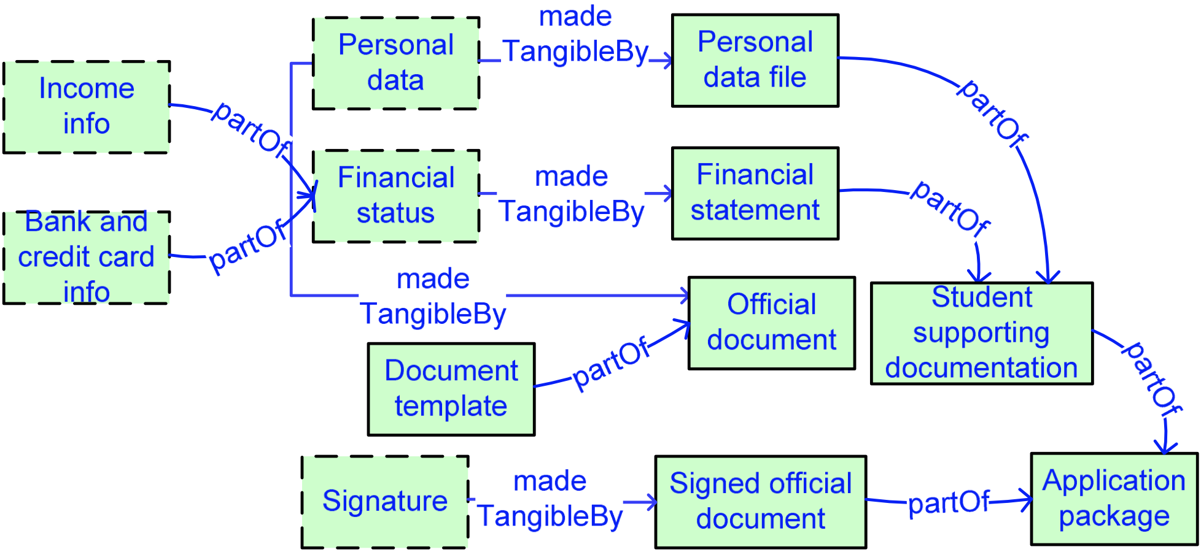
Resources
Patient’s application for eligibiliy of reimboursement
Patient Claim

Slide 106
Reasoning About Compliance - II
Key Security and Privacy Requirements
  EU Legislation’s Data Minimization Principle
  Schroeder’s Least Privilege
What the Boss wants to know:
  Employees should not be granted access to resources they do not need.
    They can only do mischief with them
  Permissions to execute activities or manage resources is consistent with the objectives assigned to the employee by the organization
Need-to-Know Satisfaction
  IF there is a delegation path of resources that arrives to an actor
  THEN the resources is needed for a goal assigned to the actor
  AND the goal has been delegated to the actor from the root goal for which the resource has been obtained.

Slide 107
Need-To-KNOW Example
The patient submitted his personal data to the hospital for the purpose of drug dispensation
The Resource Path
  Personal data made tangible by inserting into in File-F record
  Hospital share File-F record with External Ambulatory and Clinical Unit
The Goal Delegation Path
  Hospital breaks goal of Drug Dispensation to prescription of drug and physical dispensation of drug
  Hospital delegates prescription of drug to External Ambulatory
  Hospital delegates physical dispensation to Pharmacy
Need-to-know (and compliance with EU law) is violated!
  The Clinical Unit has no business with drug dispensation!
  Either ask patient’s consent for more purposes or restrict File-F sharing

Slide 108
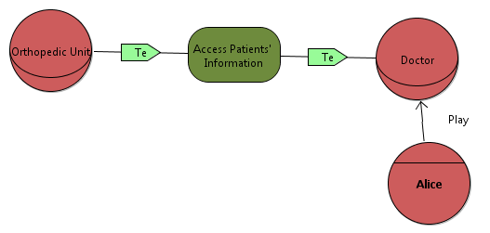
Trust modeling
Trust → ternary relation represents expectations/beliefs of an actor (the trustor) concerning the behavior of another actor (the trustee). The object (e.g., goal or resource) around which a trust relation centers is called trustum
  E.g., the patient trust the Operational Unit of the Hospital to manage his/her personal data; the Operational Unit trust the doctors in using the patient’s data
Trust of permission:
  not abuse of the permission
Trust of execution:
  Expected to achieve the delegated goal

Slide 109
REASONING ABOUT COMPLIANCE - III
Trust and Delegation
  When we delegate a goal to an actor do we trust him to achieve it?
  When we delegate a resource to an actor do we trust him not to misuse it?
    This is different than need-to-know. The actor might still need access to the resource but might still use it for other purposes
  In business practice it is very frequent to have untrusted delegation
    E.g. “Global outsourcing” packages: you get a very good deal on network management but you also need to buy PC fleet management
Explicit Representation of Trust leads to the first control-risk analysis to solve
  Untrusted Delegation
  Trusted Organizational Base

Slide 110
Reasoning About Compliance – IV
What the boss wants to know:
  do we depend for the achievement of our critical goals from an untrusted actors?
Untrusted Delegation
  There is a delegation path from the critical goal to an actor
  BUT there is NO trust path from the key stakeholders to that actor
Solution 1: Add a Trust delegation link
  Well...this is equivalent to say “We don’t know if this guy is reliable, so let’s assume it is.”
    A classical student’s solution. Add the link and security errors go away
  Sometime it is ok but beware it changes the Trusted Organizational Base!
Solution 2: First risk to consider in the spiral phase!
  Under which circumstances will the actor fail to deliver?
  Do we have a control mechanisms/countermeasure

Slide 111
Reasoning About COMPLIANCE - V
Remember the mother and the father
  A Trusted Component is not something that is secure. It is something against which we plan no defence
Trusted Organizational Base
  The actors that are trusted to deliver the objectives assigned to them
  TOB must be validated and justified
    Legal protection (supplier trusted because there are huge fines in the contract for late delivery)
    Social protection (reputation of supplier more valuable than the money he might obtain by mismanaging)
    Ethical protection (normal behavior would consider unthinkable not to deliver)
      But beware that what is normal might change significantly from place to place
      What works for China and Italy might not work for Germany

Slide 112
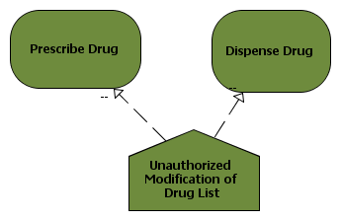
EVENT BASED RISK MODELLING
Risk is defined as an event that has a negative impact on the satisfaction of one or more goals
  Eg. Delay in sending Reimbursement report to the HealthCare Authority can be considered as a risk as it may hamper the goal Being Reimbursement
Unwanted incidents might impact goals
Can recalculate goal satisfaction based on events

Slide 113
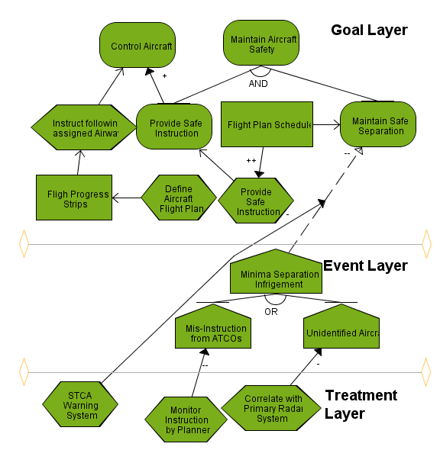
REASONING ABOUT COMPLIANCE - V
Goal
  “thing” that need to be achieved
Event
  “uncertain circumstance” that affect the goal layer
Treatment or Control
  Security controls to treat events
CO 1
Risk
CO 2
CO 1.1
CO 1.2
Risk
Risk
Risk

Slide 114
Target for the day - Rationale
Why we use models?
  because models allows us to answer more precisely to questions about the quality of final Governance, Risk and Compliance Requirements.
    we can prove fulfillment of strategic goals for an actor does not depend on another untrusted actor (at least at this level of abstraction)
    We cannot do the same if we just use natural language
  The type of questions determine the type of models
    i.e. presence of different constructs that capture different properties.
Expressiveness in Models is not free
  At the beginning you must design our construct and identify reasoning procedures about it
  Each and every time you draw a constructl for a specific application you must ask a domain expert or a stake-holder whether all real-life situations corresponding to the constructs are actually present

Slide 115
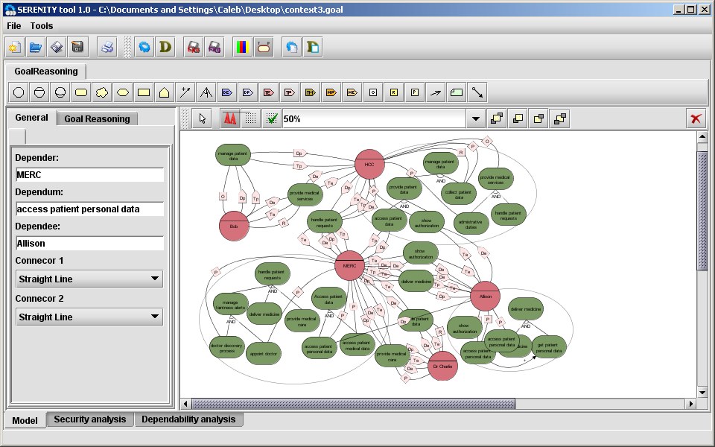
TOOL: http:\\sistar.disi.unitn.it

