Slide 1
Valid Policies for Secure Key Management
Guillaume Scerri and Ryan Stanley-Oakes,
University of Bristol

Slide 2
Headlines
Generic key wrapping API
Simple proof in the symbolic model
Computational guarantees

Slide 3
Overview
Background
  What are key management APIs?
  Computational vs Symbolic Cryptography
Methodology
  The Bana, Comon-Lundh model (BC14)
  Our symbolic key management API
Our Results
  Valid API Policies
  Symbolic and Computational Security Theorems
Ongoing Work

Slide 4





What is Key Management?
Different keys in a large cryptographic system have different properties
Keys may have relationships between them e.g. derived keys, wrapped keys
Keys need to be stored and used in multiple locations
How do we safely move keys around?

Slide 5

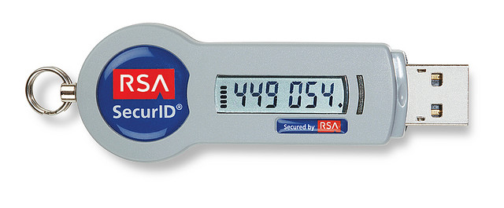
Cryptographic Tokens
Tamper Resistant Devices used to securely store keys
Can carry out cryptographic operations

Slide 6
What is a Cryptographic API?
User
Asks to perform cryptographic operation
API
Checks a policy
Token
Carries out operation using internally stored keys
e.g. not allowed to symmetrically wrap a sensitive key under a non-sensitive key

Slide 7
PKCS#11
Widely-used, standardised API
Key Management commands including key wrapping
Also general cryptography including encryption of data
Keys are pointed to by handles and handles have attributes
  e.g. “the key pointed to by this handle is sensitive”

Slide 8
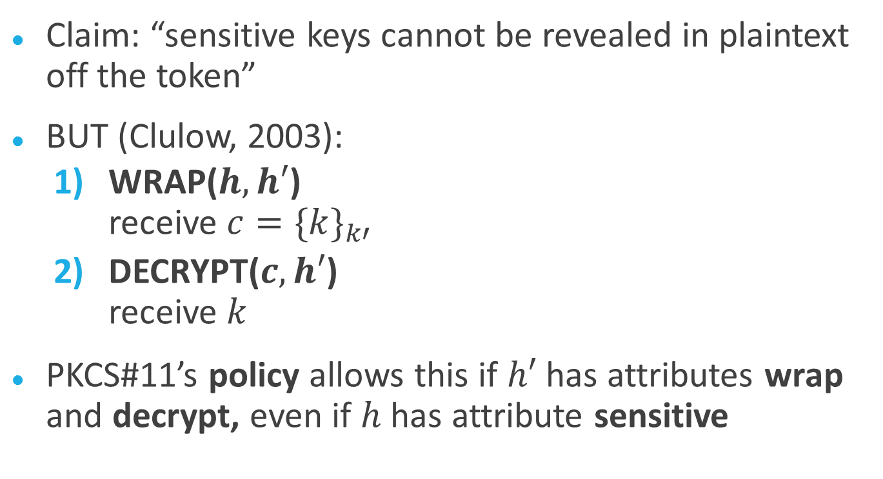
Security of PKCS#11
Claim: “sensitive keys cannot be revealed in plaintext off the token”
BUT (Clulow, 2003):
  WRAP($h,h′$)
  receive $c={\{k\}}_{k′}$
  DECRYPT($c, h′$)
  receive $k$
PKCS#11’s policy allows this if $h′$ has attributes wrap and decrypt, even if $h$ has attribute sensitive

Slide 9
Conflicting Attributes
Wrap/decrypt obviously bad combination of attributes (there are others)
PKCS#11 doesn't bind the attributes to a key when wrapping
Different handles pointing to same key can have different attributes
Even with attribute binding, how can we guarantee our API policy doesn't allow for attacks?

Slide 10
Security Models
Notes:
Now we discuss some different approaches to proving security, which can be used to avoid the kind of vulnerabilities just described.

Slide 11
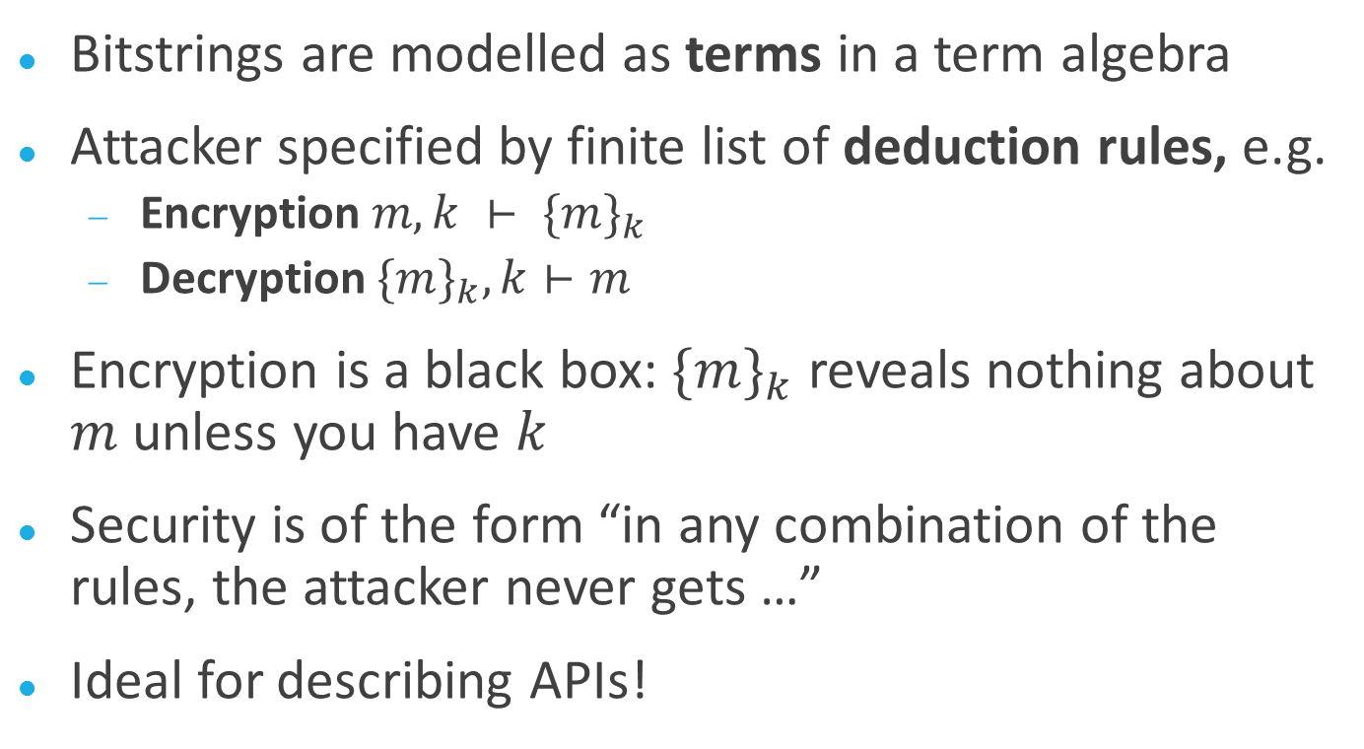
Symbolic Cryptography
Bitstrings are modelled as terms in a term algebra
Attacker specified by finite list of deduction rules, e.g.
  Encryption $m, k ⊢ {\{m\}}_{k}$
  Decryption ${\{m\}}_{k}, k⊢m$
Encryption is a black box: ${\{m\}}_{k}$ reveals nothing about $m$ unless you have $k$
Security is of the form “in any combination of the rules, the attacker never gets …”
Ideal for describing APIs!

Slide 12
Symbolic Cryptography
PROS
CONS
Short(ish), simple(ish) proofs
Less error-prone
Proofs can be automated
Security statements are intuitive; we abstract away details e.g. of probabilities
Security is usually a reachability property, not indistinguishability property
List of attacker rules might miss real attacks – how do you know you've thought of everything?
Notes:
Reachability e.g. “no attacker can obtain k”
Indistinguishability e.g. “no attacker can distinguish k from a random string”

Slide 13
Computational Cryptography
Realistic adversary (arbitrary PPT)
Attacker against a protocol / API can do anything except break security of underlying primitives (e.g. encryption scheme)
Security is of the form “for any attacker, the probability of … is negligible”
Notes:
I’m omitting references to the security parameter, but “negligible” means a negligible function of the security parameter.

Slide 14
Computational Cryptography
PROS
CONS
Concrete statements about realistic attackers
Easy to formulate indistinguishability properties
  Complicated security statements (games, reductions)
  Proofs are usually long and hard to read
  Proofs are error-prone
  Very hard to automate proofs
Notes:
Security statements will usually be of the form “at attacker who game 1 with non-negligible probability can be used to build an attacker who wins game 2 with non-negligible probability” – games themselves are detailed and complicated

Slide 15
BC14
Bana, Comon-Lundh (2014): A Computationally Complete Symbolic Attacker for Equivalence Properties (CCS 2014)
Symbolic model with computational guarantees
Used to express indistinguishability properties of protocols

Slide 16
BC14
Like computational model, attacker is any polynomial-time Turing machine with finitely many restrictions (not finitely many abilities).
Restrictions are axioms: formulae expressing what is not possible
Axioms come with computational soundness proofs (computational security property implies axiom)

Slide 17
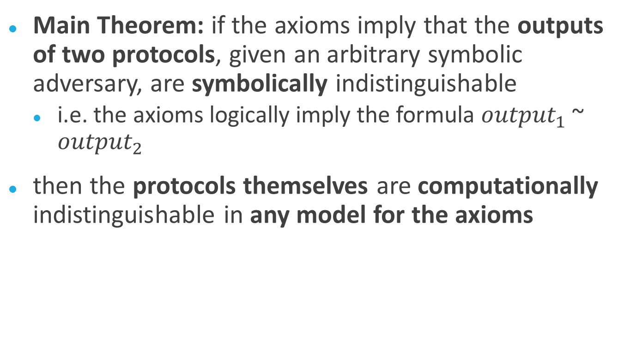
BC14
Main Theorem: if the axioms imply that the outputs of two protocols, given an arbitrary symbolic adversary, are symbolically indistinguishable
  i.e. the axioms logically imply the formula ${output}_{1}$ ~ ${output}_{2}$
then the protocols themselves are computationally indistinguishable in any model for the axioms

Slide 18

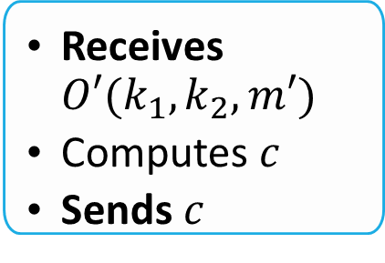

How an API Works
  Receives $O(h_{1},h_{2}, m)$
  Checks properties of $h_{1},h_{2}, m$
  Sends $O′(k_{1},k_{2}, m′)$
  Receives $c$
  Updates state
  Sends$c′$
API
  Sends $O(h_{1},h_{2}, m)$
  Receives $c′$
  Receives$O′(k_{1},k_{2}, m′)$
  Computes $c$
  Sends $c$
User
Token
Notes:
Corruption is not a typical API query! But used to model e.g. side-channel attacks.

Slide 19
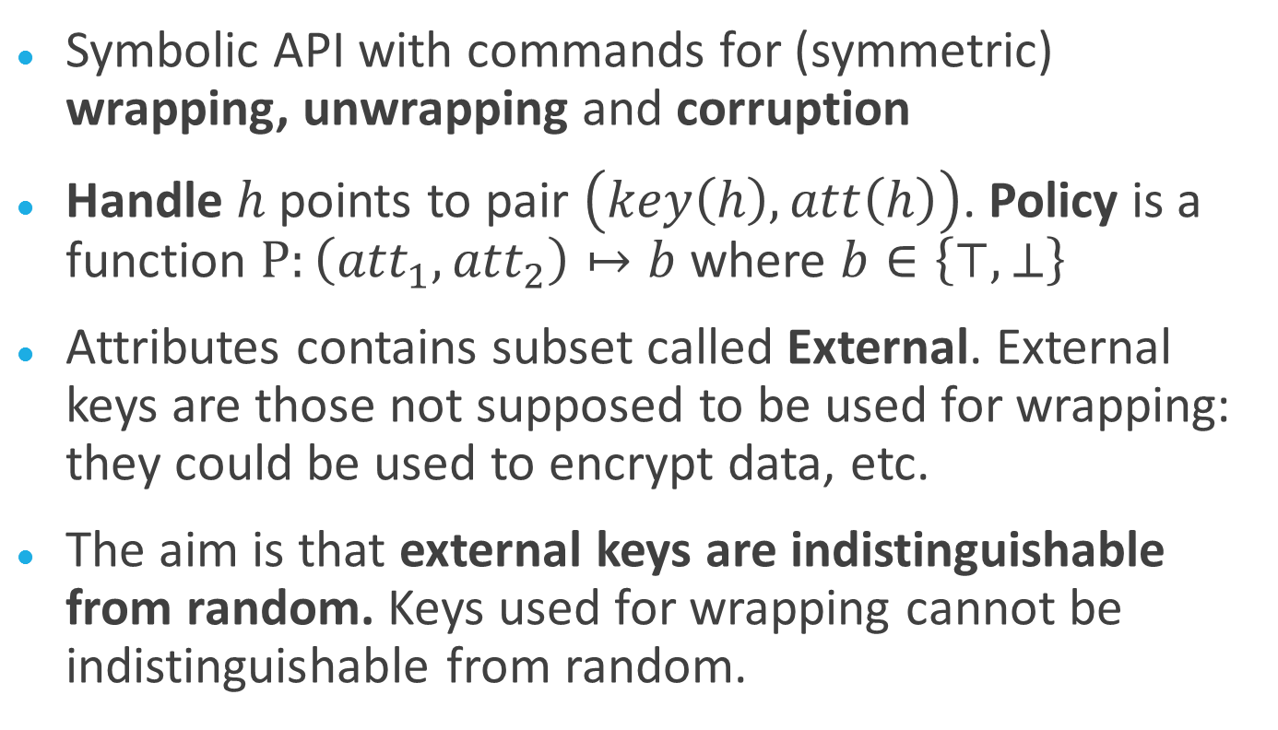
Our API
Symbolic API with commands for (symmetric) wrapping, unwrapping and corruption
Handle $h$ points to pair $\left(key\left(h\right), att\left(h\right)\right)$. Policy is a function $P:\left({att}_{1},{att}_{2}\right)↦b$ where $b∈\left\{⊤,⊥\right\}$
Attributes contains subset called External. External keys are those not supposed to be used for wrapping: they could be used to encrypt data, etc.
The aim is that external keys are indistinguishable from random. Keys used for wrapping cannot be indistinguishable from random.
Notes:
We assume that the set of keys is randomly generated at the start of an execution of our API. In practice, there would be a key generation / key derivation command.

Slide 20
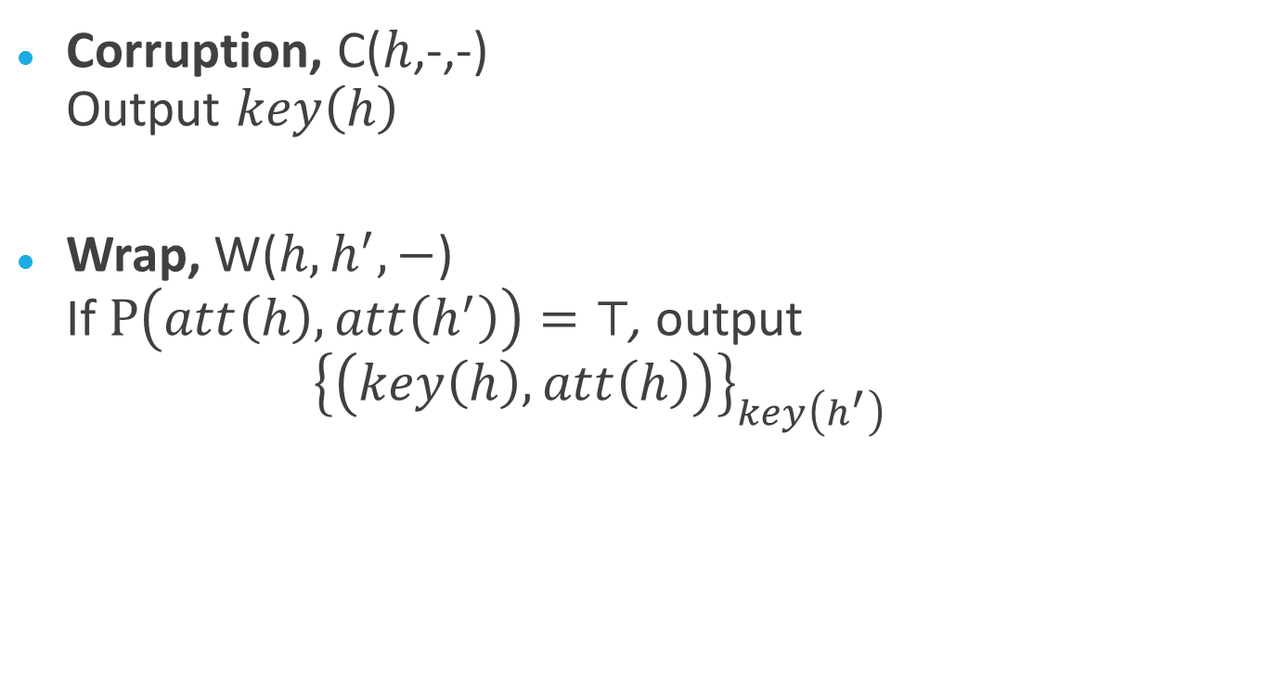
Our API
Corruption, C($h$,-,-)
Output $key\left(h\right)$
Wrap, W($h, h^{′},−$)
If $P\left(att\left(h\right), att\left(h^{′}\right)\right)=⊤$, output
${\left\{\left(key\left(h\right),att\left(h\right)\right)\right\}}_{key\left(h^{′}\right)}$

Slide 21
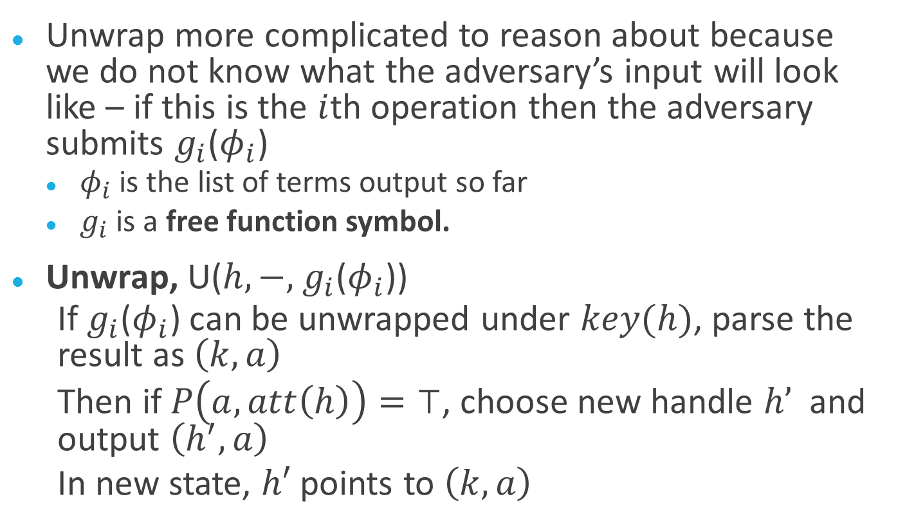
Our API
Unwrap more complicated to reason about because we do not know what the adversary’s input will look like – if this is the $i$th operation then the adversary submits $g_{i}$($φ_{i}$)
  $φ_{i}$ is the list of terms output so far
  $g_{i}$ is a free function symbol.
Unwrap, U($h,−,$ $g_{i}$($φ_{i}$))
  If $g_{i}$($φ_{i}$) can be unwrapped under $key(h)$, parse the result as $\left(k, a\right)$
  Then if $P\left(a, att\left(h\right)\right)=⊤$, choose new handle $h’$ and output $\left(h^{′}, a\right)$
  In new state, $h′$ points to $\left(k,a\right)$
Notes:
We have to check the policy again: if the adversary forged a wrap, we need to make sure the key they import is “weaker” in some sense than the unwrapping key, otherwise corruption will propagate higher and higher.
Explain that the conditions here depend upon the properties of the free function symbol. Therefore we have to do a big case disjunction over all the possibilities of the unwrap: if they submit a previously created wrap under key(h), which one was it?
So our theorem is intuitive but non-trivial.

Slide 22
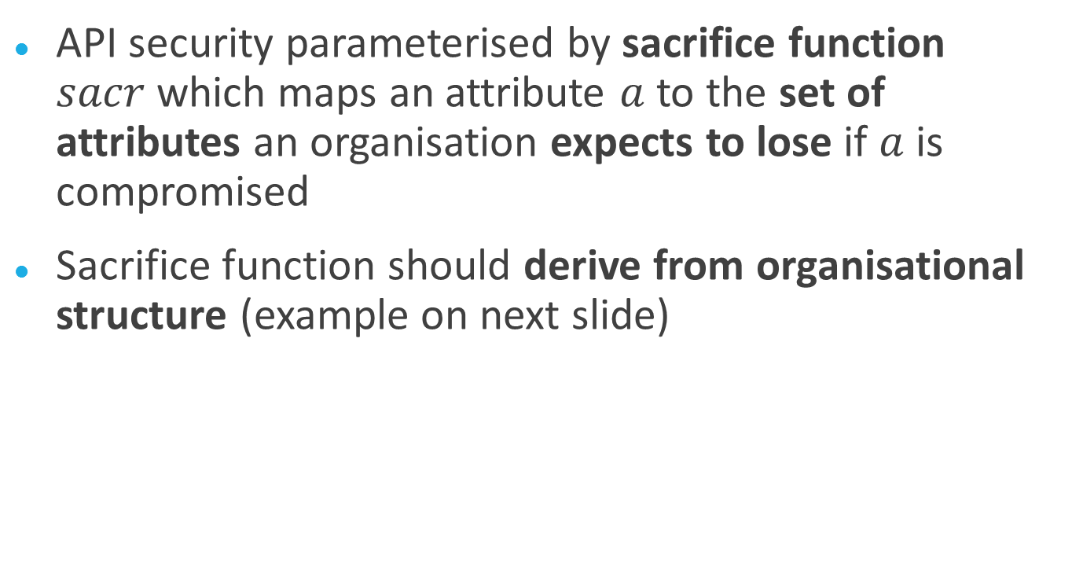
Sacrifice Function
API security parameterised by sacrifice function $sacr$which maps an attribute $a$ to the set of attributes an organisation expects to lose if $a$ is compromised
Sacrifice function should derive from organisational structure (example on next slide)

Slide 23


Example of Sacrifice Function
Attribute of employee 1’s key is in the sacrifice set of the attribute of the Boss’s key, but not the attribute of the Head of Team B’s key.
Boss
Head of Team A
Head of Team B
Employee 1
Employee 2
Employee 3
Notes:
If someone corrupts the key of the Head of Team B, the keys of Team A ought to remain uncompromised.

Slide 24
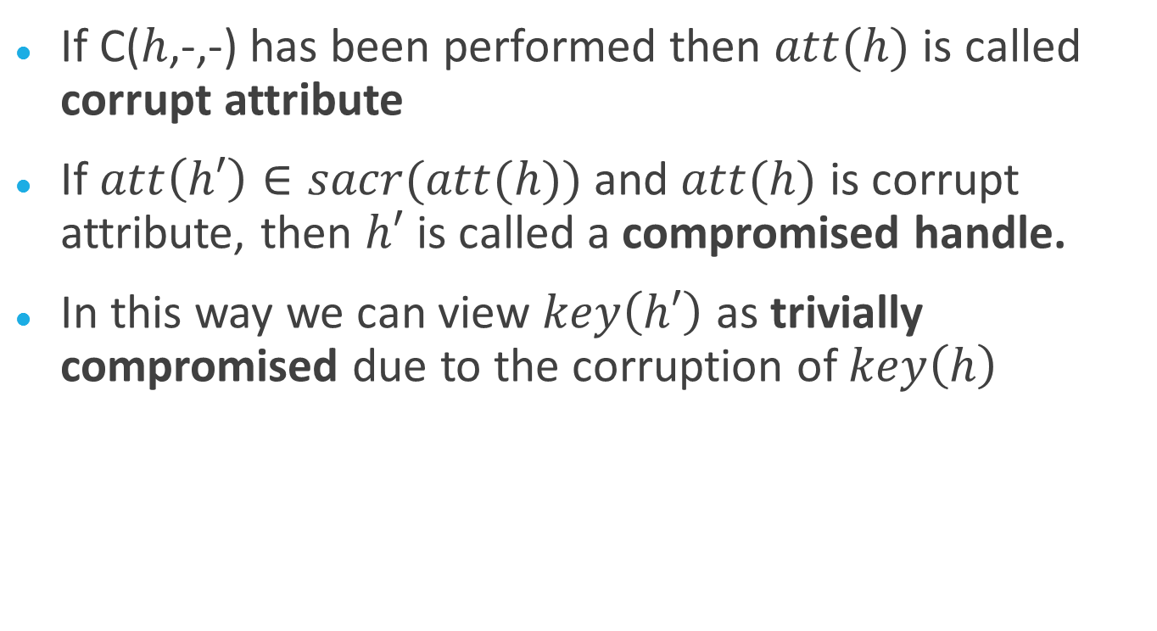
Compromised Handles
If C($h$,-,-) has been performed then $att(h)$ is called corrupt attribute
If $att\left(h′\right)∈sacr(att(h))$ and $att(h)$ is corrupt attribute, then $h′$ is called a compromised handle.
In this way we can view $key\left(h′\right)$ as trivially compromised due to the corruption of $key\left(h\right)$
Notes:
It is worth remarking that, since the adversary can unwrap their own input, the new handle will just point to the result of that unwrapping which may not be symbolically the same as a key, attribute pair. So we have to extend these definitions to arbitrary terms that are “semantically equal”, i.e. equal as bit strings, to attributes.

Slide 25
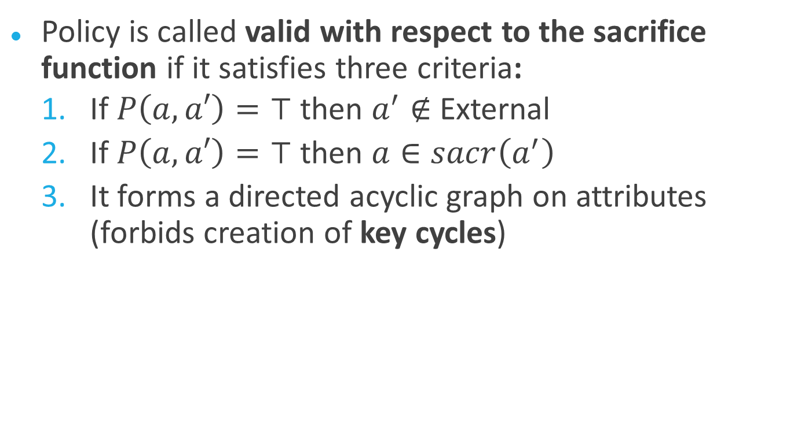
Valid API Policies
Policy is called valid with respect to the sacrifice function if it satisfies three criteria:
  If $P\left(a,a′\right)=⊤$then $a^{′}∉$ External
  If $P\left(a,a′\right)=⊤$then $a∈sacr\left(a^{′}\right)$
  It forms a directed acyclic graph on attributes (forbids creation of key cycles)
Notes:
These three criteria are actually (informal versions of) axioms about the computational interpretation of the function symbol P.
Note that sacrifice function could be cyclic, but policy cannot be. Policy must at least respect the sacrifice function but may need to do more.

Slide 26
Symbolic Security
Axioms & valid policy yield:
For any a* in External and any M > 0, no adversary who
  is given the key k* at the start
  performs M operations using the API
  does not compromise h*
can distinguish between:
API1, where h* points to (k*, a*)
API2, where h* points to ($, a*), for a random key $.
Notes:
Here we have the “bounded sessions” restriction which is inherent to the computational soundness of BC14. M can be any positive integer, but the adversary cannot choose it and so it cannot increase without bound as the security parameter increases.

Slide 27
Computational Security
In any computational API where policy is valid and wrapping is IND-CCA and INT-CTXT secure, keys that are
  Not trivially compromised
  Not used to wrap other keys
are indistinguishable from random.
Notes:
An immediate corollary from the symbolic theorem, thanks to the computational soundness of BC14.

Slide 28
Ongoing Work
Add more commands to the model
Prove soundness of our axioms with respect to more modern computational security notions e.g. AE-AD
Investigate modifications to BC14 that allow the adversary to use an unbounded number of operations (in particular, so the number of corruptions can increase with the security parameter)

Slide 29
Recap
A generic symbolic key wrapping API with strong computational security guarantees and a fairly simple proof
Keys not trivially compromised and not used to wrap other keys are indistinguishable from random
The adversary is an active and adaptive polynomial-time Turing Machine using a bounded number of operations (and hence number of corruptions doesn’t depend on security parameter)

