Slide 1
“What is the unit of Security?”
Eerke Boiten, university of Kent, UK @ FOSAD 2016

Slide 2
Meta
The objectives of this talk are:
  Starting the day, starting FOSAD
  More questions than answers
  Main example’s background grabs foreground
  Getting it wrong in creative & interesting ways
  Inspire you, and me

Slide 3
Problem TO BE addressed
Aiming to Security
from a formal perspective (abstract description, formal semantics, formal proof & logic)
“ISO27001[… ]information security as an organisational function needs to be measured against performance targets” [Calder & Watkins 2015]
Predict
Measure
Manage
Control

Slide 4
Problem TO BE addressed
Software security assessment is as scientific as wine-tasting
(paraphrasing Wayne Jansen: “Directions in Security Metrics Research”, NIST 2009)

Slide 5
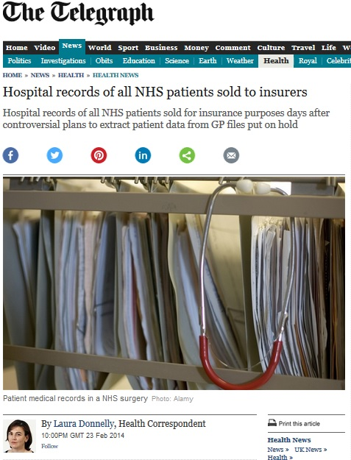
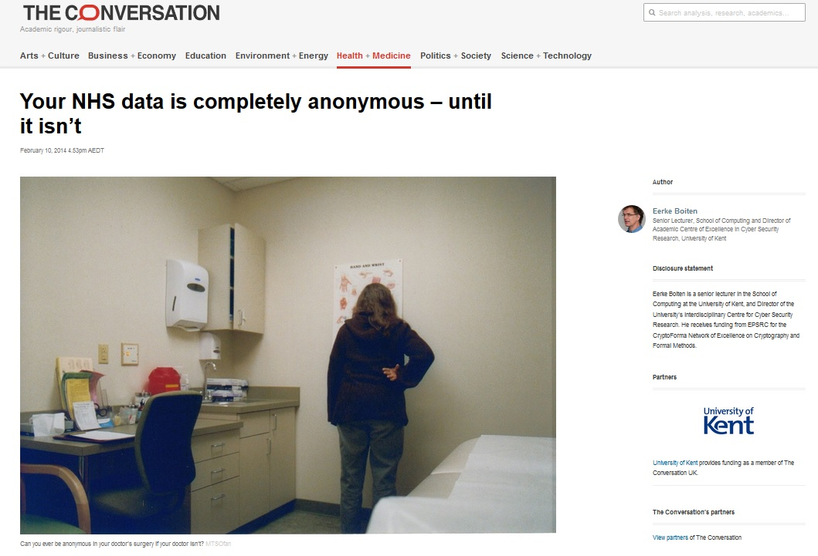
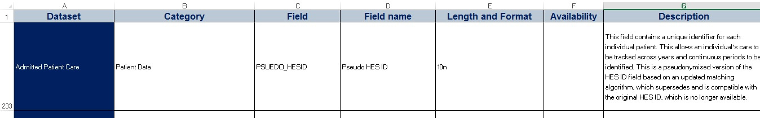
REAL Example: what is the re-identification risk of pseudonymised Hospital episode statistics?

Slide 6
What is the unit of security? V.0
A monoid (S,⊕,1⊕) satisfies ∀a,b,c ∈ S:
  a⊕b ∈ S
  (a⊕b) ⊕ c = a ⊕ (b⊕c)
  a ⊕ 1⊕ = a = 1⊕ ⊕ a
  1⊕ is the unit of the monoid [semigroup with identity]

Slide 7
unit of functional composition
Unit of composition in (pipeline) “systems” or functional programs:
Unfortunately NOT unit of security in such programs: a wire is an attack surface!
in
out
in=out

Slide 8
Unit of composition in sequential programs
S ; T sequential composition, unit is “skip” (do nothing)
skip ; S = S
Already dubious in some concurrency settings.
Security context: NOP-stacks make a difference!

Slide 9
deliberate misinterpretation!?
There’s no unit of security!
(More precisely: the unit of functional composition isn’t a unit of security.)
More practically: functional decomposition may not be security decomposition [and UC is complex] – 1st point of caution

Slide 10
2nd point of caution: “The Refinement paradox”
“choose x”
allows all possible values for x, so it is refined by
“x := secret”
Can be prevented by secrecy-preserving refinement (Jürjens, Morgan)
However, if the non-determinism arises from abstract principles like “concurrency = arbitrary interleaving”, a scheduler that creates a side channel is also a refinement.

Slide 11
2nd point of caution: “The Refinement paradox”
The practical consequence of this is:
Not all security problems can be predicted from an abstract specification
Related: how is any measurement impacted by patching? (Don’t say we shouldn’t.)

Slide 12
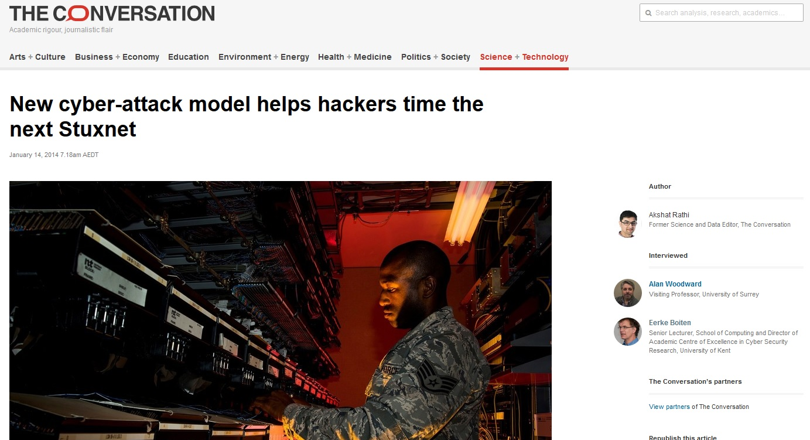
3rd point of caution: “GIGO”

Slide 13
e.g. forms of risk assessment
1-5 likelihood x 1-5 impact.
Quantitative: probability x cost. “the time cost of accuracy quite often outweighs the benefits for the organisation” [Calder & Watkins 2015]

Slide 14
SOME Security-related system Measurements [QASA 2013-2015, …]
Information Theory based: amount of information (leaked/preserved); bandwidth
Probability (of failure)
  Variants of specification languages, model checking
  In provable security: negligible f of security parameter
  Attack trees
Measuring attack surface (~ code complexity metrics, e.g. # in/outgoing method calls)
Human interface of security management: incidents, training effects, …

Slide 15
What is the unit of security?
[I’m not a natural sciences historian BUT]
Part of the success of physics is that it isn’t just about generating numbers
It’s also about units of measurement
These give an immediate sanity check on formulas
Programmers may view these as type checks
  Which camp are you in? C or Haskell?

Slide 16
Data Privacy Measurement
Specific focus: not security assessment in general, but privacy impact assessment
High level but usually informal
Two types of risks: inherent from the data, plus consequences of getting security wrong

Slide 17
Exercise for the break
What different measurements might you do on a [relational] database?
What would the relevant units of measurement be?
What would these measurements be good for?

Slide 18
DATA PHYSICS & DATA ETHICS
Data science and data ethics: what can we do, and what should we do with data?
Unique form of ethics: data is concrete, observable, objective.
Making what we do with the data, and what impact that has concrete, observable, objective and measurable: “data physics”
(and data ethics can then base decisions on this)

Slide 19
what is the unit of privacy?
What different measurements might you do on a [relational] database?
What would the relevant units of measurement be?
What would these measurements be good for?

Slide 20

Modulating sensitive data use
Different ways of putting
privacy protections
around:
Sensitive database
Results
User
Queries

Slide 21
SAFE HAven
We could talk about
measurement here too.
“possibly” = decision
hidden from user
possibly hidden from user
Sensitive database
Results
User
Queries

Slide 22
differential privacy
hidden from user
system-modified (or withheld)
Sensitive database
Results
User
Queries

Slide 23
share de-identified database
distort (lose/change information)
Sensitive database
“Anonymised” database
Results
User
De-identify
Queries

Slide 24
Measurements on an anonymised database
quasi-identifier tuple: a set of attributes that together uniquely identifies a data subject [would be key if not longitudinal!]
k-anonymity: for any value of quasi-identifier tuple, we have (0 or) ≥k matching entries in the table
l-diversity: [and within such group of entries] we find l different values for a collection of sensitive attributes
t-closeness: [and within such a group] distributions of sensitive attributes are within a bound t of its distribution over the entire population

Slide 25
what can we do to “anonymise”?
Elide field: replace [quasi-identifier] value by “null” [unit v.2]
Generalise field: replace [quasi-identifier] value by a set of values (wider locality, age range, …)
Pseudonymise: replace every value for candidate key by a “meaningless” value. [Hash; random oracle]
Delete: remove info about extremely rare values
(& other measures which actually falsify information – more broadly Statistical Disclosure Control)

Slide 26
Attacks against “anonymised”
Re-identify: recover candidate key value for tuple(s), e.g. link pseudonym to identity, e.g via other table.
Identify: match pseudonym with pseudonym in other table
Recover sensitive attribute: find out value of sensitive attribute for a given identity
Specialise: (partially) undo generalisation
& probabilistic versions of all of these: partial information, e.g. re-identification up to k

Slide 27
So the risk for pseudonymised hes?
Which attack!?
k-anonymity (etc) is same as non-pseudonymised
insight: pseudonymisation defends against use of external information, either directly in queries or through join with other tables
what are the quasi-identifiers? in a longitudinal database, “everything”, and info across rows

Slide 28
what else to measure?
In What UNITS?
width of table: more info/key is more specific
number of tuples, vs. size of population
functional dependencies
how many of the 33 bits of identity?
distortion from information quality
external information that can re-identify
HARM of sensitive attributes (expectations rather than probabilities?)
COST of attacks

Slide 29
A somewhat disappointing end
The copy-sharing model is reality and in terms of current climate (“open”, “big”) likely to remain dominant
We need to get better at judging the risks associated with the data we expose
Re-identification is wider than just showing anonymization is broken: it is privacy-intrusive deduction
Is all this a convincing justification for a “data physics” research agenda yet?

