Slide 1
Interoperability in Complex Distributed Systems
Gordon Blair
School of Computing and Communications, Lancaster University, UK

Slide 2
Outline of the Presentation
Problem analysis
  Trends in distributed systems
  Extreme heterogeneity
Focus on interoperability
  What is interoperability?
  Five interoperability challenges
Approaches to interoperability
  A state-of-the-art analysis
  Towards emergent middleware
The role of ontologies (Massimo’s part)
  Ontologies and the semantic web
  Role in emergent middleware

Slide 3
Problem Analysis
Part 1

Slide 4
A Few Words from Danny Cohen
In the beginning ARPA created ARPANET.
And the ARPANET was without form and void.
And darkness was upon the deep.
And the spirit of ARPA moved upon the face of the network and ARPA said, 'Let there be a protocol,' and there was a protocol. And ARPA saw that it was good.
And ARPA said, 'Let there be more protocols,' and it was so. And ARPA saw that it was good.
And ARPA said, 'Let there be more networks,' and it was so.

Slide 5
Gordon’s Distributed Systems Version
In the beginning there was small scale experimentation.
And the experiments were without abstraction or openness.
And darkness was upon the deep.
And the spirit of the OMG moved upon the face of distributed systems and said, 'Let there be a middleware standard,' and there was a standard. And OMG saw that it was good.
And Microsoft said, 'Let there be more standards,' and it was so. And Microsoft saw that it was good.
And the community said, 'Let there be more networks and of course also mobility, ubiquity and cloud computing for good measure,' and it was so.....

Slide 6
…. but is it good?
Early distributed systems
  Limited in scale and heterogeneity, issues such as openness, and support for QoS not a big issue
Internet-scale distributed systems
  Large scale and significant levels of heterogeneity (platforms, languages and middleware), significant advances in supporting openness and QoS
The complex distributed systems of tomorrow
  Significant increases in scale and also heterogeneity in all its dimensions (cf. systems of systems); more dynamic; major research questions concerning openness and QoS

Slide 7
Illustrating the challenge:
Towards environmental observatories
Motivation
  Many well-known challenges to the environment
    Global warming, pollution, diminishing of natural resources, threats to bio-diversity, etc.
  The environment decade [Al Gore, Earth in the Balance]
    Book also focuses on the potential role of technology in addressing these problems
What is an environmental observatory?
  Investigating the role of contemporary computing technologies, particularly where pervasive technologies meet distributed systems in supporting the (real-time) monitoring and management of the natural environment

Slide 8
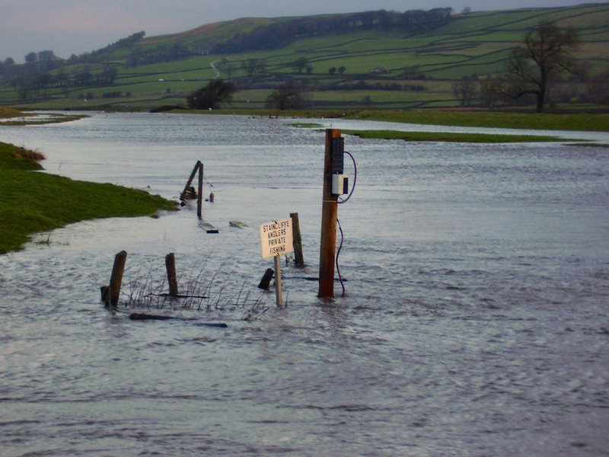

Slide 9
A Closer look at interoperability
Part 2

Slide 10
Focus on Interoperability
Self-Management
Security
Interoperability
Privacy
Scalability
  “the extent by which two implementations of systems from different manufacturers can co-exist and work together by merely relying on each other’s services as specified by a common standard”.

Slide 11
Interoperability Challenges
Five challenges that must be resolved to achieve interoperability:
Discovery protocol interoperability *
Interaction protocol interoperability *
Data interoperability *
Application interoperability *
Interoperability of non-functional properties

Slide 12

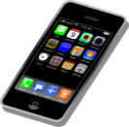
Illustrating Interoperability Challenges
Who has?
I offer!
Need 5!
Will be 9€
Client / Server
Peer-2-Peer
€
UPnP
£
SOAP

Slide 13
Illustrating Interoperability Challenges
No. | Country | Platform | Middleware | Application | Data/ Currency
1 | Germany | Java | Tuple Space | GetInfo | EUR
2 | Great Britain | Microsoft | SLP+SOAP | GetInfo | GBP
3 | France | Java | SSDP+SOAP | GetInfo | EUR
4 | Italy | Java | SSDP+SOAP | GetLocation+ GetPrice+ GetQuantity | EUR
5 | Switzerland | Java | SSDP+SOAP | GetInfo | CHF
6 | Spain | Java | SLP+SOAP | GetInfo | EUR
Use different middleware = cannot interoperate
Exchange different data = cannot interoperate
Call different application operations = cannot interoperate

Slide 14
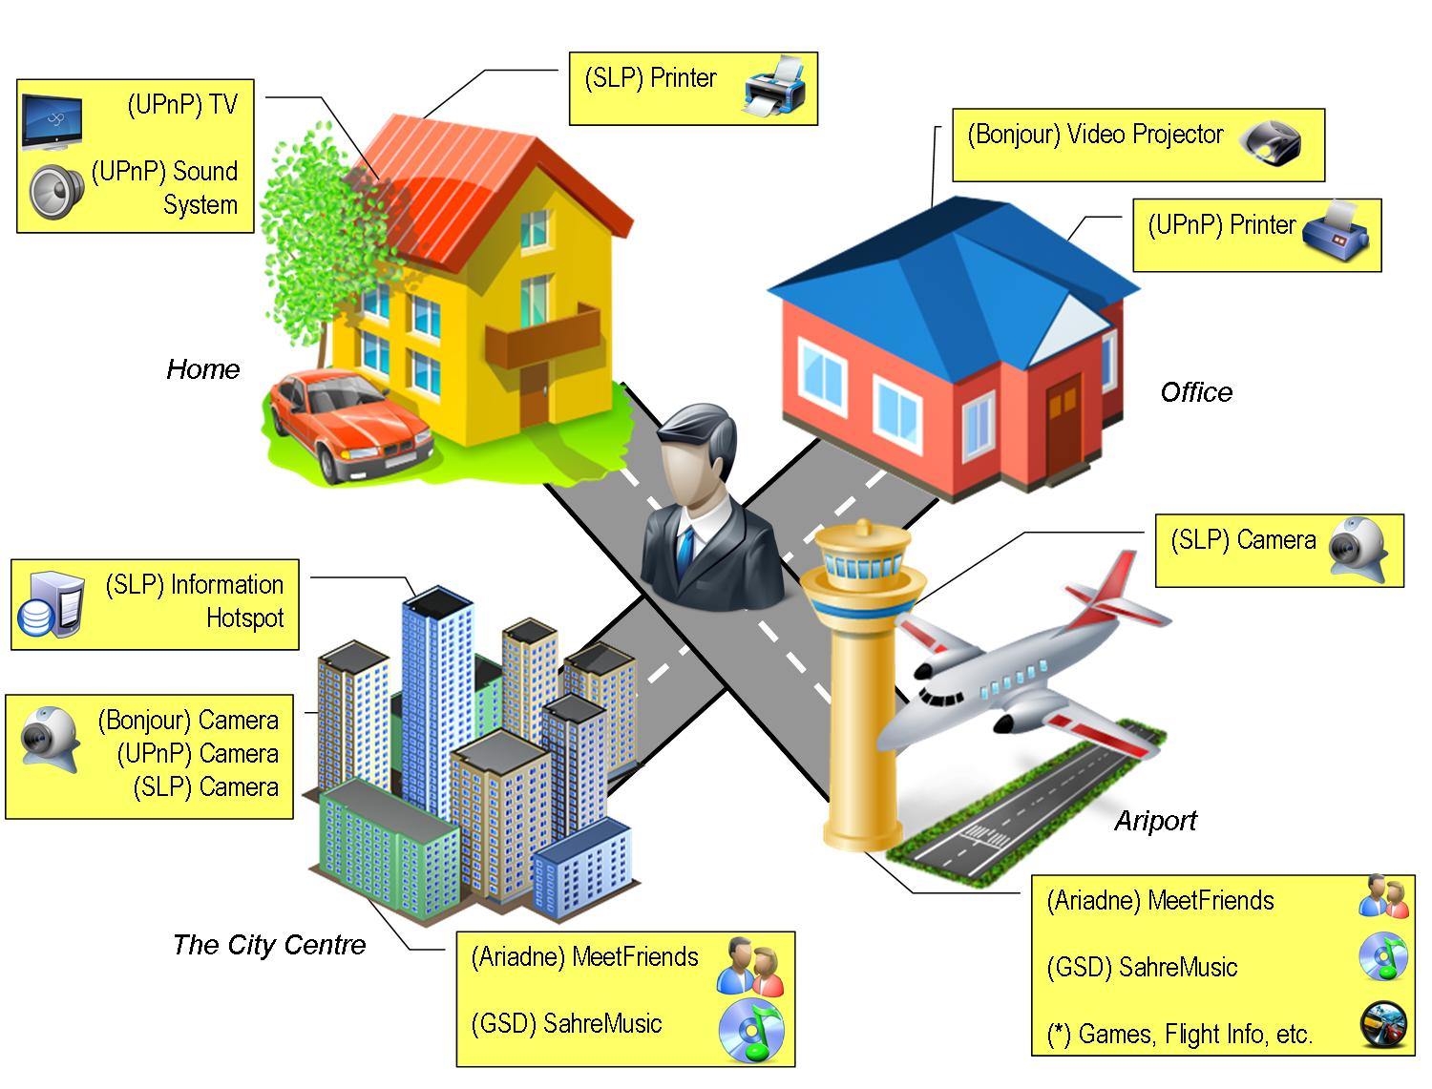
1. Discovery Protocol Interoperability

Slide 15
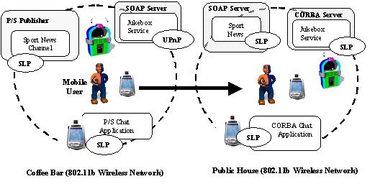
2. Middleware Protocol Interoperability
CORBA Service (IIOP)
Web
Service (SOAP)

Slide 16
3. Data Interoperability
<price> <value> 1 </value> <currency> euro </currency> </price> | <price> <value> 1 </value> <currency> pound</currency> </price>
<price> <value> 1 </value> <currency> euro </currency> </price> | price(1,euro)
<price> <value> 1 </value> <currency> euro </currency> </price> | <cost> <amount> 1 </ amount > <denomination> €</ denomination > </cost>

Slide 17
4. Application Interoperability
CORBA Client Calls:
  GetInformation(Merchant) → Name, Product, Price
CORBA Server Interface
  GetName()→Name
  GetProduct()→Product
  GetPrice()→Price
Client cannot interoperate with this service (even when the protocols and data match)
  Cannot easily standardise application interfaces

Slide 18
EXISTING APPROACHES TO INTEROPERABILITY
Part 3

Slide 19
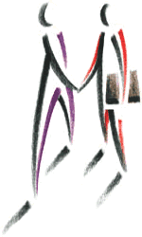
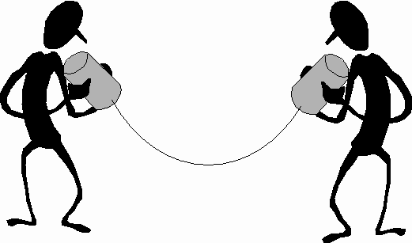
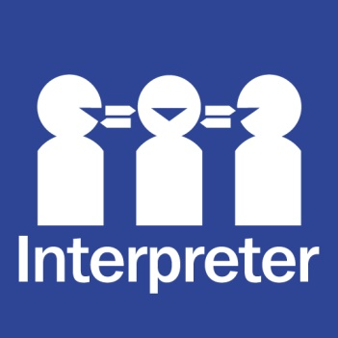
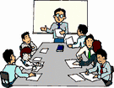
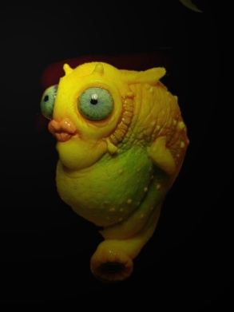
Approaches to Interoperability
1. One speaker talks the other’s language
2. Auxiliary Languages (e.g. Esperanto)
3. One 3rd party translator e.g. English to French translator
4. A chosen shared language
5. Babel fish

Slide 20
Standards-based Approaches
Application
Middleware
Middleware
Application
Peer
Peer
CORBA, Web Services
  Everyone has to be aware of the same standard
  No interoperation with alternative standards and protocols
  New standard comes along ...
    Another interoperability problem
4. A chosen shared language

Slide 21
Bridging
Legacy Application
Legacy Middleware
A
Bridge A to B
Legacy Middleware
B
Legacy Application
Peer
3rd Party Peer (Infrastructure)
Peer
E.g. SOAP2CORBA
Bridge must be deployed
Significant development effort
  For every protocol pair
  New protocol
    Equals a bridge to every existing protocol
3. One 3rd party translator e.g. English to French translator

Slide 22
Transparent Interoperability
Legacy Application
Legacy Middleware
Translation to Intermediary
Translation from Intermediary
Legacy Middleware
Legacy Application
Peer
3rd Party Peer (Infrastructure)
Peer
Enterprise Service Buses (ESB), INDISS
Mapping to a common protocol
  Translation at either end – to/from the legacy or local protocol
Greatest common divisor problem
  Only have the subset of behaviour that matches between a pair
2. Auxiliary Languages (e.g. Esperanto)

Slide 23
Interoperability Substitution Platforms
Application
Interoperability Platform
Translation
Substituted Middleware
Legacy Middleware
Legacy Application
Peer
Peer
UIC, ReMMoC, WSIF
One peer has to know in advance it will be a translator
  Knowledge of all potential protocols ...
1. One speaker talks the other’s language

Slide 24
We Want Future-Proof Interoperability
Existing approaches to interoperability do not work for distributed systems of tomorrow
  Fundamental re-think required
  Towards emergent middleware
  Can we observe, learn synthesize and deploy a binding dynamically
Interoperability Solution
Monitor & Learn
Monitor & Learn
Synthesize
CORBA service
Web Service
Generated BINDING
5. Babel fish

Slide 25
THE ROLE OF ONTOLOGIES (Massimo)
Part 4

Slide 26
Conclusions
This presentation has charted the increasing complexity of contemporary distributed systems stemming from extreme heterogeneity and dynamism
This level of complexity makes it very difficult to ensure even the most basic property of distributed systems, that is interoperability
Existing solutions are not sufficient to meet the demands of complex distributed systems
We argue that a new approach is required:
  Emergent middleware
Ontologies have a key role in realising emergent middleware by providing cross-cutting capabilities capturing the meaning of concepts and supporting associated reasoning capabilities

