Slide 1
The CONNECT Architecture: Overview and Middleware Interoperability Aspects
Nikolaos Georgantas, INRIA
Joint work with ARLES colleagues and colleagues from FP7 ICT FET CONNECT project

Slide 2
Outline
Introduction to CONNECT
CONNECT Architecture
  From System Discovery to CONNECTor Synthesis
Middleware Interoperability Aspects
  Approach to Middleware Abstraction
  CONNECT Discovery & Demo (by Rachid Saadi)
  Approach to Middleware Synthesis & Demo (by Paul Grace)
Conclusion

Slide 3
The CONNECT Approach to Interoperability: Emergent Middleware
Synthesize CONNECTors between heterogeneous Networked Systems (NS)
  Generate middleware and application protocols to create connections that will overcome the interoperability barrier
    CONNECTors devised and created at Run Time
    Minimal a priori knowledge/ assumptions
NS
CONNECTor
NS
« Mediating » connector
aka Emergent Middleware
See lecture by Gordon Blair & Massimo Paolucci on
Interoperability in Complex Distributed Systems
3

Slide 4


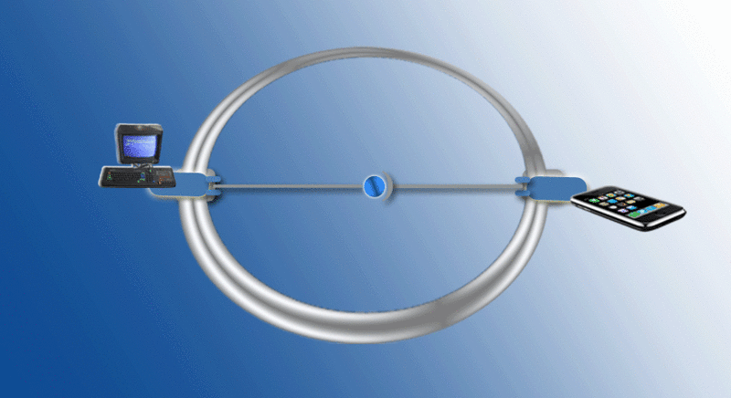
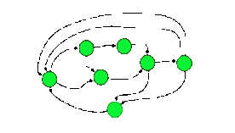
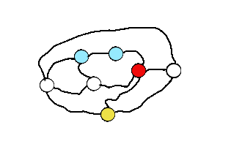
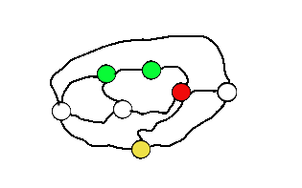
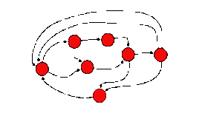
A Runtime Model-centric Approach to
Eternal Interoperability
Pre-built
middleware protocol translation
From
Non-CONNECTed
Pre-built connectors
at syntactic level
Pre-built
middleware protocol
substitution
Networked System
Networked System
1) Modelling and reasoning about peer functionalities
To
CONNECTed
Emergent connectors
at semantic level
for eternal connectivity
2) Learning connector behaviours
Dependability assurance
3) Modelling, reasoning about,
and composing dynamically connector behaviours, both functional & non-functional
4) Runtime synthesis of connectors

Slide 5
Overall View
CONNECT Enabling Architecture
enabler
enabler
collaboration
enabler
output
output
input
input
networked system
networked system
networked system
networked system
CONNECTor
input
networked system
networked system
Networked Systems
CONNECTed System Architecture

Slide 6
The CONNECT Enablers
Service Provision
NS
NS
Requirements
Protocols
Learning
CONNECTor
Synthesis
Discovery

Slide 7
CONNECTed System Life-cycle
CONNECT Continuous Process
interaction behavior learning
Networked System interoperable discovery and matching
CONNECTor model synthesis
monitoring, model-based testing
learned model evaluation and update
common mechanisms
feedback and resynthesis
feedback and resynthesis
dependability analysis
monitoring and model-based assessment
(online)
CONNECTed systems
model-based evaluation
(offline)
CONNECTors
model-to-model, model-to-code transformations
CONNECTor deployment and execution

Slide 8
Outline
Introduction to CONNECT
CONNECT Architecture
  From System Discovery to CONNECTor Synthesis
Middleware Interoperability Aspects
  Approach to Middleware Abstraction
  CONNECT Discovery & Demo (by Rachid Saadi)
  Approach to Middleware Synthesis & Demo (by Paul Grace)
Conclusion

Slide 9
Assumptions of the Architecture
Operating environment
  We assume IP-based systems which are open and consist of potentially federated autonomous systems
System assumptions
  Networked systems are discoverable and the associated discovery protocols are known to CONNECT
  We can discover at least the interface description for a networked system and in a language that is known to CONNECT
  We know the ontologies as required for a domain (and ontology alignment is possible but provided outside CONNECT)
  CONNECT-aware hosts are available for deployment of key behavior (CONNECTors)

Slide 10
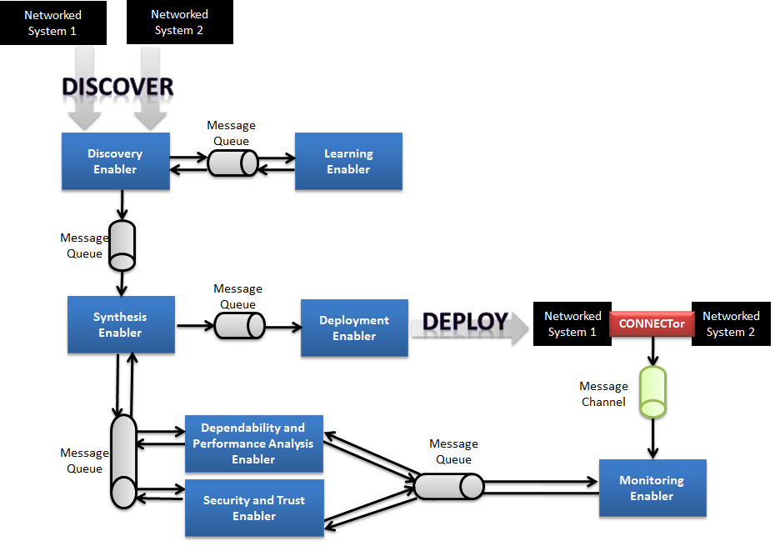
The Enabler Architecture

Slide 11
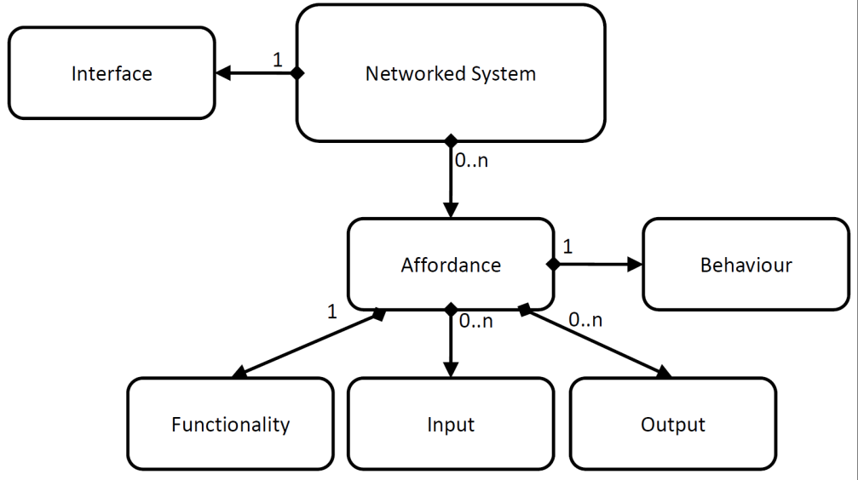
Networked System Model
Networked System (NS)
Affordance
Semantic concept
Behavior
Interface
Non-Functional Properties

Slide 12
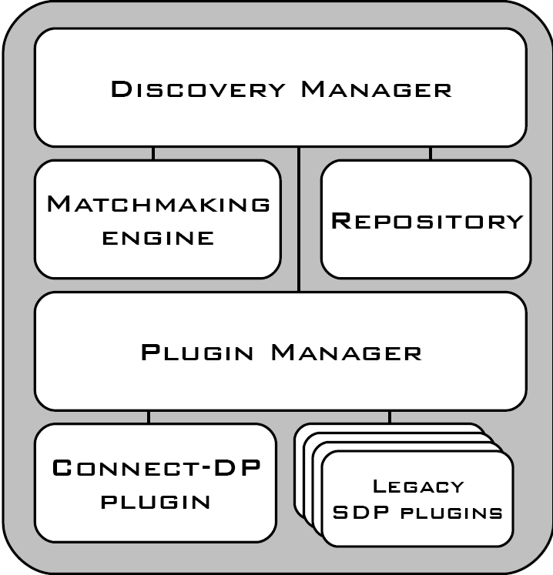
Discovery Enabler
The architecture is based on previous interoperable service discovery solutions, namely:
MUSDAC and UBISOAP

Slide 13
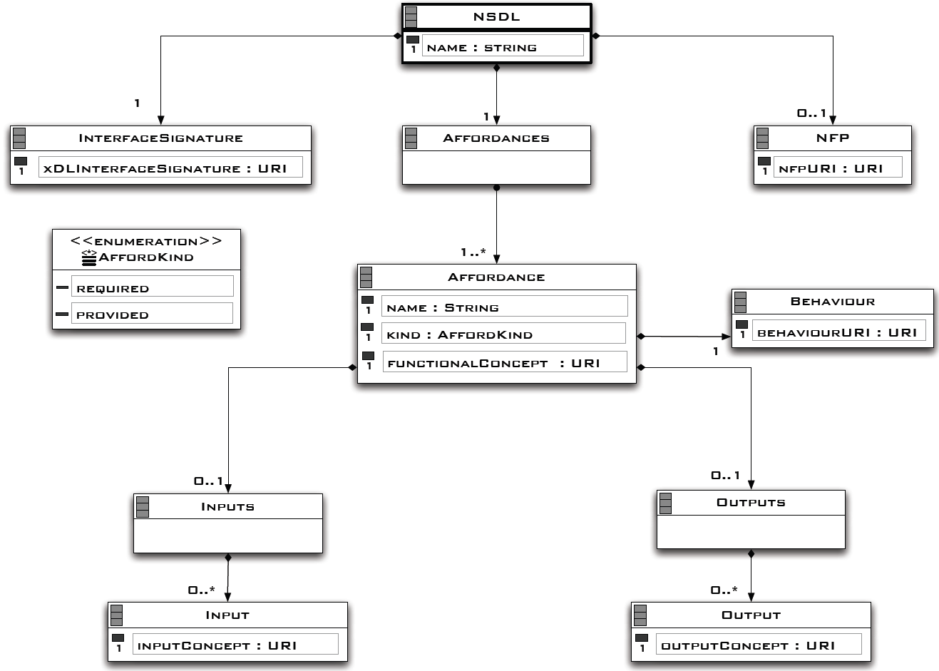
The Networked System Description Language (NSDL)

Slide 14
Synthesis Enabler
Middleware-specific application LTSs
Concretization
Middleware Abstraction
Middleware-abstraction rules
Concrete (application- & middleware-layer) Connector Specification
Middleware-agnostic application LTSs
Ontology-based
specifications
refers to
Common
Abstraction
Ontology
Mapping
Connector
Representation
Meta-Model
refers to
Code
Templates (e.g., Java templates)
Abstract application LTSs
Code Generation
Code
Generator
Transformation
Engine (e.g., JET Engine)
Functional Matching
ERROR
FAIL
SUCCESS ( + non functional concerns)
Protocol Mapping
Connector Actual
Code Implementation
(e.g., Java Files)
Abstract (application-layer) Connector Specification
See lectures by: Valérie Issarny on Middleware-layer Connector Synthesis,
Paola Inverardi on Application-layer Connector Synthesis

Slide 15
The Connector Architecture
Runtime Model Interface
Event Notification Interface
Message
Interoperability
Behavioral
Interoperability
Message
Interoperability
Networked System 2
Listener
Mediator
Listener
Networked System 1
Actuator
Actuator
Connector
Mediator Engine
Network Engine

Slide 16
Outline
Introduction to CONNECT
CONNECT Architecture
  From System Discovery to CONNECTor Synthesis
Middleware Interoperability Aspects
  Approach to Middleware Abstraction
  CONNECT Discovery & Demo (by Rachid Saadi)
  Approach to Middleware Synthesis & Demo (by Paul Grace)
Conclusion

Slide 17
Middleware Abstraction
Middleware abstraction is key element of NS Discovery and CONNECTor Synthesis
  To deal with NS heterogeneous middleware
Middleware abstraction followed by CONNECTor concretization enables
  Matching between middleware-agnostic representations of NS applications and synthesizing an appropriate application-layer CONNECTor
  Mapping between NS middleware and synthesizing an appropriate middleware-layer CONNECTor
Essential trade-off in the abstraction approach
  Middleware semantics abstraction for effective application-layer CONNECTor synthesis, vs.
  Middleware semantics preservation for robust middleware-layer CONNECTor synthesis
An approach to middleware abstraction attempting to preserve semantics

Slide 18
Approach outline
Generic Application (GA)
A three-level abstraction
  From heterogeneous middleware platforms (e.g., Web Services, JMS, LIME) to the corresponding middleware coordination models (client/server, publish/subscribe, tuple space)
  From the middleware coordination models to a single generic application coordination model
    Special attention paid to preservation of coordination semantics
  Elicit/introduce API primitives for all the models and mappings between them
  Elicit IDLs for describing public interfaces for all the models
Client/Server (CS), Publish/Subscribe (PS), Tuple Space (TS)
heterogeneous middleware platforms
To showcase applicability
  Integrate our abstractions into a coordination middleware architecture enabling workflow-based orchestration of heterogeneous systems
  Implement into a prototype middleware by building on BPEL and its extensibility support mechanism

Slide 19
Client/Server Connector Model
  Sample CS primitives
  send (destination, operation, input)
  receive (source, operation, output, timeout)
  setreceive (source, operation, output, handle)
  invoke (destination, operation, input, output, timeout)
Widely employed middleware platforms
  Web Services, Java RMI, CORBA
Our model integrates wide range of semantics
  Direct (non queue-based) messaging
  Remote procedure call (RPC)
Enables all different kinds of reception semantics
  Blocking, blocking with timeout, non-blocking
Space & time coupling between two interacting entities

Slide 20
Publish/Subscribe Connector Model
  Sample PS primitives
  publish (broker, filter, event, lease)
  subscribe (broker, filter, mode, handle)
    mode = sync, async
  getnext (handle, event, timeout)
Middleware platforms supporting asynchronous events interaction
  JMS, SIENA
Our model abstracts comprehensively
  Queue-, topic-, and content-based PS systems
Enables rich reception semantics
  Synchronous pull by the subscriber: blocking, blocking with timeout, non-blocking
  Asynchronous push by the broker
Space (de)coupling & time decoupling between two/multiple interacting peers

Slide 21
Tuple Space Connector Model
  Sample TS primitives
  out (tuplespace, scope, template, tuple, lease)
  take (tuplespace, scope, template, policy, tuple, timeout)
    policy = one, all
  read ()
  register (tuplespace, scope, template, handle)
Middleware platforms supporting shared data space interaction
  JavaSpaces, LIME
Our model based on the classic tuple space semantics (Linda) extended with some advanced features
  Asynchronous notifications, explicit scoping, bulk data retrieval
Space & time decoupling between multiple interacting peers, some specifics
  Access to a single, commonly shared copy of the data
  No subscription
  Non-deterministic concurrency semantics
  Multiple read problem

Slide 22
Generic Application Connector Model
  Sample GA primitives
  post (coupling, scope, data, lease)
  setget (coupling, scope, mode, data, handle)
    mode = sync, async
  get (coupling, scope, handle, policy, data, timeout)
    policy = remove, copy, removeall, copyall
Comprehensively incorporates end-to-end interaction semantics of application entities employing any of the CS, PS, TS middleware connectors
  Generic post() and get() primitives for data
Introduces four types of coupling
  Strong, weak, very weak, any

Slide 23
Mapping and GA scope
  Sample mapping PS ↔ GA
  publish() ↔ post()
  subscribe() ↔ setget()
  getnext() ↔ get()
  coupling = weak
  broker ↔ scope.mainscope, filter ↔ scope.subscope
  event ↔ data
  most other parameters mapped directly
Dual role of GA scope
  Generic addressing for different couplings
  Partial semantics for data
scope.{mainsope, subscope, subsubscope}
  {destination/source, operation, null} for CS
  {broker, filter, null} for PS
  {tuplespace, scope, template} for TS

Slide 24
GA IDL
Comprehensively represents public interfaces of application entities employing any of the CS, PS, TS middleware connectors
  Sample GA IDL
  definition of types
  coupling
  data: semantics, names, types
  scope for data: semantics, names, types, values
  coordination semantics for data and scope: {post, get}, policy, mode, lease

Slide 25
Coordination middleware architecture
local coordination primitives
task
task
task
application coordination level
orchestration workflow
remote interface description
GA
remote coordination primitives
GA
data type system
refinement mapping
remote coordination primitives
CS, PS, TS
remote interface description
CS, PS, TS
middleware coordination level
refinement mapping
middleware platform level
remote middleware API
middleware platforms
data type system
remote interface description
middleware platforms
data type system

Slide 26
Coordination middleware implementation
local coordination primitives
task
task
task
application coordination level
orchestration workflow
remote interface description
GA
GA IDL
remote coordination primitives
GA
BPEL EAs
Taken care by BPEL
Taken care by BPEL
Taken care by BPEL and BPEL engine
data type system
xDL2GADL transformation
refinement mapping
GAEA2xEA transformation
remote coordination primitives
CS, PS, TS
BPEL EAs
remote interface description
CS, PS, TS
CS, PS, TS IDLs
middleware coordination level
Extended BPEL engine support
refinement mapping
middleware platform level
code templates supporting generic primitives of CS, PS, TS
remote middleware API
middleware platforms
data type system
remote interface description
middleware platforms
Taken care by BPEL and BPEL engine
data type system

Slide 27
Coordination middleware implementation
local coordination primitives
task
task
task
application coordination level
orchestration workflow
remote interface description
GA
GA IDL
remote coordination primitives
GA
BPEL EAs
data type system
xDL2GADL transformation
GAEA2xEA transformation
remote coordination primitives
CS, PS, TS
BPEL EAs
remote interface description
CS, PS, TS
CS, PS, TS IDLs
middleware coordination level
Extended BPEL engine support
native2xDL transformation
Employ middleware platform API in the corresponding code template
code templates supporting generic primitives of CS, PS, TS
remote middleware API
middleware platforms
data type system
remote interface description
middleware platforms
Introduce native interface description
middleware platform level
data type system

Slide 28
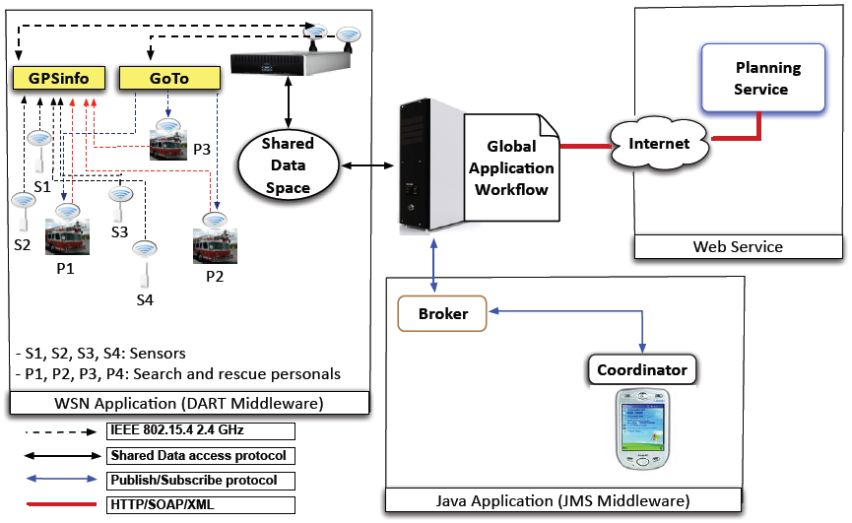
Implemented scenario
Search & Rescue Operations
Applied our coordination middleware to design and execute an application workflow integrating
  A DPWS Web service (CS), a JMS system (PS), and a JavaSpaces system (TS)

Slide 29
Evaluation
Trade-off
  Abstraction of semantics / API simplicity for application workflow design, vs.
  API expressiveness/ preservation of semantics
Extensibility
  Easiness in integrating new middleware platforms

Slide 30
Abstraction vs. expressiveness
Middleware API to GA API simplification
 | DPWS | JMS | JavaSpaces | DPWS+JMS+ JavaSpaces | GA | Simplification
Primitives | 4 | 5 | 8 | 17 | 4 | 76%
Arguments | 3 | 5 | 3 | 11 | 7 | 36%
GA API expressiveness
 | Primitives | Arguments | Optional Features
DPWS | 100% (4/4) | 100% (3/3) | 0% (0/2)
JMS | 83% (5/6) | 62% (5/7) | 0% (0/3)
JavaSpaces | 80% (8/10) | 100% (3/3) | 0% (0/3)

Slide 31
Extensibility
Effort for coordination middleware development
 | PS |  | TS
BPEL EAs (primitives/arguments) | 3 | 7 | 5 | 9
xDLs (XSD elements) | 11 |  | 14
xDL2GADLs (XSLT expressions) | 42 |  | 63
Code templates (LOC) | 1002 |  | 1912
Effort for integrating new middleware platforms
 | JMS | JavaSpaces
Code (new LOC) | 508 (34%) | 311 (14%)

Slide 32
Discussion on our abstraction approach
GA provides an abstract union of the semantics of CS, PS and TS
  After high optimization for identifying common semantics
  By construction, this enables preserving the coordination semantics
  Orchestration well-suited for applying our abstractions
Direct mediation between the heterogeneous coordination models has not yet been tackled
  Will investigate direct mapping between CS, PS and TS semantics based on the GA abstraction

Slide 33
Outline
Introduction to CONNECT
CONNECT Architecture
  From System Discovery to CONNECTor Synthesis
Middleware Interoperability Aspects
  Approach to Middleware Abstraction
  CONNECT Discovery & Demo (by Rachid Saadi)
  Approach to Middleware Synthesis & Demo (by Paul Grace)
Conclusion

Slide 34
Conclusion
CONNECT approach to Emergent Middleware
  Answer to Eternal Interoperability
CONNECT Enabler Architecture
  Focus on Discovery and Synthesis
Question of Middleware Abstraction
  Effective abstraction with preservation of semantics

Slide 35
Thank you!
Questions?

