Slide 1
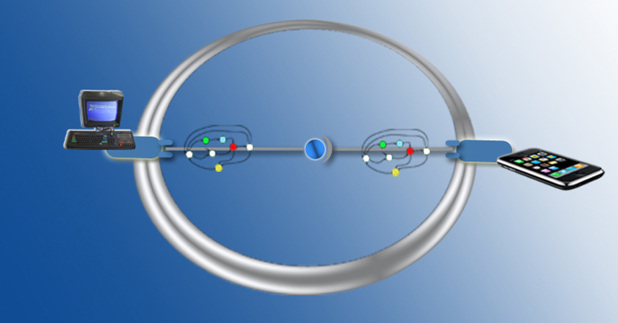
Application-layer Connector Synthesis
Paola Inverardi (paola.inverardi@di.univaq.it)
SFM-11:CONNECT, June 15th 2011
Bertinoro (Italy)

Slide 2
Outline
Introduction
  background notions: protocol, interoperability, etc.
  coordinator concept vs mediator concept
Application-layer Coordinators
  synthesis of centralized coordinators [SCP08]
  synthesis of distributed coordinators [JSS08a]
  synthesis of coordinators for real-time systems [TACAS07]
  synthesis of coordinators for evolving systems [JSS08b]
Application-layer Mediators
  synthesis of emerging mediators for ubiquitous systems [ISOLA10, RSPHDT10, WICSA/ECSA09]
Related Works
Conclusion

Slide 3
Introduction
The Ubiquitous Computing environment is populated by a wide variety of heterogeneous Networked Systems (NSs), dynamically appearing and disappearing
Heterogeneous protocols may be willing to cooperate in order to reach some common goal even though they meet dynamically and do not have a priori knowledge of each other
Challenge: how to automatically achieve the interoperability between heterogeneous protocols in the Ubiquitous Computing environment

Slide 4
Modeling Application-layer Protocols
The term protocol refers to interaction protocols or observable protocols
We consider application-layer protocols (as opposed to middleware-layer protocols)
  behavior of a system in terms of the sequences of messages at the interface level, which it exchanges with other systems
  the notion of protocol abstracts from the content of the exchanged messages, i.e., values of method/operation parameters, return values, etc.
Our focus is on harmonizing the behavioral protocol (e.g., scheduling of operation calls) of heterogeneous NSs rather than performing mediation of communication primitives or of data encoding/decoding (i.e., middleware-layer mediation)

Slide 5
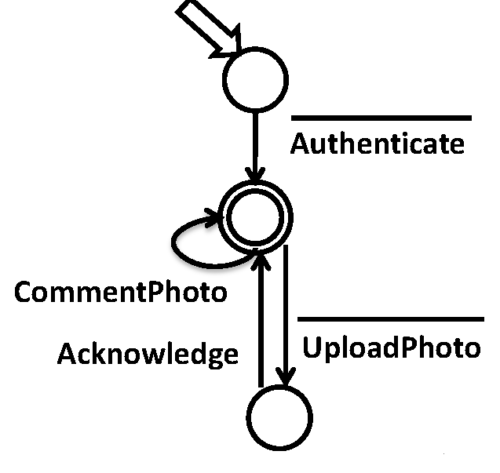
Modeling Application-layer Protocols: an example
By using Labeled Transition Systems (LTSs)
Input actions, e.g., Acknowledge, model
methods that can be called;
receiving messages;
return values.
Output actions, e.g., Authenticate, model
method calls;
message transmission;
exceptions.
A Photo Sharing producer

Slide 6
Interoperability
The ability of heterogeneous protocols to communicate and correctly coordinate to achieve their goal(s)
Communication expressed as synchronization
  two protocols communicate if they are able to synchronize on common actions
  for application-layer protocols, it goes beyond single basic synchronizations and may require a well defined sequence of synchronization to be achieved (a primary from of coordination)
    E.g., sendItems <-> receiveItems (simple case)
      sendItems <-> receiveItem … receiveItem (more complex case)
Coordination expressed as the achievement of a specified goal
  two protocols succeed in coordinating if they interact through synchronization according to the achievement of their goal(s)
Goal usually specified in some automata-based or temporal logic formalism

Slide 7
The Interoperability Problem
It concerns the problem of both enabling communication and achieving correct coordination (w.r.t. the specified goal)
Solution: automatic synthesis of application-layer connectors
Automatic coordinator synthesis (our past research)
  the main focus is on addressing correct coordination by assuming the communication problem already solved
Automatic mediator synthesis (our current research in CONNECT)
  it focuses on the whole interoperability problem, i.e., addressing communication + correct coordination

Slide 8
Coordinator concept
already communicating black-box
components
their interaction may deadlock…
Component 1
Component 3
…or violate a specified desired
behavior
Component 2
desired behavior
specification
solution
Component 1
Component 3
the coordinator is an additional component synthesized so as to intercept all component interactions in order to prevent deadlocks and those interactions that violate the specified desired behavior
Coordinator
Component 2

Slide 9
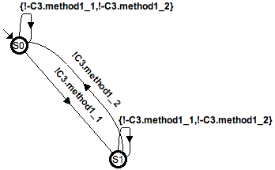
The need for Coordinators: the Shared Resource scenario
AlternatingProtocol desired
behavior specification
Deadlock!
Screenshots from the SYNTHESIS tool. If you are interested on it, attend the lab session…

Slide 10
Mediator concept
In the Ubiquitous Computing (UbiComp) domain, the granularity of a system shifts from the granularity of a system of components (as in the CBSE domain) to the one of a System-of-Systems (SoS)
An SoS is characterized by an assembly of a wide variety of building blocks. Thus, in the UbiComp domain, enabling communication between heterogeneous NSs regardless, at a first stage, possible coordination mismatches, becomes a primary concern
This introduces another specific notion of connector, i.e., the notion of mediator seen as a communication connector

Slide 11
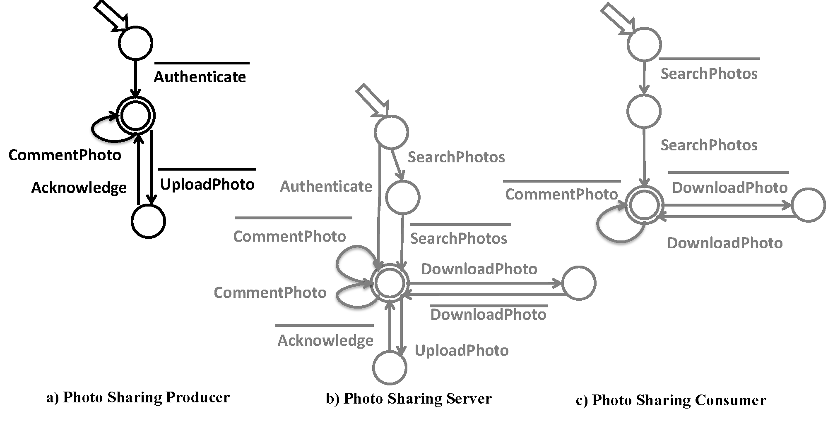
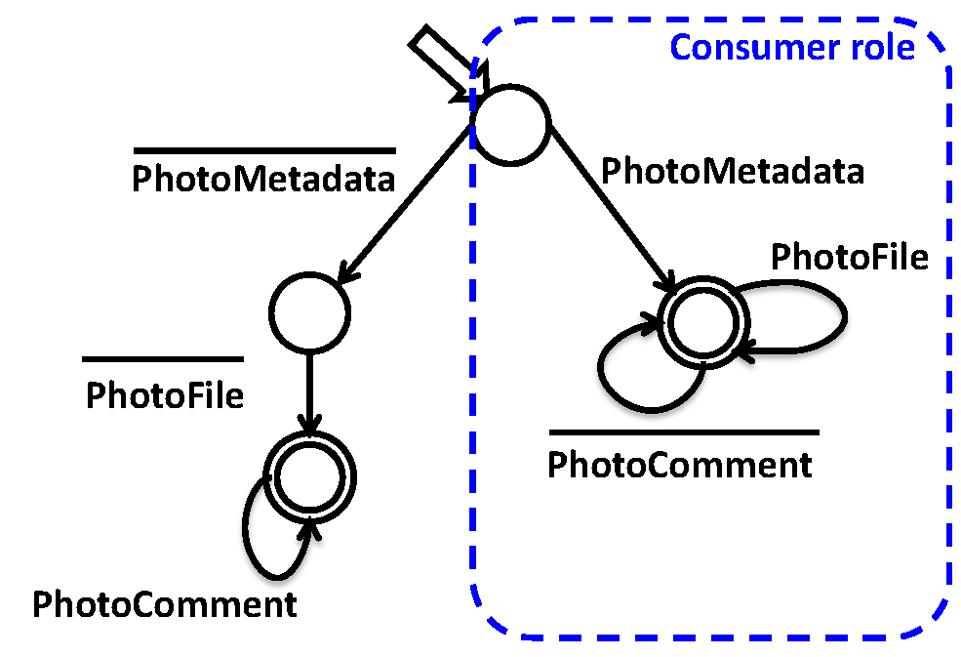
The need for Mediators: the Photo Sharing Scenario
Infrastructure based implementation
Peer-to-peer based implementation

Slide 12
Outline
Introduction
  background notions: protocol, interoperability, etc.
  coordinator concept vs mediator concept
Application-layer Coordinators
  synthesis of centralized coordinators [SCP08]
  synthesis of distributed coordinators [JSS08a]
  synthesis of coordinators for real-time systems [TACAS07]
  synthesis of coordinators for evolving systems [JSS08b]
Application-layer Mediators
  synthesis of emerging mediators for ubiquitous systems [ISOLA10, RSPHDT10, WICSA/ECSA09]
Related Works
Conclusion

Slide 13
Automatic Synthesis of
Failure-Free Coordinators (FFC)
Communication issues are assumed to be already solved
  protocols are already able to synchronize, although deadlocks in their interaction can occur or their interaction could not satisfy specified behavioral properties
A specific instance of the interoperability problem
  given a set of interacting components, C, and a set of behavioral properties, P, automatically derive a deadlock-free assembly, A, of these components which guarantees every property in P, if possible
  A is a composition of the components in C plus a synthesized coordinator
  the coordinator is an additional component that controls the message exchange to prevent possible deadlocks and those interactions violating the properties in P
Four different approaches (following slides)
  centralized coordinator, distributed coordinator, for evolving systems, for real-time systems

Slide 14
Automatic Synthesis of Centralized FFC
– Basic Idea –
A simple software architecture structure which exploits the separation between functional behavior and Integration/Communication behavior.
Extra information at component level: component Assumptions.
Our approach:
  detect software anomalies
  prevent software anomalies
  guarantee given coordination policies (behavioral properties)

Slide 15
Automatic Synthesis of Centralized FFC
– Modeling –
Component behaviour modelled using finite state machines
Integration through parallel composition of component models
In the context of CCS:
  Components: sequence and choice operators
      E.g. Server = call.service.return.Server
  Integration: parallel composition and restriction operators
      E.g. (C₁ | C₂ | ... | C_{n}) / L
Deadlock: (C₁ | C₂ | ... | C_{n}) / L can reach a state where no actions are possible

Slide 16
Automatic Synthesis of Centralized FFC
– Assumptions –
Component requirement on its environment in order to guarantee a property in a specific integration context
In a sense we are enhancing component semantics
In our case we use: “My context never blocks me” or in other words “If I can perform action a, my context must be able to perform action a”
Assumptions modeled in the same way as components

Slide 17
Automatic Synthesis of Centralized FFC
– Background notions (cont’d) –
Coordinator Free Architecture (CFA)
Component 1
Component 2
channel
channel
Component 3
a Coordinator Free Architecture (CFA) is a set of
components directly connected in a synchronous way
in CCS : (C₁ | C₂ | ... | C_{n}) \ U_{i=1..n} Act_{i}

Slide 18
Automatic Synthesis of Centralized FFC
– Background notions –
Coordinator Based Architecture (CBA)
top
Component 1
channel 1
bottom
REQUEST
top
Coordinator
NOTIFICATION
bottom
channel 2
channel 3
top
top
Component 2
Component 3
bottom
bottom
in CCS:
(C₁[f₁] | C₂ [f₂] | ... | C_{n}[f_{n}] | K) \U _{i=1..n} Act_{i}[f_{i}]
K is the synthesized connector, f_{i} a suitable relabeling function

Slide 19
Automatic Synthesis of Centralized FFC
– Component Local Views –
How to model all the local views from the component
perspective?
msg1
msg2
AC-Graph: the inner knowledge
msg3
Knowing the composition mechanism and the property
AS-Graph: assumptions on the environment
msg1
msg2
Knowing the characteristics of the coordinator
msg3
msg1?
msg1_{C}
msg2_{C}
msg2?
EX-Graph: assumptions on the coordinator
msg3?
msg3_{C}

Slide 20
Automatic Synthesis of Centralized FFC
– Component Local Views Unification –
is based on a
usual first-order
unification algorithm
C1
C2
Coordinator
C3
msg2_{C1}
msg2_{C2}
msg2?
msg1_{C1}
msg1_{C2}
msg1?
msg1?
msg1?
msg1_{C3}
msg2?
msg2?
msg2_{C3}
coordinator
graph obtained
by the unification
of the EX-Graphs
msg1_{C1}
msg1_{C3}
msg2_{C1}
msg2_{C3}
msg1_{C2}
msg2_{C2}
msg1_{C3}

Slide 21
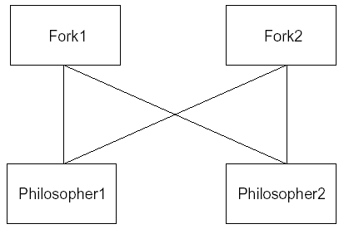
Automatic Synthesis of Centralized FFC
– Deadlock Freedom: an example –
Dining Philosophers Problem:
Assigning a deadlock-free
routing policy to the coordinator
it is possible avoids the deadlock
scenario.
Table
Deadlock Scenario:
Table
component Philosopher1 requests and gets the resource of component Fork1;
component Philosopher2 requests and gets the resource of component Fork2;
component Philosopher1 requests and waits for the resource of component Fork2;
component Philosopher2 requests and waits for the resource of component Fork1;
Coordinator
Coordinator Free Architectural View
Coordinator Based Architectural View

Slide 22
Automatic Synthesis of Centralized FFC
– 3-step method –
Coordinator Free Architecture
Component 1
Component 3
Component 2
local views of each component
Component 1
Component 3
Component 1
Component 1
Component 3
Component 3
Coordinator code
(assembly code)
Coordination policy
deadlock-freeness
Failure-free Coordinator
Deadlock-free Coordinator
(no-op) Coordinator
Component 2
Component 2
Component 2
Deadlock-free Coordinator Based Architecture
Failure-free Coordinator Based Architecture
Coordinator Based Architecture

Slide 23
Automatic Synthesis of Centralized FFC
– running example: inputs –
CFA
P
C1 and C2 has to interact by
following an Alternating Interaction
Protocol
C

Slide 24
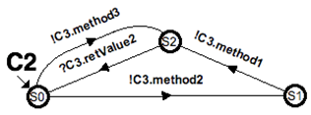
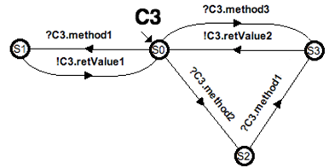

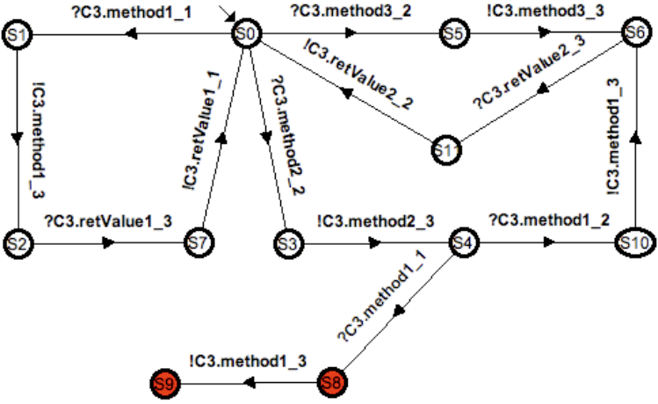
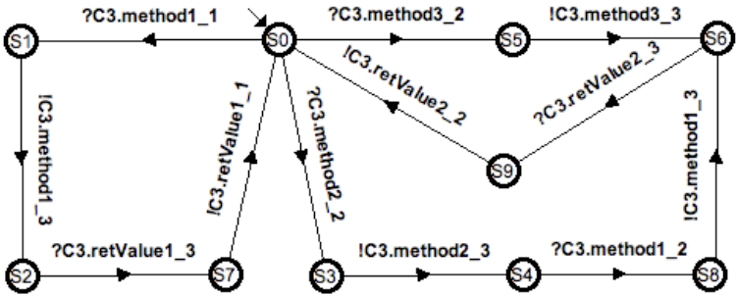
Automatic Synthesis of Centralized FFC
– running example: enforcing deadlock freedom –
Deadlock-free Coordinator
No-op Coordinator

Slide 25
Automatic Synthesis of Centralized FFC
– running example: enforcing failure-freeness –
- The Failure-free Coordinator is a refinement
of the deadlock-free one that obeys the
alternating protocol specified by P
It is obtained by performing a suitable notion
of synchronous product between P and the
deadlock-free coordinator

Slide 26
Automatic Synthesis of Centralized FFC
– running example: FFC’s code synthesis –
class K : public IC3 {
// stores the current state of the coordinator
private static int sLbl;
// stores the current state of the
// property automaton
private static int pState;
// stores the number of clients
private static int clientsCounter = 0;
// channel's number of a client
private int chId;
// COM smart pointer; is a reference to
// the inner C3 object
private static C3* c3Obj;
...
// the constructor
K() {
sLbl = 0;
pState = 0;
clientsCounter++;
chId = clientsCounter;
c3Obj = new C3();
...
}
HRESULT method1(S_DA da) {
if(sLbl == 0) {
if((chId == 1) && (pState == 0)) {
pState = 1; sLbl = 9;
return c3Obj->method1(da);
}
}
… /* other if-statements for each
FFC state in which it is possible
to perform method1 */ …
return E_Handle;
}
These interfaces export
three services:
- method1 (affected by the policy)
method2 (affected by the policy)
method3 (a simple delegation)
By visiting the LTS modeling the FFC protocol, the actual code implementing the coordinator component is automatically derived
  C++ implementation for COM/DCOM component-based systems (centralized FFC) – in this example…
  AspectJ implementation for J2EE applications, i.e., EJB component-based systems (distributed FFC) – in the following slides…
(k0,p0)
?C3.method1_1
C1
!C3.method1_3
C3
C2
?C3.retValue1_3
!C3.retValue1_1
COORDINATOR COMPONENT
(k9,p1)

Slide 27
Outline
Introduction
  background notions: protocol, interoperability, etc.
  coordinator concept vs mediator concept
Application-layer Coordinators
  synthesis of centralized coordinators [SCP08]
  synthesis of distributed coordinators [JSS08a]
  synthesis of coordinators for real-time systems [TACAS07]
  synthesis of coordinators for evolving systems [JSS08b]
Application-layer Mediators
  synthesis of emerging mediators for ubiquitous systems [ISOLA10, RSPHDT10, WICSA/ECSA09]
Related Works
Conclusion and Future Perspectives

Slide 28
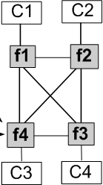
Automatic Synthesis of Distributed FFC
– the reference architectural style –
black-box
components
standard communication
additional communication
synchronous
channels
f1
f2
Distributed CBA
coordination
wrappers
f3
f4
asynchronous
channels
a demo for this approach, and related SYNTHESIS tool,
will be given during the lab session…

Slide 29
Automatic Synthesis of Distributed FFC
– first step of the method –
Coordinator-Free Architecture (CFA)
Centralized Coordinator-Based Architecture (Centralized CBA)
C1
C2
Centralized Coordinator
C3
C4
based on the previous approach

Slide 30
Automatic Synthesis of Distributed FFC
– second step of the method –
Centralized CBA
C1
C2
1) Deadlock-freedom analysis
Centralized Coordinator (LTS)
2) Desired behavior analysis
C3
C4
Desired behavior
specification:
LTS-based notation

Slide 31
Automatic Synthesis of Distributed FFC
– second step of the method –
Distributed CBA
Distributed Coordinator
(i.e., set of wrappers)
Deadlock free
Desired behavior satisfying
(automatically distributed by Synthesis)
C1
C2
W1
W2
Centralized Coordinator
W3
W4
C3
C4

Slide 32
Automatic Synthesis of Distributed FFC
– summing up –
C1
C2
C1
C2
C3
C4
C3
C4
C1
C2
W1
W2
W3
W4
C3
C4

Slide 33


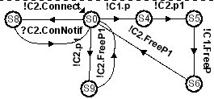
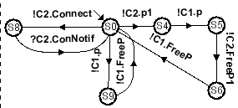
Automatic Synthesis of Distributed FFC
– running example: inputs –
C1 C2
C3 C4
A possible deadlock can occur if both C3 and C4 perform the action at the right of the initial state s0
P
C3 cannot
access resource
C2 without
performing
authentication, first

Slide 34
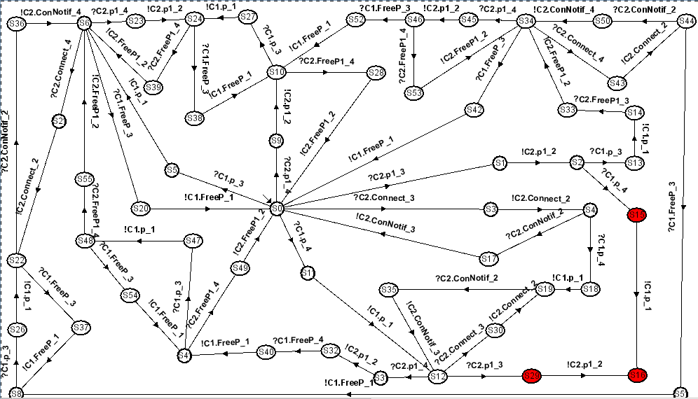
Automatic Synthesis of Distributed FFC
– running example: no-op centralized coordinator –
Red nodes represent possible occurring deadlocks

Slide 35
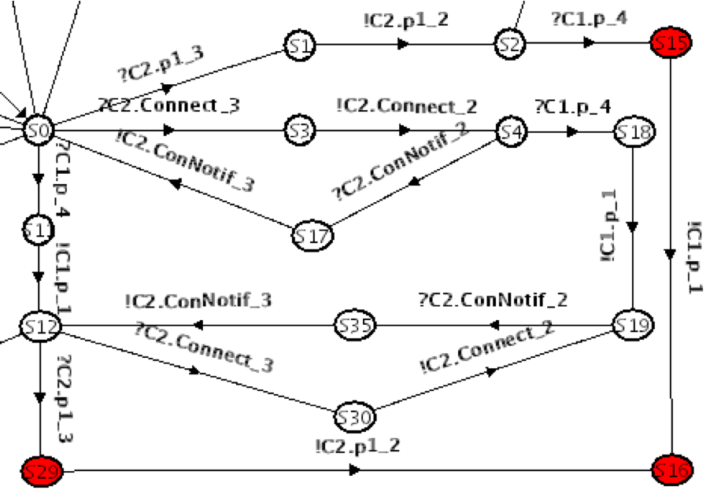
Automatic Synthesis of Distributed FFC
– running example: Last Chance (LC) states elicitation –
when C3 is willing to
perform action p1, its
wrapper, FC3, must
ask permission to the
other wrappers in order to
discover whether the
global state is different from
S12 (C3 is allowed to perform
p1) or not (C3 is not allowed
to perform p1)
E.g., S12 = <S3,S0,S0,S9>,
FC3 will ask to FC1, FC2, and
FC3, if their supervised
components are in, or will
reach, the states S3, S0, and
S9, respectively

Slide 36
Automatic Synthesis of Distributed FFC
– running example: Updating and Allowed (UA) actions elicitation –
each wrapper knows
what are the property
states from which it is
allowed to perform some
action, which action, and
the related target states

Slide 37
Automatic Synthesis of Distributed FFC
– pseudo-code for the implementation of the wrappers –
A wrapper F_{C} establishes when its controlled component C can move (by cooperating with the other wrappers F_{H}):
  The component C must be active (with respect to P)
  Before moving by means of action a, F_{C} checks in F_{C}^{LC} if a is an action that can lead to forbidden states
    If it is, F_{C} has to ask the permission to the other component wrappers before performing a
    If not, F_{C} allows C to perform a without asking anything
  If C is allowed to perform action a, F_{C} has to check in F_{C}^{UA} whether a makes P change its state or not
    If it does, F_{C} has to send a block message to all the wrappers whose supervised component cannot move (with respect to P) and an unblock message to all the ones whose supervised component was blocked, but now can move because of the new state of P
  When F_{C} asked, to some F_{H}, for the permission of performing an action
    F_{H} answer to F_{C} whenever F_{H} is in, or will reach, a state different from the one for which F_{H} has been enquired by F_{C}
    otherwise, F_{H} does not answer hence attempting to block F_{C}

Slide 38
Automatic Synthesis of Distributed FFC
– running example: wrappers’ AspectJ code synthesis –
for each action, a pointcut is defined in order to intercept the corresponding method call
for each action, an advice after() is defined in order to update the current local state (i.e., state), the property state (i.e., ps), and to inform all the other wrappers of the updated current local state (i.e., Notify())
For instance, the wrapper for C3 (i.e., for Client1) is an
Aspect instrumenting the .class of C3 as follows:
e.g.,
after() returning (int res) : Connect_action() {
if((state.intValue() == 0) && (res != -1)) state = new Integer(0);
if((ps.read() == 0) && (res != -1)) ps.write(1);
Notify();
}
e.g., pointcut Connect_action() : call(int Server2.Connect(..));

Slide 39
Automatic Synthesis of Distributed FFC
– running example: wrappers’ AspectJ code synthesis –
an advice around() is used to enforce the specified desired behavior, it is defined for any component action that is a negative action on the property automaton
for each action a stored into the last chance states table, an advice before() is defined in order to eventually unblock possible wrappers still waiting for the permission to proceed and, in turn, ask for the permission to proceed on a
e.g.,
int around() : FreeP1_action() {
if((ps.read() == 0)) { return -1; }
return proceed();
}
e.g.,
int around() : p1_action() {
if((ps.read() == 0)) { return -1; }
return proceed();
}
e.g.,
before() : p1_action() {
Notify();
AmIAllowed();
}

Slide 40
Outline
Introduction
  background notions: protocol, interoperability, etc.
  coordinator concept vs mediator concept
Application-layer Coordinators
  synthesis of centralized coordinators [SCP08]
  synthesis of distributed coordinators [JSS08a]
  synthesis of coordinators for real-time systems [TACAS07]
  synthesis of coordinators for evolving systems [JSS08b]
Application-layer Mediators
  synthesis of emerging mediators for ubiquitous systems [ISOLA10, RSPHDT10, WICSA/ECSA09]
Related Works
Conclusion and Future Perspectives

Slide 41
Automatic Synthesis of FFC for Real-Time Systems
– aims –
Propose a lightweight component model
  to express real-time interaction properties
Develop a method to check incompatibilities between components (due to timing and/or protocol mismatch) and to produce FFC incrementally
Implement this method inside a tool chain

Slide 42
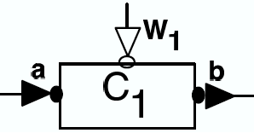
Automatic Synthesis of FFC for Real-Time Systems
– component model –
A component has input ports (a), output ports (b), and one clock port (w1)
Interaction between two connected components is synchronous
  reading and writing operations are blocking
The clock port is a special input port (modeled as an element of {0,1}) that tells whether the component is enabled (1) or disabled (0)
  connected at the instantiation to a periodic clock

Slide 43
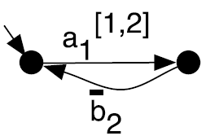
Automatic Synthesis of FFC for Real-Time Systems
– component interaction protocol –
The interaction protocol is specified as a LTS with actions of the form: x_{l}^{{u}[i,j]}
action label (a is a read / b is a write) x_{l}^{{u}[i,j]}
  controllability tag
  duration (local time units)
  latency (global time units)
The component is instantiated with a periodic clock (e.g. (10)); when disabled it can only let the global time elapse, when enabled it can also perform an action

Slide 44
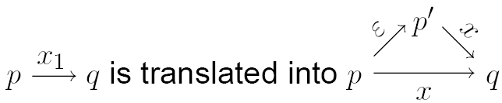
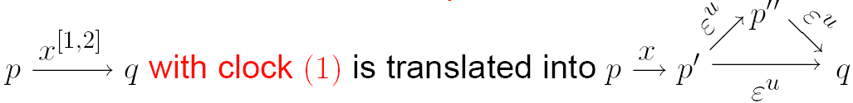
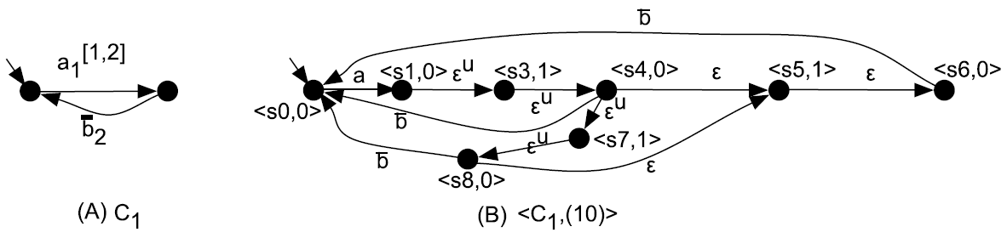
Automatic Synthesis of FFC for Real-Time Systems
– component semantics –
Latency is a QoS requirement
Duration is a constraint of the execution platform
each state is labeled with
the global time instant
modulo the periodic
clock’s length (e.g.,<s4,0>
and <s5,1>)

Slide 45
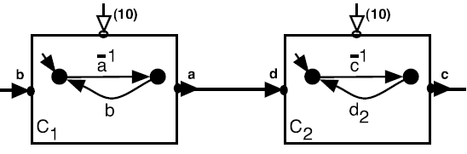
Automatic Synthesis of FFC for Real-Time Systems
– an example –
Assembly put together components and specify ports renaming
Here, the interaction protocols do not match
Proposal: to generate automatically a correct-by-construction and bounded coordinator in order to solve protocol/latency/duration/clock inconsistencies

Slide 46
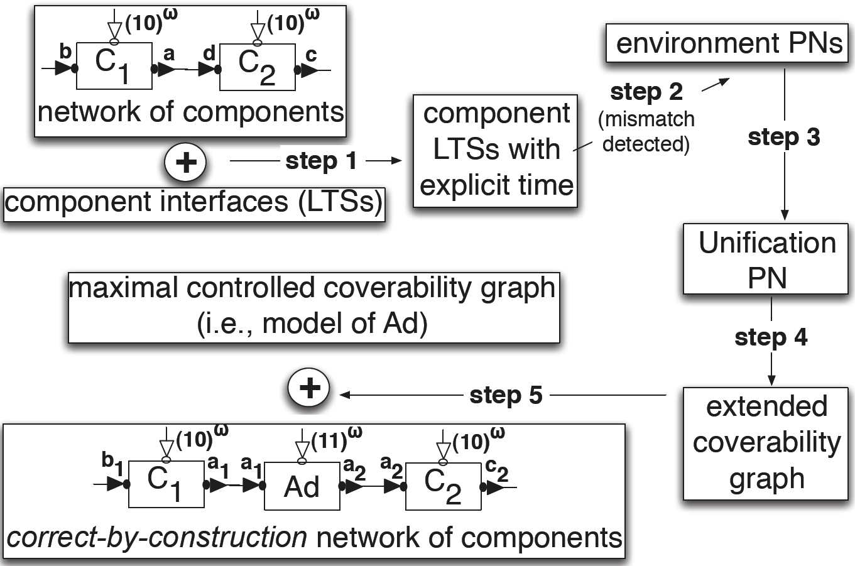
Automatic Synthesis of FFC for Real-Time Systems
– method overview –

Slide 47
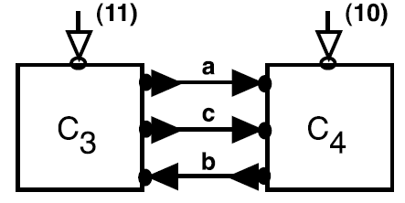
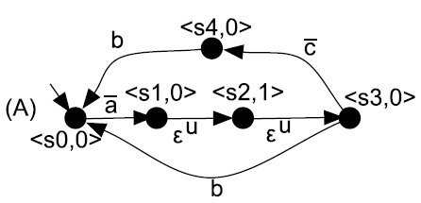
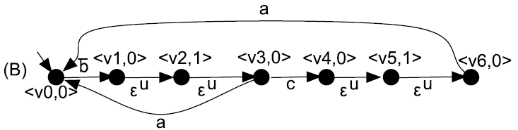
Automatic Synthesis of FFC for Real-Time Systems
– running example –
Semantics LTS of <C3,(11)>
Semantics LTS of <C4,(10)>

Slide 48
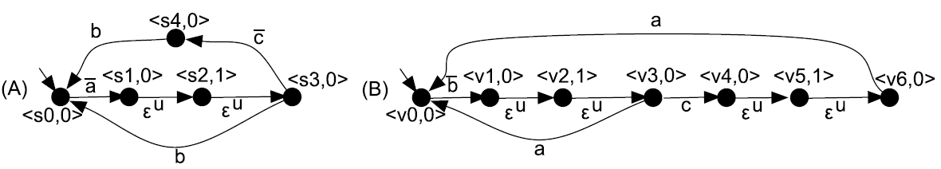
Automatic Synthesis of FFC for Real-Time Systems
– running example: mismatch detection –
We compute the synchronous parallel composition of the LTSs
Deadlocks are sink states in this parallel composition
We use CADP to detect such sink states
In the example, the initial state of the synchronous product is a sink state:

Slide 49
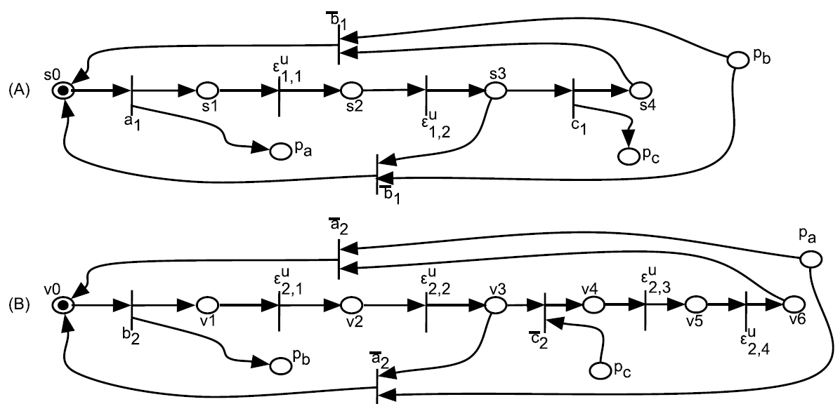
Automatic Synthesis of FFC for Real-Time Systems
– running example: component’s expectation –
For each component, we compute one Petri Net (PN) modeling what the component expects from its environment (i.e., the other components plus the environment)

Slide 50
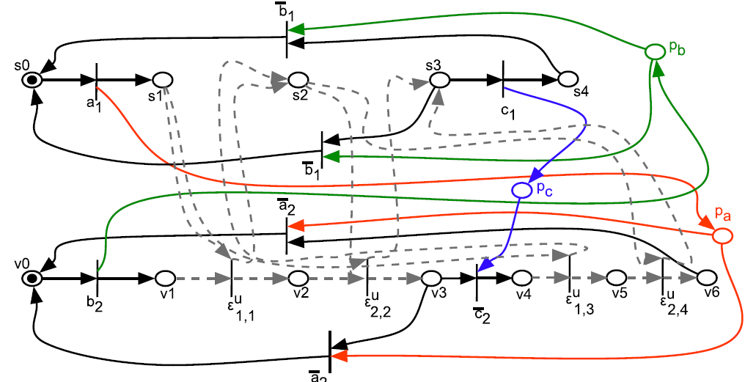
Automatic Synthesis of FFC for Real-Time Systems
– running example: unification PN –
We build the causal dependencies (read/write) by unifying the pending places
And we compose synchronously the time-elapsing transitions (only the firable ones are shown)

Slide 51
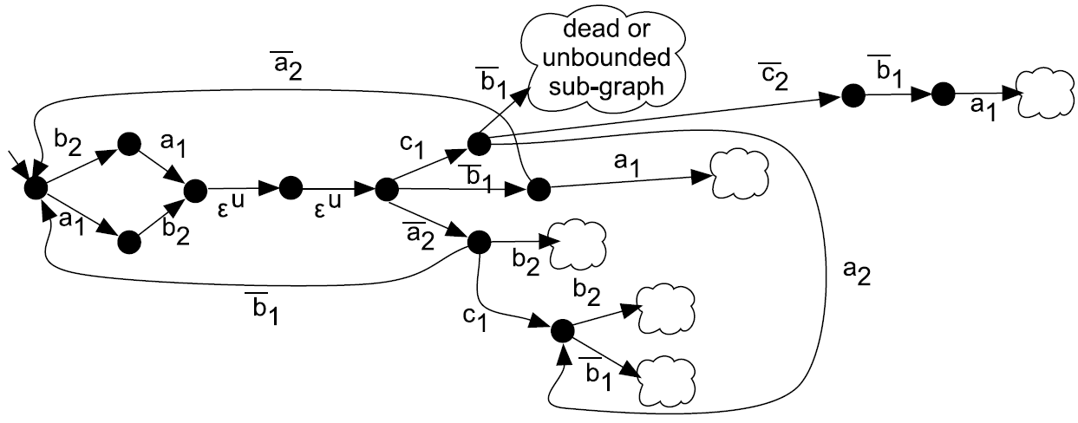
Automatic Synthesis of FFC for Real-Time Systems
– running example: extended coverability graph –
Each node is a new marking of the unification PN
The “cloud-nodes” represent parts of the graph that contain only dead nodes or nodes with infinite markings

Slide 52
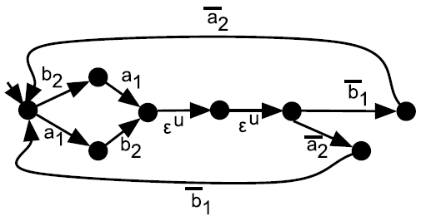
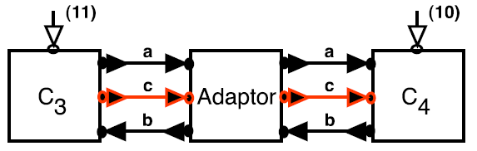
Automatic Synthesis of FFC for Real-Time Systems
– running example: controlled coverability graph –
We prune the transitions that lead inevitably to cloud-nodes and that are controllable:
This is the correct by construction and bounded adaptor to be put between C3 and C4:

Slide 53
Automatic Synthesis of FFC for Real-Time Systems
– tool chain –
CADP
SynthesisRT
SynthesisRT
SynthesisRT
TINA

Slide 54
Outline
Introduction
  background notions: protocol, interoperability, etc.
  coordinator concept vs mediator concept
Application-layer Coordinators
  synthesis of centralized coordinators [SCP08]
  synthesis of distributed coordinators [JSS08a]
  synthesis of coordinators for real-time systems [TACAS07]
  synthesis of coordinators for evolving systems [JSS08b]
Application-layer Mediators
  synthesis of emerging mediators for ubiquitous systems [ISOLA10, RSPHDT10, WICSA/ECSA09]
Related Works
Conclusion and Future Perspectives

Slide 55
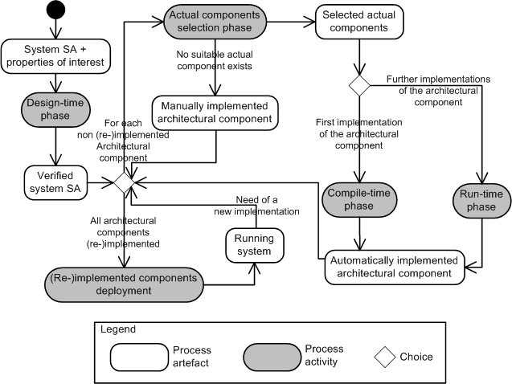
Automatic Synthesis of FFC for
Evolving Systems
FFC synthesis is used to
automatically produce an
assembly of Off-The-Shelf
components that
implements a specified
and verified architectural
component, both at
compile- and run-time

Slide 56
Outline
Introduction
  background notions: protocol, interoperability, etc.
  coordinator concept vs mediator concept
Application-layer Coordinators
  synthesis of centralized coordinators [SCP08]
  synthesis of distributed coordinators [JSS08a]
  synthesis of coordinators for evolving systems [JSS08b]
  synthesis of coordinators for real-time systems [TACAS07]
Application-layer Mediators
  synthesis of emerging mediators for ubiquitous systems [ISOLA10, RSPHDT10, WICSA/ECSA09]
Related Works
Conclusion and Future Perspectives

Slide 57
Automatic Synthesis of Mediators
Problem: interoperability between heterogeneous protocols within the ubiquitous computing environment
Goal: to find an automated solution to solve the problem
Compatible or functionally matching protocols: protocols that can potentially communicate by performing complementary sequences of actions
  “Communication” through (at least one) complementary sequences of actions, i.e., trace
  “Potentially” because of heterogeneities that can be mediated , i.e. mismatches (e.g. languages, third parties sequences of actions, ...)
Interoperability: ability of heterogeneous protocols that functionally match to communicate and coordinate, i.e., synchronize to reach their goal(s)

Slide 58
Proposed Solution
A theory to automatically elicit and synthesize a mediator that allows the protocols to interoperate by solving their behavioral mismatches
Mediator: protocol that allows the communication among compatible protocols by mediating their differences

Slide 59
The Theory of Mediators
P
M
(mediator)
Q
Protocols
mapsP
mapsQ
O_{Q}
Ontologies
O_{P}
O_{PQ}
A_{P}
A_{Q}
Abstracted protocols
Inf_{P}
Inf_{Q}
Abstraction information
Matching information
I_{M}
Common abstracted protocol
U E
I_{PQ}

Slide 60
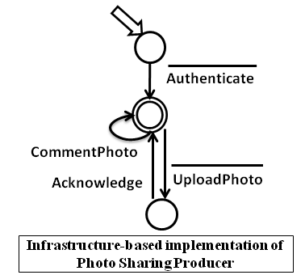
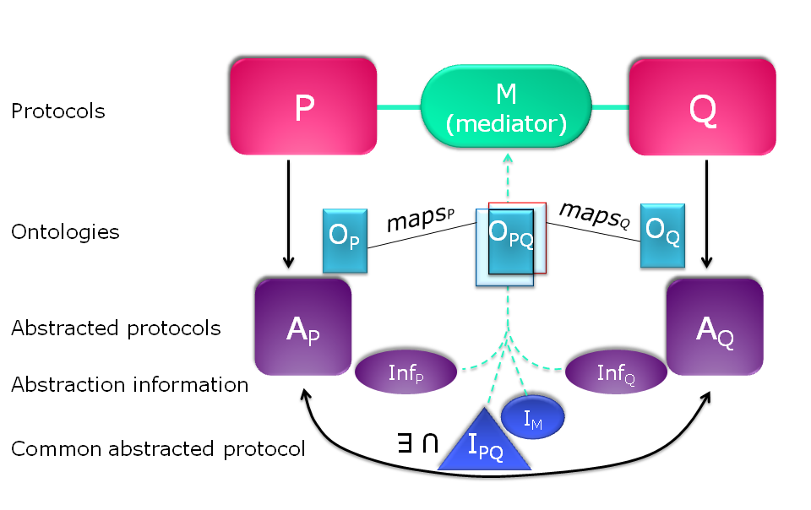
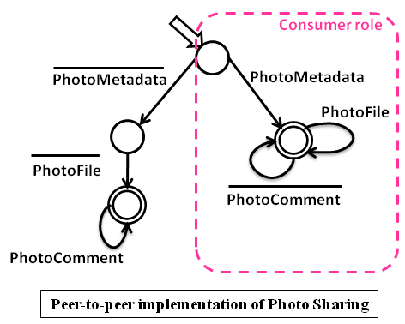
The Theory of Mediators
Protocols as Labelled Transition Systems (LTSs)
Initial state + final state define the coordination policies (traces)

Slide 61
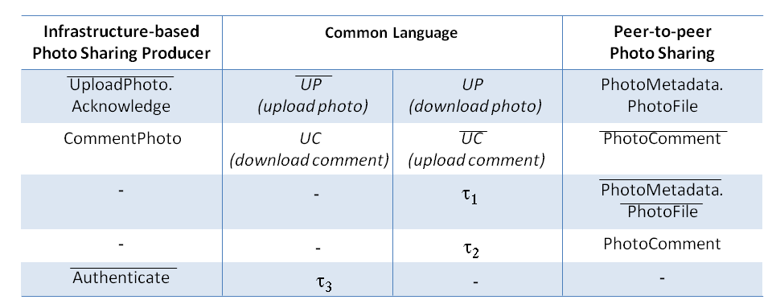
The Theory of Mediators
Ontologies describing:
  the semantics of the protocols actions
  the common language
  taus for third parties communications

Slide 62
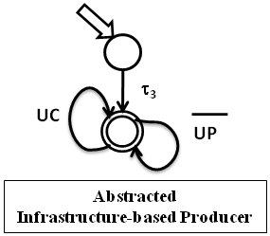
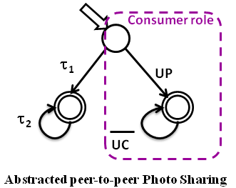
The Theory of Mediators
Abstraction:
  relabeling of protocols with common language and taus

Slide 63
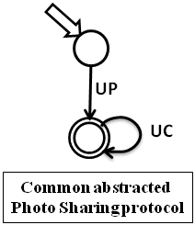
The Theory of Mediators
Compatibility or Functional matching:
  complementary traces modulo mismatches and third parties communications
Successful matching:
  a mediator exists and
  it can be automatically synthesized

Slide 64
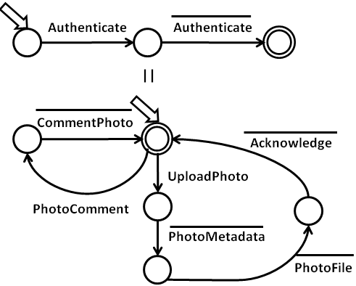
The Theory of Mediators
Mapping
  mediator synthesis
The mediator enables protocols interoperability, i.e., communication and coordination (under fairness assumption)

Slide 65
Outline
Introduction
  background notions: protocol, interoperability, etc.
  coordinator concept vs mediator concept
Application-layer Coordinators
  synthesis of centralized coordinators [SCP08]
  synthesis of distributed coordinators [JSS08a]
  synthesis of coordinators for evolving systems [JSS08b]
  synthesis of coordinators for real-time systems [TACAS07]
Application-layer Mediators
  synthesis of emerging mediators for ubiquitous systems [ISOLA10, RSPHDT10, WICSA/ECSA09]
Related Works
Conclusion and Future Perspectives

Slide 66
Related Works
Interoperability and automated synthesis of mediators and coordinators have been the focus of extensive studies within different research communities. Examples:
  schedulers synthesis, supervisory control, discrete controller synthesis
  model checking & reachability analysis & automatic assumption generation
  adaptors theories, theories of connectors, component adaptation
  protocol conversion, Web services mediation, wrappers, bridges
  …
  (see the paper for an extensive description)

Slide 67
Conclusion…
Rigorous techniques for the automatic synthesis of mediators between networked systems protocols that meet dynamically and need to interoperate without a priori knowledge of each other
  emphasis on “the elicitation of a way to achieve communication“
Contributions:
  a theory of emerging mediating connectors including supporting automated model-based techniques and tools. The theory rigorously characterizes:
    application layer protocols
    their abstraction
    the conditions under which two protocols are functionally matching
    the notion of interoperability between protocols based functional matching
    the mapping, i.e., the synthesis of the mediator behavior needed to achieve protocol inteoperability under functional matching

Slide 68
Conclusion…
Other contributions:
  design of a comprehensive mediator synthesis process
  a set of mediator patterns to tackle in a systematic way the protocol mediation and to characterize the protocol mismatches
  combined approach including the theory and a monitoring system towards taking into account also non-functional properties

Slide 69
…and Future Perspectives
We plan to:
  implement the theory algorithms in order to automatize the mediator generation
  study run-time techniques towards efficient synthesis
  scale the synthesis process
    the abstraction step is a first attempt
  extend the validation of the theory
  translate the synthesized connector model into an executable artefact that can be deployed and run in the network
  ensure dependability taking into account both functional and non-functional interoperability during the synthesis process
  relax assumptions, towards a dynamic environment, and manage the consequent uncertainty

Slide 70
…and Future Perspectives
we also plan to:
  integrate with complementary works ongoing within the CONNECT project so as to develop an overall framework enabling the dynamic synthesis of emergent connectors among networked systems:
    (i) learning techniques to dynamically discover the protocols (instead of assuming them given) that are run in the environment
    (ii) data-level interoperability (instead of assuming the ontology given) to elicit the data mappings. This may rise the problem of dealing with partial or erroneous specifications

Slide 71
Bibliography
[SCP08] M. Tivoli and P. Inverardi, Failure-free coordinators synthesis for component-based architectures (2008), in: Science of Computer Programming, 71:3(181-212)
[JSS08a] M. Autili, L. Mostarda, A. Navarra and M. Tivoli, Synthesis of decentralized and concurrent adaptors for correctly assembling distributed component-based systems (2008), in: Journal of Systems and Software, 81:12(2210-2236)
[JSS08b] P. Pelliccione, M. Tivoli, A. Bucchiarone and A. Polini, An architectural approach to the correct and automatic assembly of evolving component-based systems (2008), in: Journal of Systems and Software, 81:12(2237-2251)
[TACAS07] M. Tivoli, P. Fradet, A. Girault and G. Goessler, Adaptor Synthesis for Real-Time Components, in: TACAS, pages 185-200, Springer, 2007
[ISOLA10] Inverardi, P., Issarny, V., Spalazzese, R.. A theory of mediators for eternal connectors. In ISoLA 2010, Part II. LNCS, vol. 6416, pp. 236-250. Springer, Heidelberg, 2010
[RSPHDT10] R. Spalazzese. A Theory of Mediating Connectors to achieve Interoperability. PhD thesis, University of L'Aquila, April 2011
[WICSA/ECSA09] Spalazzese R., Inverardi P., Issarny V..Towards a Formalization of Mediating Connectors for on the Fly Interoperability. In Proceedings of WICSA/ECSA 09. pages 345-348, 2009

Slide 72
Thank you !
Questions ?

