Slide 1
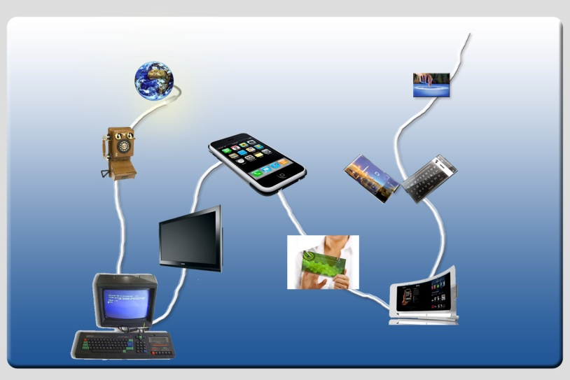
Middleware-layer Connector Synthesis:
Beyond State of the Art in Middleware Interoperability
Valérie Issarny, INRIA
Joint work with A. Bennaceur, D. Bromberg
And colleagues from FP7 ICT FET CONNECT project

Slide 2





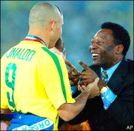

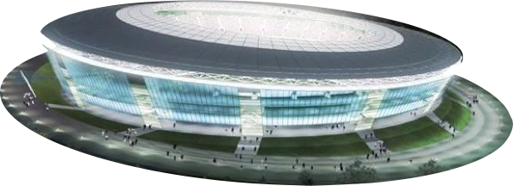







Composing Systems in
Today’s Pervasive Networks
The Simple Yet Challenging Photo Sharing Scenario
Discovery protocol interoperability
Interaction protocol interoperability
Data interoperability
Application interoperability
Interoperability of non-functional properties
Any peer around?
Is it a jpg file?
Am I allowed to forward those pictures?
May I get all the related pictures?
How may I get the picture?
See Lecture by Gordon Blair on
Interoperability in Complex Distributed Systems

Slide 3
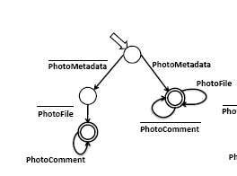
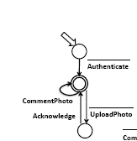
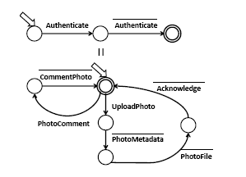
Mediation to
Make Systems Interoperable
P2P Photo Sharing
C/S-based Producer
Mediation that actually bridges the
Application (Different protocols for accessing photo files)
&
Middleware (Different interaction paradigms)
Layers
See Lecture by Paola Inverardi on
Application-layer Connector Synthesis

Slide 4
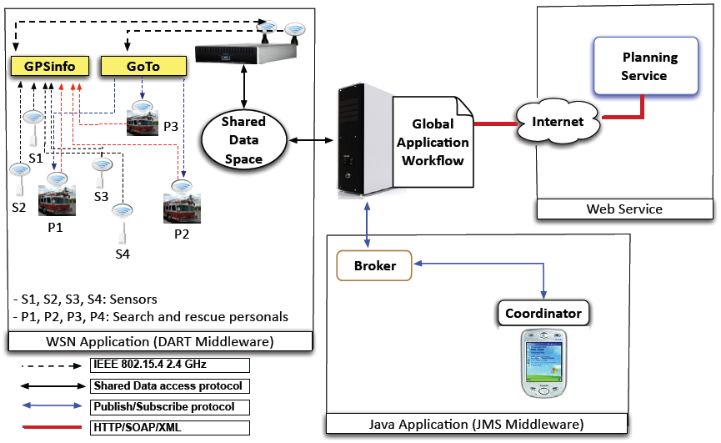
Mediation Must Span All Layers
Yet Another Scenario: Search & Rescue Operations
Constituent systems heterogeneity in coordination models, communication protocols, data representation models (middleware platforms)
Most common coordination models: client/server, pub/sub, tuple space
See Lecture by Nikolaos Georgantas on
CONNECT Architecture

Slide 5
The Holy Grail Middleware
Application
Middleware
Middleware
Application
Peer
Peer
Middleware as a solution to interoperability in the heterogeneous distributed system world
  Common reference abstractions for developers
  E.g., SOAP, CORBA, JMS, …

Slide 6
But…
Application
Middleware
Middleware
Application
Peer
Peer
Middleware is yet another source of heterogeneity
  From standard to proprietary solutions (OMG, M/S, Java, WS, …)
And distributed systems are increasingly heterogeneous
  From closed networks to Internet, mobile, ubiquitous, cloud, grid, tiny-scale, … computing
Middleware is in crisis

Slide 7














Time to Re-think Middleware
Universal instant messaging
Today’s middleware fails to achieve interoperability
  Pervasive networked systems offering matching functionalities,
  but implementing highly heterogeneous protocols from application down
  to middleware layer
Need for on-the-fly interoperability
  Pervasive networked systems meet on the fly
Emergent middleware as a result of protocol composition
  Dynamic synthesis of mediation protocols
Fully Distributed LIME
Photo Sharing
×
Centralized SOAP
Photo Sharing
Photo sharing in a stadium

Slide 8
Outline
Middleware-based connectors
Formalizing middleware-based connectors
Revisiting interoperability connectors
Emergent connector synthesis
Emergent connector in practice
Conclusion

Slide 9
A Classification of Connector
Heterogeneous
interaction
paradigms
Transfer of
data and
control
Conversion
service
Ease Interaction
See. R. N. Taylor et al.
Software Architecture: Foundations, Theory & Practice - Wiley

Slide 10
Middleware-based Connector
Heterogeneous
Middleware
Supporting
Middleware
Built-in
Mediation
Discovery &
Routing
NFP
Enforcement
See R. N. Taylor et al.
Software Architecture: Foundations, Theory & Practice - Wiley

Slide 11
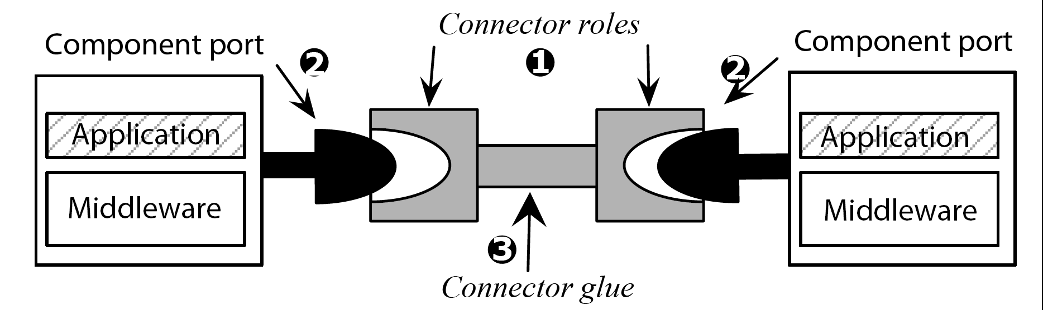
Connecting Systems

Slide 12
Connecting Systems

Slide 13
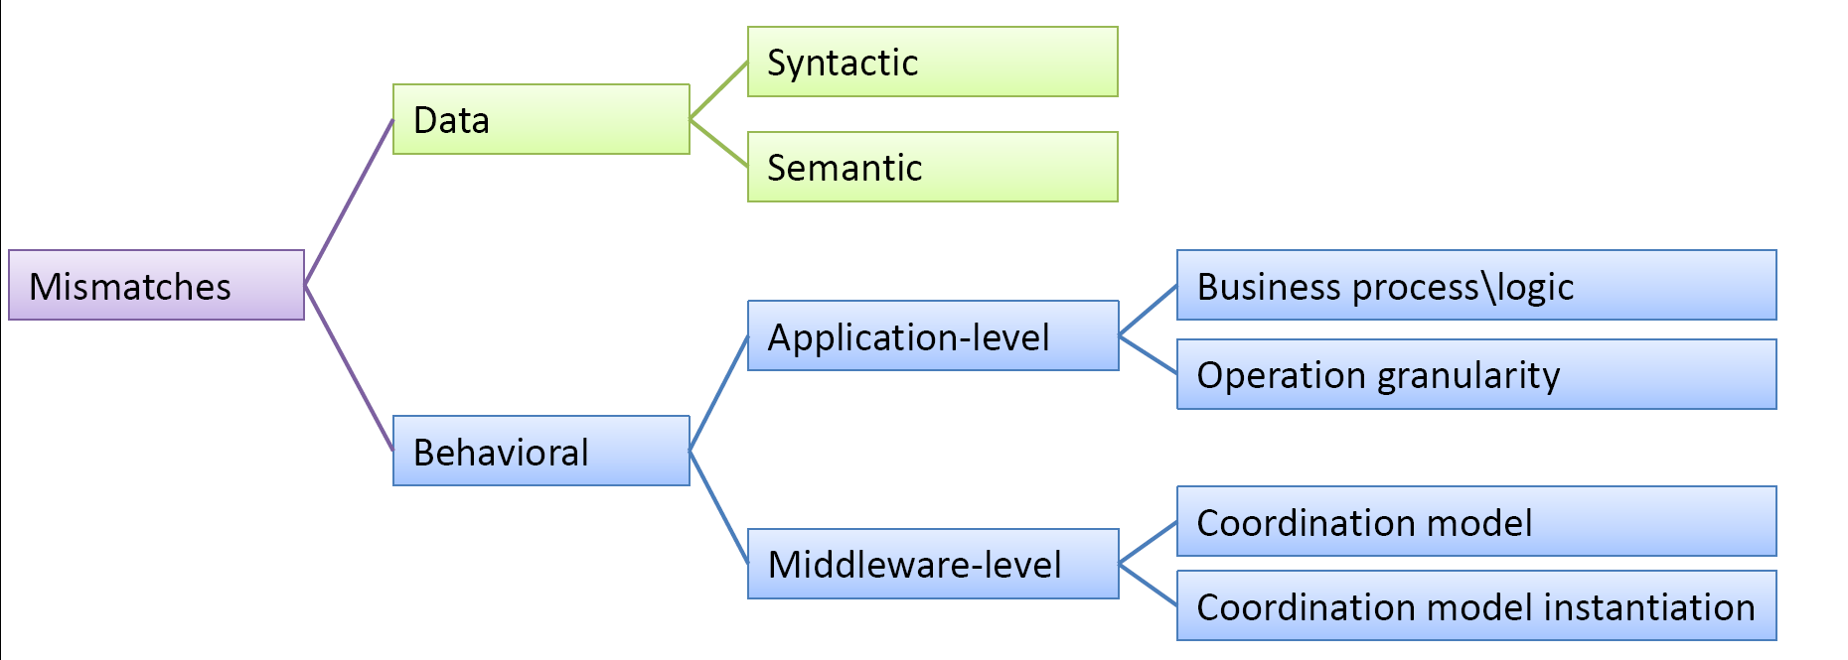
Classifying Connection Mismatches

Slide 14
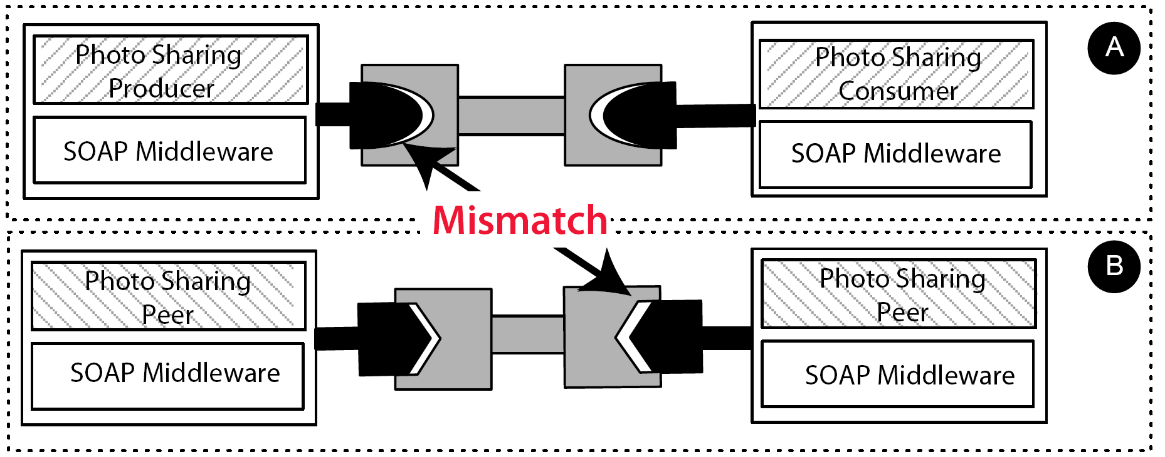
Application Mismatches

Slide 15
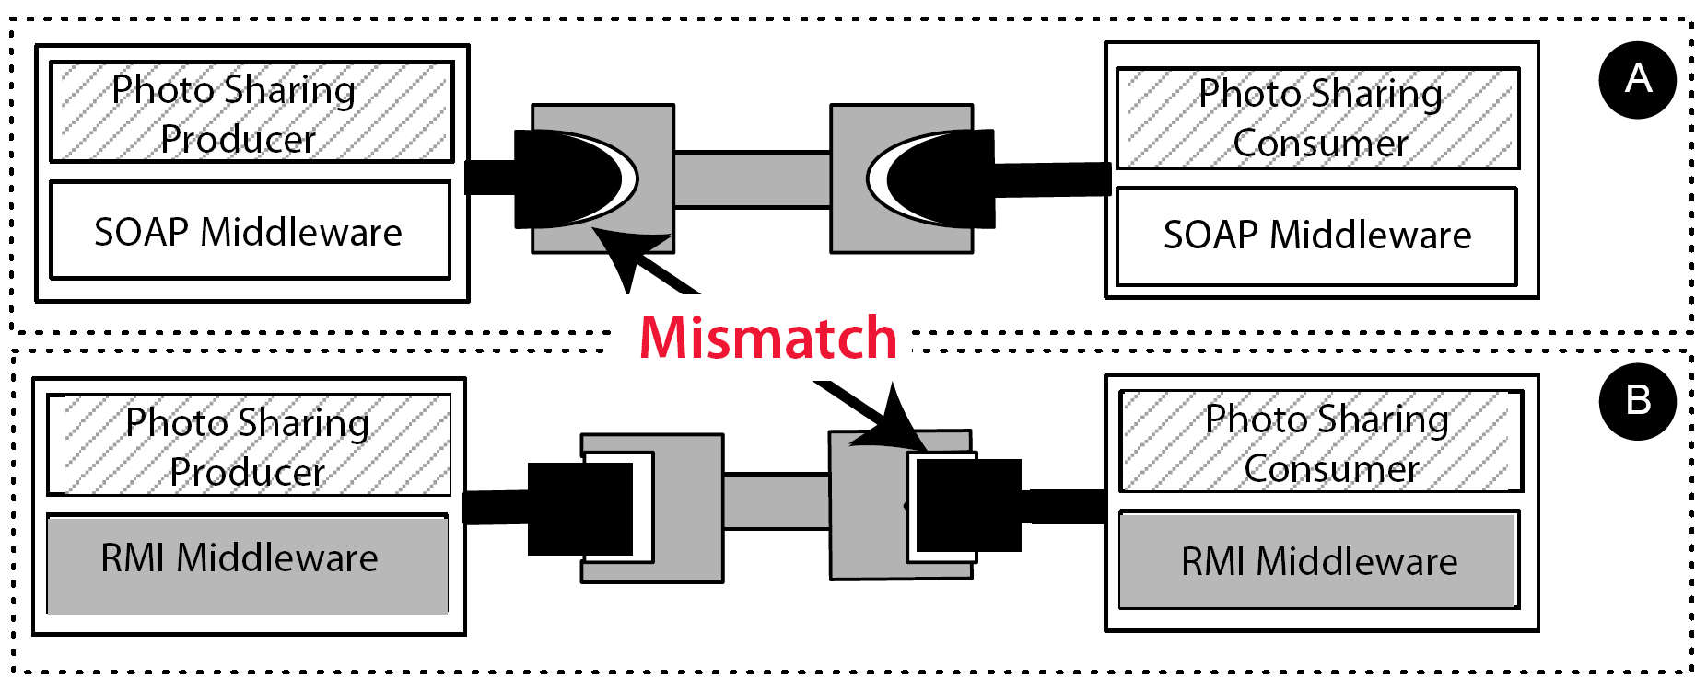
Middleware Mismatches

Slide 16
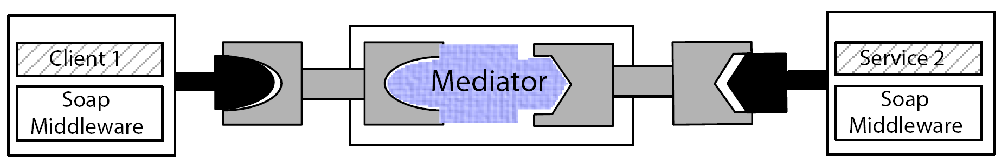
Mediation Connector

Slide 17
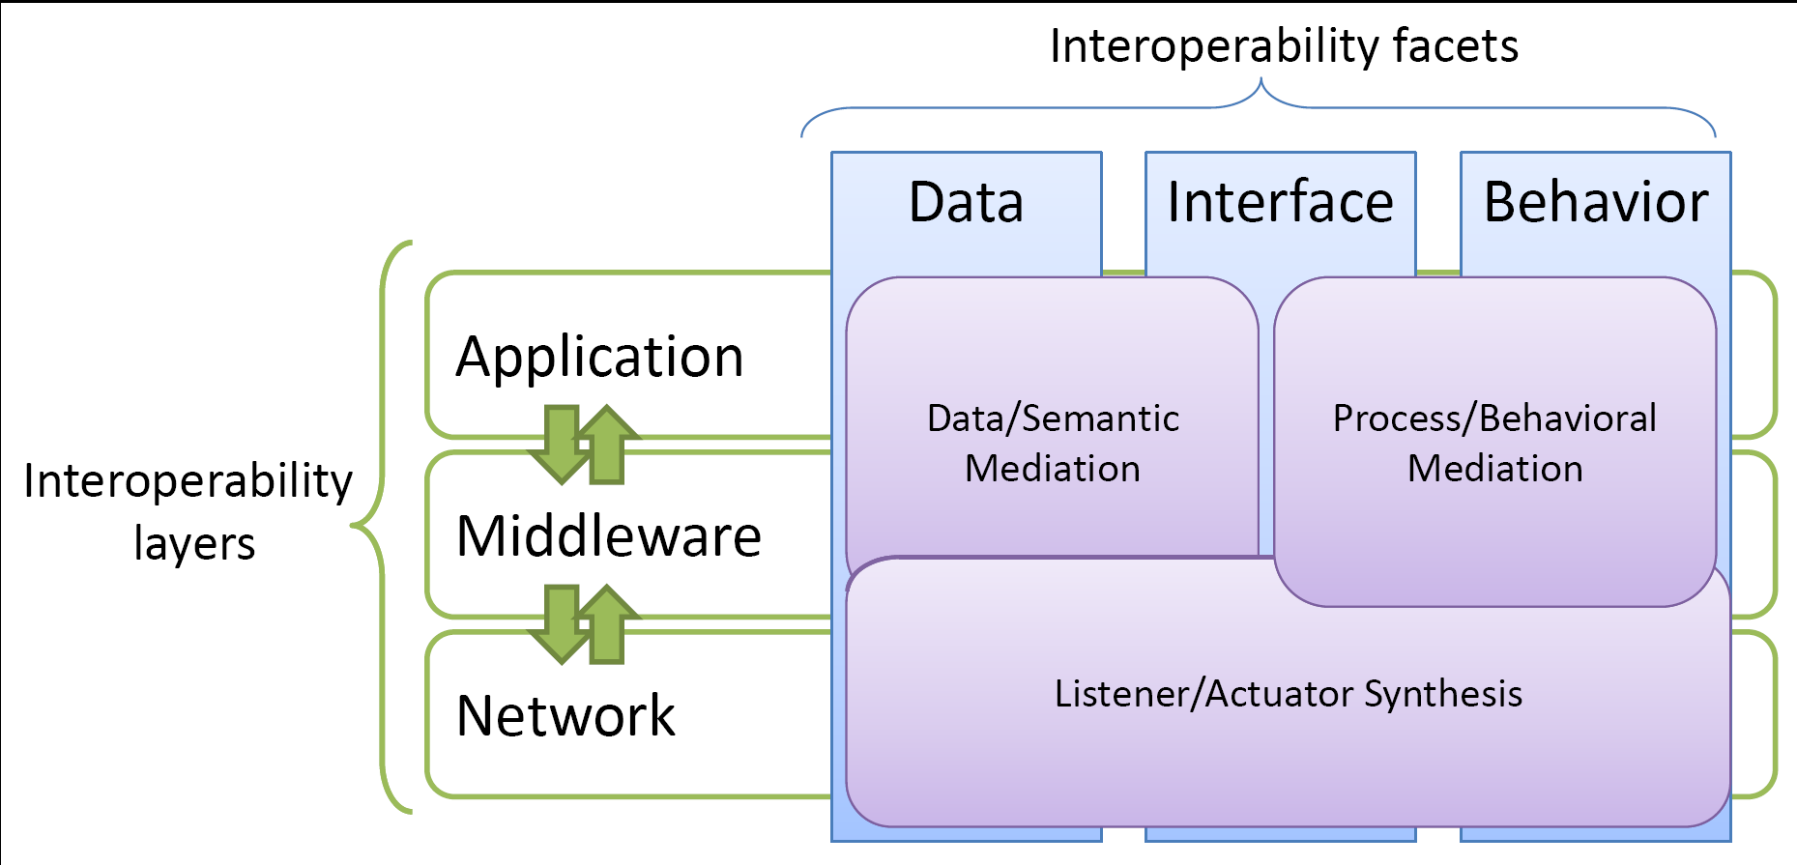
The Many Facets of Mediation
How to make mediation connector emergent?

Slide 18
Towards Emergent Connectors
Formalizing middleware-based connectors to reason about interoperability
Revisiting existing interoperability connectors
Emergent connector synthesis

Slide 19
Outline
Middleware-based connectors
Formalizing middleware-based connectors
Revisiting interoperability connectors
Emergent connector synthesis
Emergent connector in practice
Conclusion

Slide 20
Finite State Processes
END Predefined process, successfull termination
set S Denotes a set of action labels
[i : S] Binds the variable i to a value from S
Primitive Processes (P)
a -> P Action prefix
a -> P | b -> P Choice
P;Q Sequential composition
P(X =‘ a) Parameterized process: P is described using parameter X
and modeled for a particular parameter value, P(a)
P/{new_1/old_1, …, new_n/old_n}
Relabeling
P \{a1, a2, …, an} Hiding
P +{a1, a2, …, an} Alphabet extension
Composite Processes (||P)
P||Q Parallel composition
forall [i : 1..n] P(i) Replicator construct: equivalent to the parallel composition
a : P Process labeling

Slide 21
SOAP-based Middleware Connector
SOAP
Role ClientSOAP = SOAP-RPCCall -> SOAP-RPCReceiveReply -> ClientSOAP
Role ServerSOAP = SOAP-RPCReceiveCall -> SOAP-RPCReply -> ServerSOAP
GlueSOAP = SOAP-RPCCall -> SOAP-RPCReceiveCall -> GlueSOAP
| SOAP-RPCReply -> SOAP-RPCReceiveReply -> GlueSOAP
||ConnectorSOAP = ClientSOAP || GlueSOAP || ServerSOAP
See Work by D. Garlan et al. at CMU

Slide 22
Photo Sharing over SOAP
- Application -
set SOAP_PhotoSharing_Actions =
{uploadPhoto, searchPhoto, downloadPhoto, downloadComment,
commentPhoto}
PhotoSharingConsumer = (req.searchPhoto -> P1),
P1 = (req.downloadPhoto ->P1 | req.commentPhoto -> P1)
|req.downloadComment -> P1 | terminate -> END).
PhotoSharingProducer =
(req.uploadPhoto -> PhotoSharingProducer | terminate -> END).
PhotoSharingServer =
(prov.uploadPhoto -> PhotoSharingServer
|prov.searchPhoto -> PhotoSharingServer
|prov.downloadPhoto -> PhotoSharingServer
|prov.commentPhoto -> PhotoSharingServer
|prov.downloadComment -> PhotoSharingServer | terminate -> END).

Slide 23
Photo Sharing over SOAP
- SOAP Middleware -
ClientSOAP (X =’ op) =
(req.[X] -> P1 | terminate -> END),
P1 = (SOAP-RPCCall[X] ->SOAP-RPCReceiveReply[X] -> ClientSOAP ).
ServerSOAP (X =’ op) =
(prov.[X] -> P2 | terminate -> END),
P2 = (SOAP-RPCReceiveCall[X] -> SOAP-RPCReply[X] -> ServerSOAP ).
GlueSOAP (X =’ op) =
(SOAP-RPCCall[X] -> P0 | terminate -> END),
P0 = (SOAP-RPCReceiveCall[X] -> SOAP-RPCReply[X]
-> SOAP-RPCReceiveReply[X] -> GlueSOAP ).

Slide 24
Photo Sharing over SOAP
- Photo Sharing System -
||SOAP_PhotoSharing =
(PhotoSharingProducer
|| PhotoSharingConsumer
|| PhotoSharingServer
|| (forall [op:SOAP_PhotoSharing_Actions] ServerSOAP (op))
|| (forall [op:SOAP_PhotoSharing_Actions] ClientSOAP (op))
|| (forall [op:SOAP_PhotoSharing_Actions] GlueSOAP (op))).

Slide 25
Outline
Middleware-based connectors
Formalizing middleware-based connectors
Revisiting interoperability connectors
Emergent connector synthesis
Emergent connector in practice
Conclusion

Slide 26
Approaches to Interoperability
Solutions applicable to Middleware and Application layers
  Software Bridges
  Interoperability Platforms
  Transparent Interoperability
See Lecture by Gordon Blair & Massimo Paolucci on
Interoperability in Complex Distributed Systems

Slide 27
Software Bridges
Legacy
Application
Legacy Middleware A
Bridge
A to B
Legacy Middleware B
Legacy Application
Peer
3rd Party Peer
Peer
E.g.:
OrbixCOMet, SOAP2CORBA at middleware-layer
Domain-specific bridges –MSN-Yahoo bridge - at application-layer

Slide 28
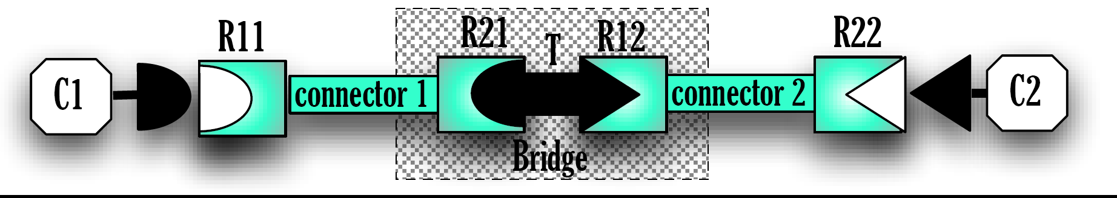
Bridge Mediator
||Direct_Bridge_Mediator = (Bridge || T)

Slide 29

Bridging Connector
Legacy connectors
Role R1_{i,i in [1..2]} = Role R1 of Connector_{i}
Role R2_{i,i in [1..2]} = Role R2 of Connector_{i}
Glue_{i,i in [1..2]} = Glue of Connector_{i}
set I_{i,i in [1..2]} = Set of events initiated from Role R1_{i} and R2_{i}
Bridge = tag₁.[e₁:I₁] -> tag₂.[e₁] -> Bridge
| tag₂.[e₂:I₂] -> tag₁.[e₂] -> Bridge
Adaptation process
T = Required transformations of (tag_{i}.e_{j})s to bridge Connector1 to Connector2
Direct bridge connector
||C-DBridge = R1₁ || tag₁:Glue₁ || Bridge || T || tag₂:Glue₂ ||R2₂

Slide 30
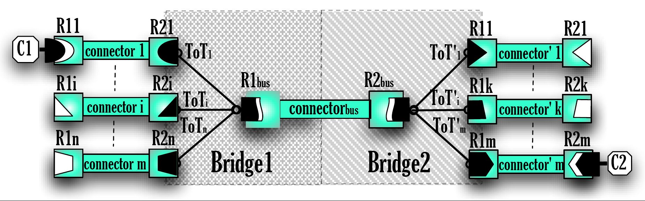
Indirect Bridge Mediator
E.g., ESB solutions (Artix, PetalS, …), Interoperability manager (MUSDAC)
Domain-specific J-EAI for interoperable IMs
||Indirect_Bridge_Mediator = (T1 || Bridge1 || Bridge2 || T2)

Slide 31
ESB Connector
R1
R2
Bus
Role R1_{bus} = Role R1 of Connector_{bus}
Role R2_{bus} = Role R2 of Connector_{bus}
Glue_{bus} = Interactions between Role R1_{bus} and Role R2_{bus}
Legacy connectors
Role R1 = |_{i=1..n} (a.glue_{i} -> R1_{i}),
R1_{i, i=1..n} = (R1_{i} initial specification as given by Connector_{i}) | reset -> R1
Role R2 = |_{k=1..m} (a.glue’_{k} -> R2_{k}),
R2_{k, k=1..m} = (R2_{k} initial specification as given by Connector’_{k}) | reset -> R2
Glue _{i=1..n} = Interactions between R1_{i} and R2_{i}
Glue’ _{k=1..m} = Interactions between R’1_{k} and R’2_{k}
Events
set I1_{i, i=1..n} (O1_{i, i=1..n} ) Set of events initiated (observed) from Role R1_{i}
set I2_{k, k=1..m} (O2_{k, k=1..m} ) Set of events initiated (observed) from Role R2_{k}

Slide 32
ESB Connector (2)
T₁
T₂
Adaptation process
T₁ = |_{i=1..n} (a.glue_{i} -> ToT_{i}),
ToT _{i=1..n} = Required transformations to bridge Connector_{i} to Connector_{bus} | a.reset -> T₁
T₂ = |_{k=1..m} (b.glue’_{k} -> ToT’_{k}),
ToT’_{k, k=1..m} = Required transformations to bridge Connector_{bus} to Connector_{’k} | b.reset -> T₂
Bridging processes
Bridge₁ = |_{i=1..n} (a.glue_{i} -> Bridge_{i}),
Bridge_{i=1..n} = [e : I1_{i}] -> a.tag_{i}.[e] -> Bridge_{i} | a.tag_{i}.[e : O1_{i}] -> [e] -> Bridge_{i}
| a.reset -> Bridge₁
Bridge2 = |_{k=1..m} (b.glue’_{k} -> Bridge’_{k}),
Bridge’_{k=1..m} = [e : I2_{k}] -> b.tag_{k}.[e] -> Bridge’_{k}|b.tag_{k}.[e : O2_{k}] -> [e] -> Bridge’_{k}
|b.reset -> Bridge₂
Indirect bridge connector
||C-IBridge = R1 || T1 ||_{i=1..n} a.tag_{i}:Glue_{i} || Bridge₁|| Glue_{bus} || Bridge₂ ||_{k=1..m} b.tag_{k}:Glue’_{k} || T2 || R2

Slide 33
Software Bridges Assessment
Handcoded development of bridges (i.e., Process T)
Direct bridging does not scale
Interoperability limited to the behavior of the intermediary in
the case of indirect bridging

Slide 34
Interoperability Platforms
Application
Interoperability Platform
Legacy Middleware
Application
Translation
Substituted Middleware
Peer
Peer
E.g.:
UIC, ReMMoC at middleware-layer
Domain-specific platform – IM Pidgin, Adium - at application-layer

Slide 35
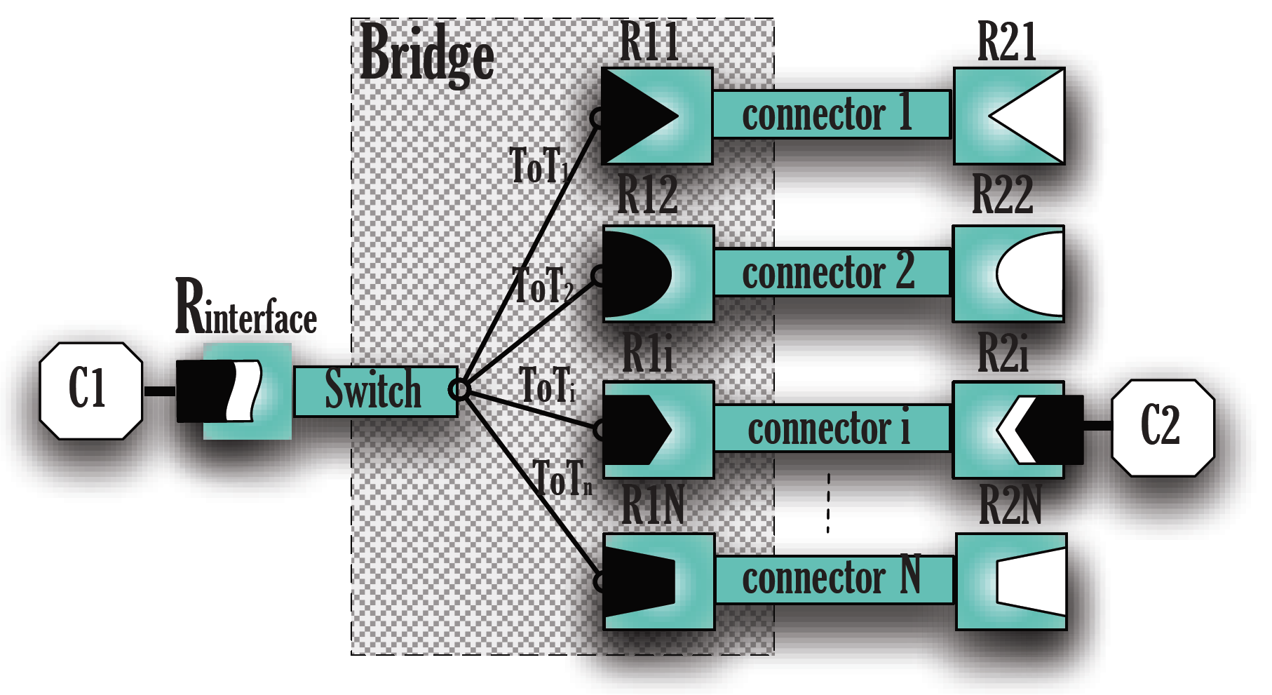
Interoperability Mediator
||Interoperability_Mediator = (Switch || Bridge || T)

Slide 36
Interoperability Connector (1)
Proprietary interface
Role R_{interface} = Bridge interface
Role R2 = |_{i=1..n} (glue_{i} -> R2_{i}),
R2_{i,i in [1..n]} = Inititial spec of Role R2 of Connector_{i} | reset -> R2
Glue_{i,i in [1..n]} = Glue of Connector_{i}
Initiated and observed events
set I2 (O2)_{i,i in [1..n]} = Set of events initiated (observed) from Role R2_{i}
set I (O) _{interface} = Set of events initiated (observed) from Role R_{interface}
Switch process
Switch = (election -> reset -> Switch |_{i=1..n} election -> glue_{i} -> Switch)\{election}

Slide 37
Interoperability Connector (2)
Adaptation process
T = |_{i=1..n} (glue_{i} -> ToT_{i}),
ToT _{i=1..n} = Required transformations to bridge R_{interface} to Connector_{i} | reset -> T
Bridging process
Bridge = |_{i=1..n} (glue_{i} -> Bridge_{i}),
Bridge_{i, i in [1..n]} = [e : R_{interface}] -> tag_{i}:[e] -> Bridge_{i} | tag_{i}:[e :O_{interface}] -> [e]-> Bridge_{i}
| [e : I2_{i}] -> tag_{i}:[e] -> Bridge_{i} | tag_{i}.[e :O2_{i}] -> [e]-> Bridge_{i}
| reset -> Bridge
Interoperability platform connector
||C-InteropPlatforms = R_{interface} || Switch || T || Bridge ||_{i=1..n} tag_{i} :Glue_{i} || R2

Slide 38
Interoperability Platform Assessment
Proprietary interface and behavior

Slide 39
Transparent Interoperability
Legacy
Application
Legacy Middleware
Translation to Intermediary
Translation to Intermediary
Legacy Middleware
Legacy Application
Peer
3rd Party Peer
Peer
E.g.:
INDISS, ubiSOAP at middleware layer
Domain-specific interoperability – IM CrossTalk – at application layer
39

Slide 40
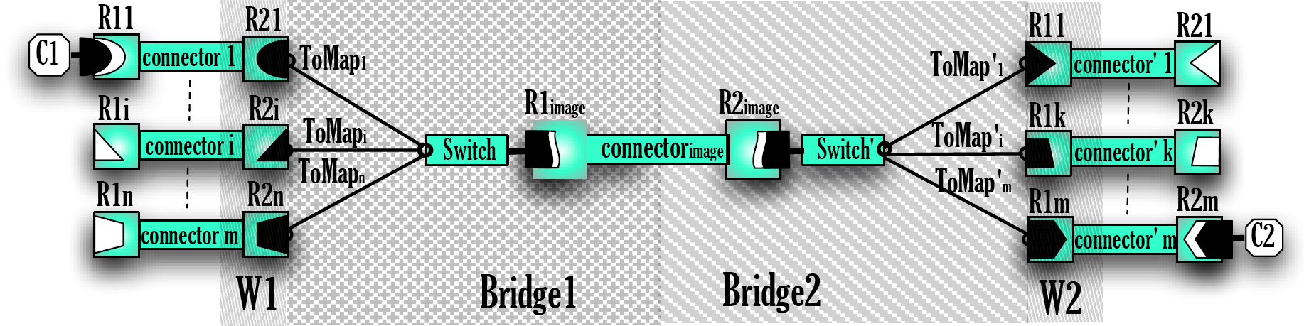
Transparent Mediator
||Transparent_Mediator =
(Switch || W₁ || M₁ || Bridge₁ || Bridge₂ || M₂ || W₂ || Switch’)

Slide 41
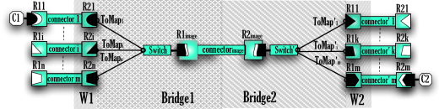
Transparent
Interoperability Connector (1)
Legacy connectors
Role R1 = |_{i=1..n} (a.glue_{i} -> R1_{i}),
R1_{i,i in [1..n]} = Inititial spec of Role R1_{i} of Connector_{i} | reset -> R1
Role R2 = |_{k=1..m} (b.glue_{k} -> R2_{k}),
R2_{k,k in [1..m]} = Inititial spec of Role R2 of Connector’_{k} | reset -> R2
Glue_{i,i in [1..n]} = Interactions between R1_{i} and R2_{i}
Glue’_{k,k in [1..m]} = Interactions between R’1_{k} and R’2_{k}
Initiated and observed events
set I2 (O2)_{i,i in [1..n]} = Set of events initiated (observed) from Role R1_{i}
set I2 (O2)_{k, k in [1..m]} = Set of events initiated (observed) from Role R’2_{k}
set E_{i, i in [1..n]} (E_{k, k in [1..m]}) = αR1_{i} ∩ αGlue_{i} (αR2_{k} ∩ αGlue’_{k})
Set Σ E1_{n} (Σ E2_{m})= U_{i=1..n} E1_{i} (U_{k=1..m} E2_{k})
Set Σ O1_{n} (Σ O2_{m})= U_{i=1..n} O1_{i} (U_{k=1..m} O2_{k})

Slide 42
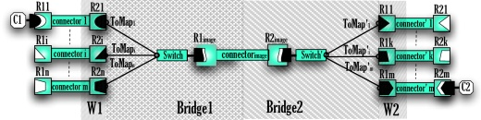
Transparent
Interoperability Connector (2)
Switch processes
Switch = (a.election -> a.reset -> Switch |_{i=1..n} a.election -> a.glue_{i} -> Switch)\{a.election}
Switch’ = (b.election->b.reset->Switch’ |_{k=1..m} b.election ->b.glue’_{k} ->Switch’)\{b.election}
Image protocol generation
W1 = |_{i=1..n} (a.glue_{i} -> ToGlue_{i}),
ToGlue_{i=1..n} = [e : I1_{i}]->a.tag_{i}:[e]->ToGlue_{i} | a.tag_{i}:[e :O1_{i}] -> [e]-> ToGlue_{i} | a.reset -> W₁
W2 = |_{k=1..m} (b.glue’_{k} -> ToGlue’_{k}),
ToGlue’_{k=1..m} = [e : I2_{k}->b.tag_{k}:[e]->ToGlue’_{k} | b.tag_{k}:[e :O2_{k}]-> [e]->ToGlue’_{k}| b.reset->W₂
M1 = |_{i=1..n} (a.glue_{i} -> ToMap_{i}),
ToMap_{i=1..n} = a.tag_{i}.[e : I1_{i}]->a.tag_{i}.f(e)->ToMap_{i}
| a.tag_{i}.f(e:ΣO1_{n}) -> a.tag_{i}.[e : O1_{i}]-> -> ToMap_{i} | a.reset -> M₁
M2 = |_{k=1..m} (b.glue’_{k} -> ToMap’_{k}),
ToMap’_{k=1..m} = b.tag_{k}.[e : I2_{k}]->b.tag_{k}.f(e)->ToMap’_{k}
| b.tag_{k}.f(e:ΣO2_{m}) -> b.tag_{k}.[e : O2_{k}]-> -> ToMap’_{k}| b.reset -> M₂

Slide 43
Transparent
Interoperability Connector (3)
Bridging process
Bridge₁ = |_{i=1..n} (a.glue_{i} -> ToBridge_{i}),
ToBridge_{i, i in [1..n]} = a.tag_{i}.f(e₂:ΣE2_{m}) -> f(e₂) -> ToBridge_{i}
| f(e₁:ΣE1_{n}) -> a.tag_{i}.f(e₂) -> ToBridge_{i}
| a.reset -> Bridge₁
Bridge₂ = |_{k=1..m} (b.glue’_{k} -> ToBridge’_{k}),
ToBridge’_{k, k in [1..m]} = b.tag_{k}.f(e₁:ΣE1_{n}) -> f(e₁) -> ToBridge’_{k}
| f(e₂:ΣE2_{m}) -> b.tag_{k}.f(e₂) -> ToBridge’_{k}
| b.reset -> Bridge₂
Transparent interoperability connector
||C-Transparent_Interop
= R₁ || Switch ||_{i=1..n} a.tag_{i}:Glue_{i}/{f(r:αGlue_{i})/[r]} || W₁ || M₁ || Bridge₁
|| M₂ || W₂ ||_{k=1..m} b.tag_{k}:Glue_{k}/{f(r:αGlue’_{k})/[r]} || Switch’ || R₂

Slide 44
Transparent Interoperability Assessment
Addresses interoperability at a single layer
Projection function f to be given, making it similar to indirect
bridging although with (design-time) adaptive buses
Does not account for the heterogeneity of interaction paradigms

Slide 45
Outline
Middleware-based connectors
Formalizing middleware-based connectors
Revisiting interoperability connectors
Emergent connector synthesis
Emergent connector in practice
Conclusion

Slide 46
The CONNECT Approach to Interoperability: Emergent Middleware
Synthesize CONNECTors between heterogeneous Networked Systems (NS)
  Generate middleware and application protocols to create connections that will overcome the interoperability barrier
    CONNECTors devised and created at Run Time
    Minimal a priori knowledge/ assumptions
NS
CONNECTor
NS
« Mediation » connector
aka Emergent middleware
See Lecture by Nikolaos Georgantas & Paul Grace on
The CONNECT Architecture
46

Slide 47
Meeting in the Heterogeneous World
Networked systems meet according to matching “Affordances”
Photo sharing
using SOAP
Photo sharing
Photo sharing
using LIME
Photo sharing
P
O_{Photo}
O_{Photo}
Q
O_{SOAP}
O_{Lime}
“Affordance” behaviour is characterized
by its protocol and related ontology
from application down to middleware layer
“Affordance” behaviour is characterized
by its protocol and related ontology

Slide 48
Networked System Model for
On-the-fly Connection
Interface definition leveraging Semantic Web service technologies
  Affordance aka Capability
    <Type, Concept, Inputs, Outputs>
  Interface signature
    Action defined as <Mdw, Application, I, O>
  Affordance behavior

Slide 49
P2P Photo Sharing Interface
Interface_{photo_sharing} = {
  < Out, PhotoMetadata, ∅, < photoMetadata >>,
  < Out, PhotoFile, ∅, < photoFile >>,
  < Rdg, PhotoMetadata,< photoMetadata >, < photoMetadataList >>,
  < Rd, PhotoFile, < photoID >, < photoFile >>,
  < Rd, PhotoComment, < photoID >, < photoComment >>,
  < Out, PhotoComment, ∅, < photoComment >>,
  < In, PhotoComment, < photoID >, < photoComment >>,
  < Rd, PhotoComment, < photoID >, < photoComment >>
}

Slide 50
P2P Photo Sharing Protocol
Application Layer
set Lime_PhotoSharing_Actions = {photoMetadata, photoFile, photoComment}
PhotoSharingPeer = (req.photoMetadata -> Consumer
| prov.photoMetadata -> Producer),
Producer = (prov.photoFile -> PhotoSharingPeer),
Consumer = (req.photoFile ->Consumer
| req.photoComment -> Consumer
| prov.photoComment -> Consumer
| req.photoFile -> PhotoSharingPeer
| req.photoComment -> PhotoSharingPeer
| prov.photoComment -> PhotoSharingPeer
| terminate -> END)

Slide 51
P2P Photo Sharing Protocol
Middleware Layer
Lime_Reader(X =‘ tuple) = (req.[X] -> P1),
P1 = (rd[X] -> Lime_Reader | rdp[X] -> Lime_Reader | rdg[X] -> Lime_Reader
| in[X] -> Lime_Reader | inp[X] -> Lime_Reader | ing[X] -> Lime_Reader
| terminate -> END).
Lime_Writer(X =‘ tuple) = (prov.[X] -> P2),
P2 = (out[X] -> Lime_Writer | outp[X] -> Lime_Writer
| outg[X] -> Lime_Writer | terminate -> END).
Lime_glue(X =‘ tuple) = (write[X] -> P0 | outp[X] -> P0 | outg[X] ->P0
| terminate -> END),
P0 = (rd[X] -> P0 | rdp[X] -> P0 | rdg[X] -> P0
| in[X] -> Lime_glue | inp[X] -> Lime_glue | ing[X] -> Lime_glue).

Slide 52
P2P Photo Sharing Protocol
Photo Sharing System
const NumberOfPeers = 2
||Lime_PhotoSharing =
( [i : 1..NumberOfPeers]:PhotoSharingPeer
|| (forall [tuple:Lime_PhotoSharing_Actions] Lime_Writer(tuple))
|| (forall [tuple:Lime_PhotoSharing_Actions] Lime_Reader(tuple))
|| (forall [tuple:Lime_PhotoSharing_Actions] Lime_glue(tuple))).

Slide 53
Talking the Same Language
The Key Role of Ontology
Aligned
Ontology
P
O_{Photo}
O_{Photo}
O_{Photo}
Q
O_{SOAP}
O_{MW}
O_{Lime}
O_{Photo}
O_{Photo}
Translation
O_{MW}
O_{MW}
Behavioral
matchmaking?
Translated
Protocols
P’
Q’
Interoperate?

Slide 54
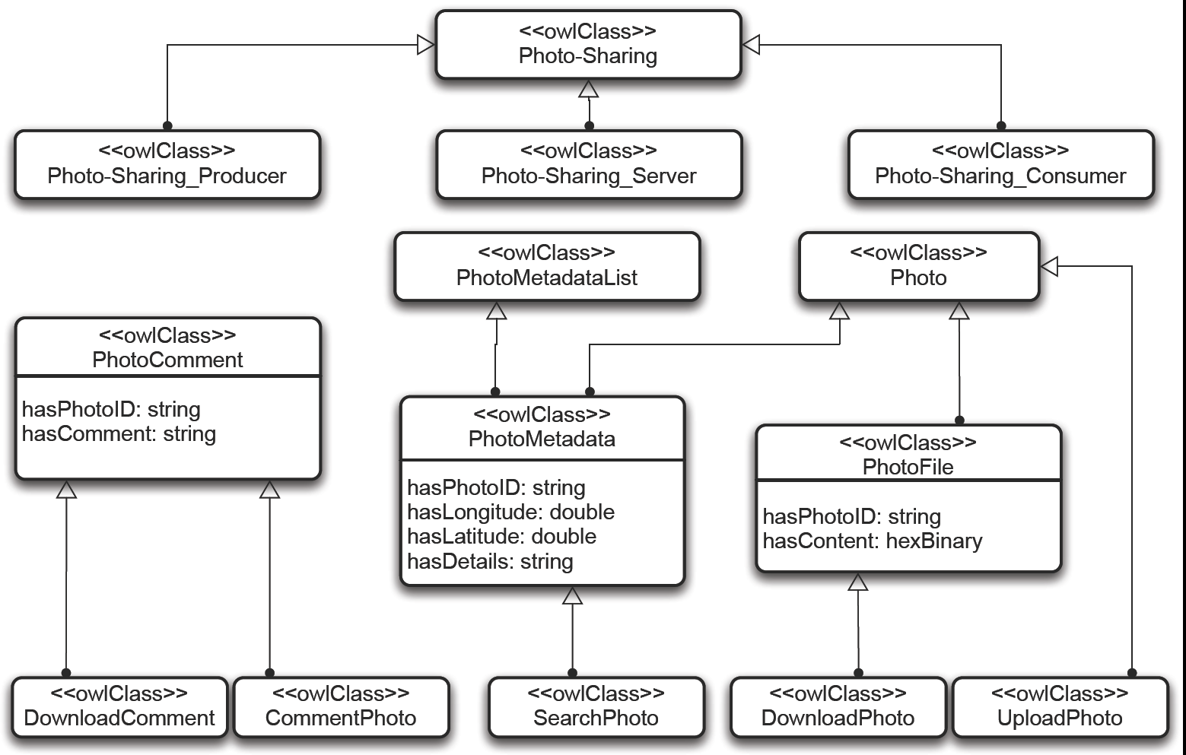
The Photo Sharing Ontology
Classified according to subsumption relationships

Slide 55
Reasoning about Mediated Matching
  Equivalence of LTS traces as the basis
Behavioral matchmaking under:
mapping of semantic-based actions
Leveraging the rich SOTA on protocol conversion/mediation
But must account for application-layer interactions
using middleware
See Lecture by Paola Inverardi on
Application-layer Connector Synthesis

Slide 56
Need to
Abstract Middleware Protocols
Towards aligning middleware functions
  4 main middleware types
    RPC
    Shared memory
    Event-based
    Message-based

Slide 57
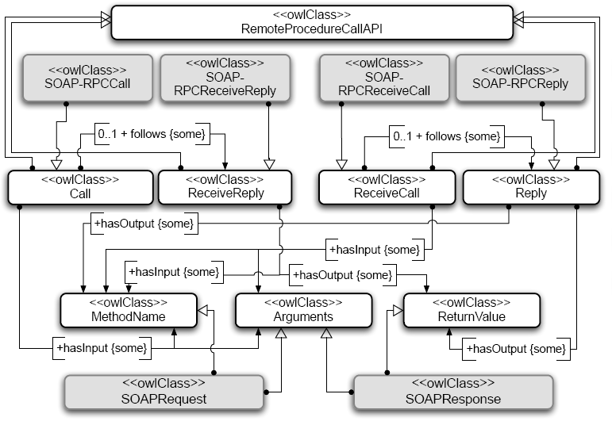
RPC Middleware

Slide 58
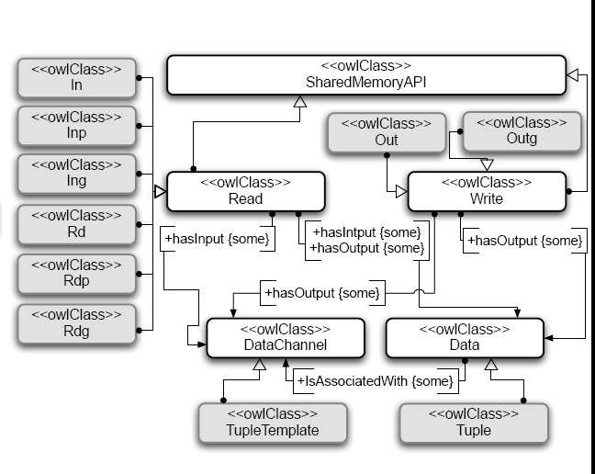
Shared Memory Middleware

Slide 59
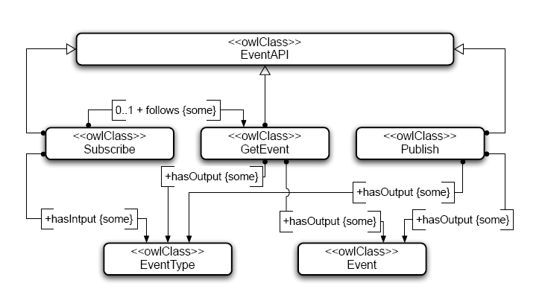
Event-based Middleware

Slide 60
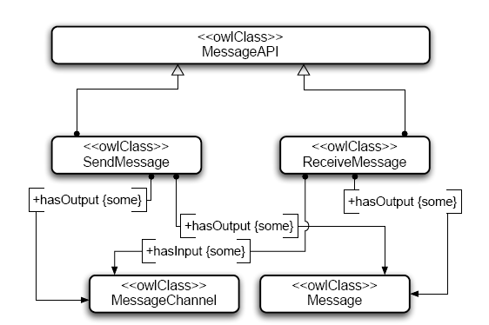
Message-based Middleware

Slide 61
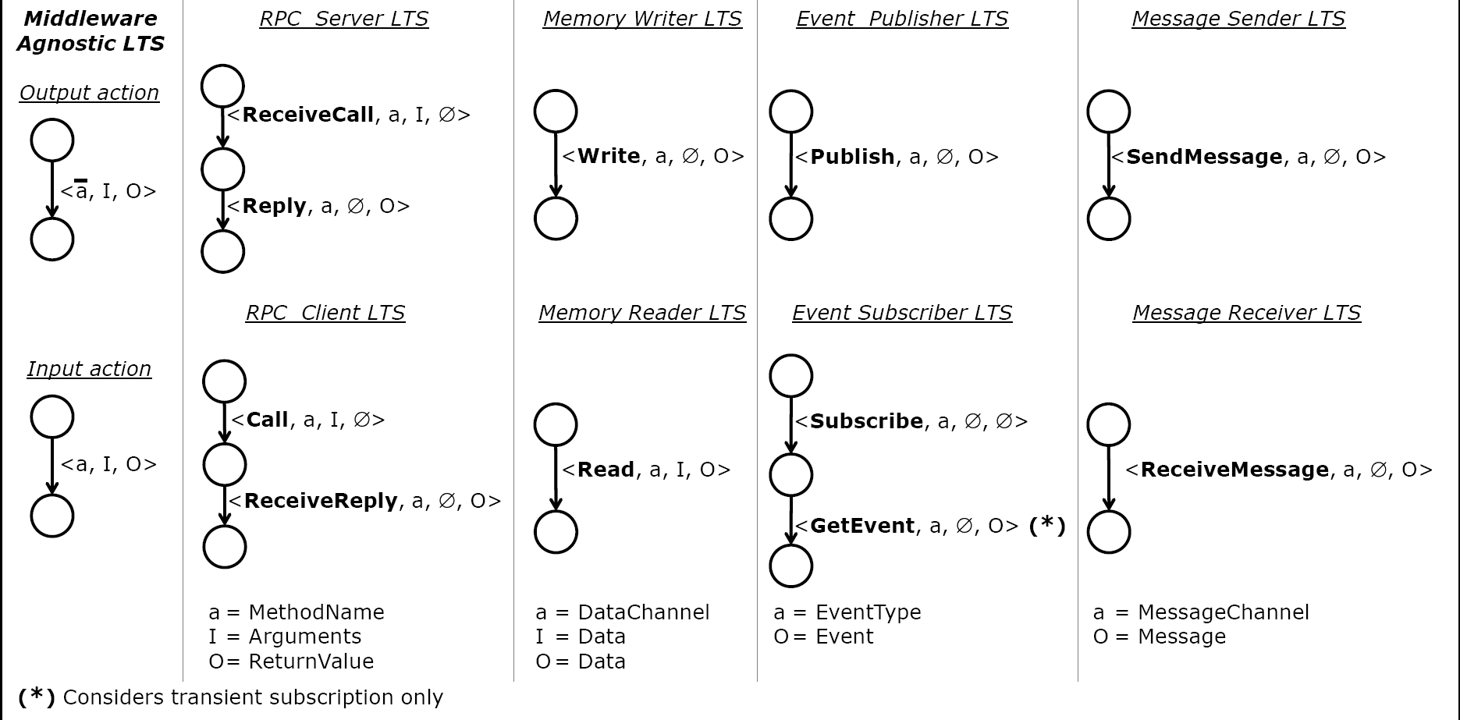
Semantics of Middleware Functions

Slide 62
From Lime to Shared Memory
P2P Photo Sharing to…
Reader(X =‘ data) = (req.[X] -> P1),
P1 = (read[X] -> Reader | terminate -> END).
Writer(X =‘ data) = (prov.[X] -> P2),
P2 = (write[X] -> Writer | terminate -> END).
SM_glue(X =‘ data) = (write[X] -> P3 | terminate->END),
P3 = (read[X] -> SM_glue).

Slide 63
Shared Memory
P2P Photo Sharing (LTS)

Slide 64
… to Middleware Agnostic
P2P Photo Sharing
Reader(X =‘ data) = (req.[X] -> P1),
P1 = (input[X] -> Reader | terminate -> END).
Writer(X =‘ data) = (prov.[X] -> P2),
P2 = (output[X] -> Writer | terminate -> END).
SM_glue(X =‘ data) =
(output[X] -> P | terminate -> END),
P = (input[X] -> SM_glue).

Slide 65
Middleware Agnostic
P2P Photo Sharing (LTS)

Slide 66
Middleware Agnostic
C/S Photo Sharing (LTS)
Consumer

Slide 67
Interoperable Systems at
Abstract Level

Slide 68
Emergent Connectors Synthesis
Affordance matching according to subsumption relationships between concepts of the affordances
Interface mapping among the actions of the protocols to be made interoperable for the following mismatches
  Splitting of input actions / Merging of output actions
  Extra output actions
Verifying whether protocols may successfully coordinate according to the computed interface mapping
Mediation connector that implements the computed interface mapping + message translation

Slide 69
Interface Mapping
Map_{I}(I_{A1}, I_{A2}) = ∪_{<a, I, O>∈IA1} {<a, I, O> → map(<a, I, O>, I_{A2})} ∪
∪_{<a’, I’, O’>∈IA2} {<a’, I’, O’> → map(<a’, I’, O’>, I_{A1})}
with:
map(<a, I_{a}, O_{a}>, I) = {<<out.b_{i}, I_{i}, O_{i}> ∈ I>_{i=1..n} |
a ⊆ ∪_{i} {b_{i}}
^ I_{i} _{≤ n} ⊆ (∪_{j<i} {O_{i}}) ∪ {I_{a}}
^ O_{a} ⊆ (∪_{j<i} {O_{i}}) ∪ {I_{a}}
}
and:
∀seq₁ ∈ map(<a, I_{a}, O_{a}>, I), !∃ seq₂ ∈ map(<a, I_{a}, O_{a}>, I) | seq₂ < seq₁

Slide 70
Mediator Synthesis
Adaptation processes:
M_{a} = (||_{i} Processes that merge/split A1 actions)
M_{a’} = (||_{i’} Processes that merge/split A2 actions)
M_{b’} = (||_{i} Processes that consume extra output actions of A2)
M_{b} = (||_{i} Processes that consume extra output actions of A1)
Behavioral matching under mediation:
P1 || M_{a} || M_{b’} ≤ P2 || M_{a’} || M_{b}
where A1 ⊆ A2 and A1 req A2
Emergent connector:
M_{a} || M_{b’} || M_{a’} || M_{b}

Slide 71
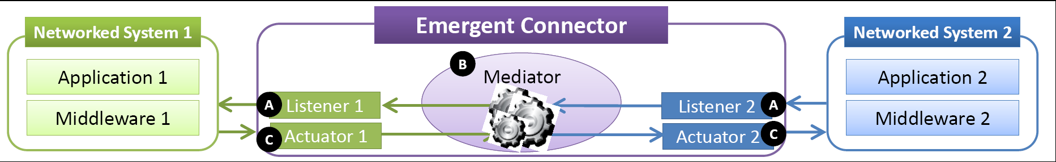
From Abstract to Concrete Emergent Connectors
See Lecture by Nikolaos Georgantas & Paul Grace on
The CONNECT Architecture

Slide 72
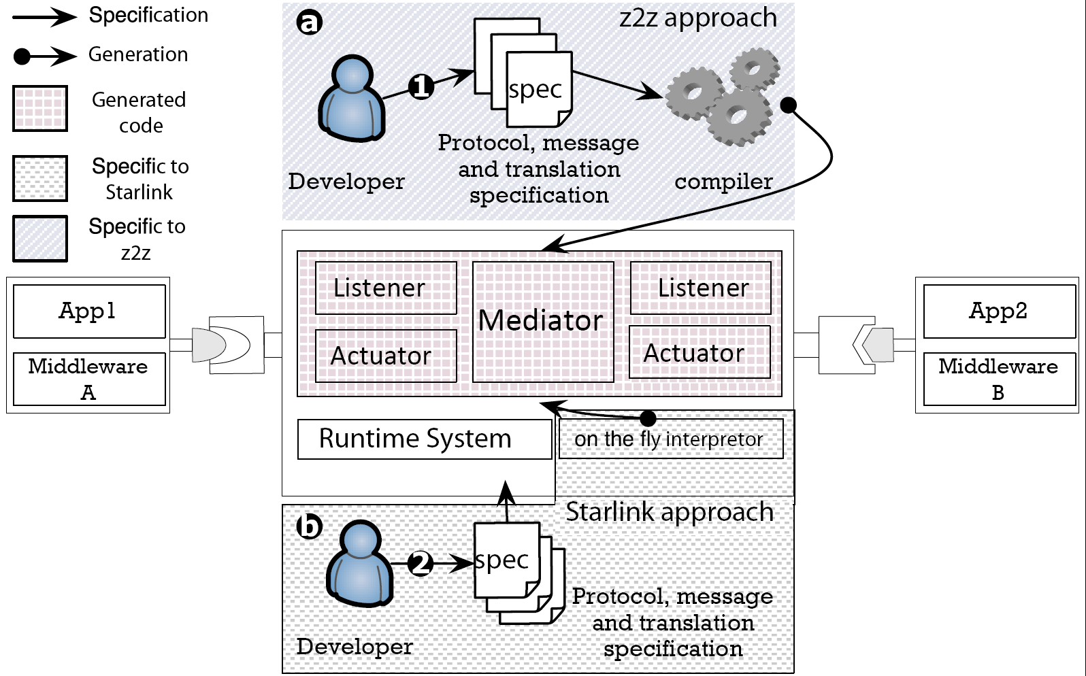
Appraches to Middleware Synthesis
Still a long way to go…

Slide 73
Outline
Middleware-based connectors
Formalizing middleware-based connectors
Revisiting interoperability connectors
Emergent connector synthesis
Emergent connector in practice
Conclusion

Slide 74



The Instant Messaging Case Study
XMPP System
XMPP Client
XMPP
XMPP Client
MSN Client
MSN Client
MSNP
MSNP System
1-1 Interface mapping
Behavioral matching using OFSP
(FSP enriched with ontology reasoning over actions)

Slide 75
Making IMs interoperable
Software bridges
  Direct: MSN & Yahoo!Messenger
  Indirect: J-EAI
Interoperability platforms
  Pidgin, Adium
Transparent interoperability
  CrossTalk

Slide 76
The CONNECT Way

Slide 77
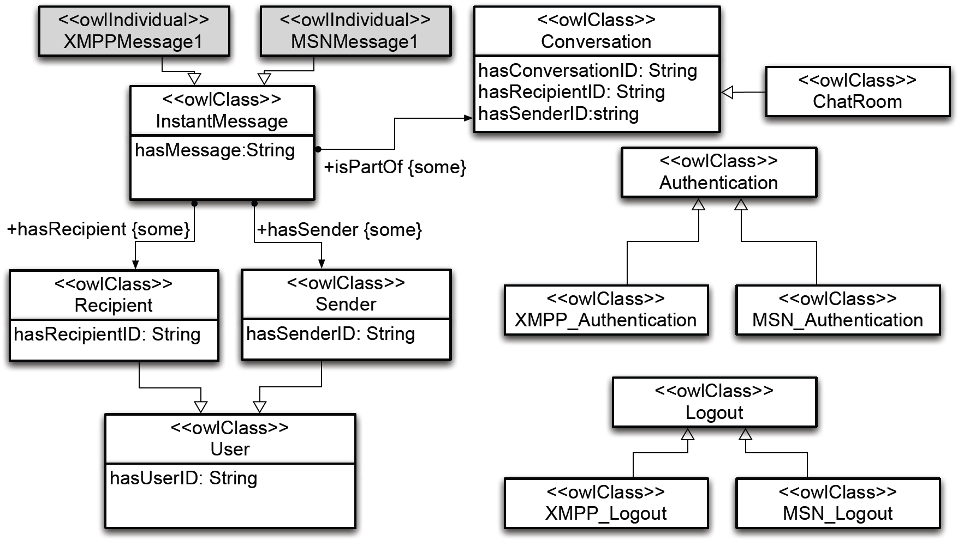
The IM Ontology

Slide 78
OFSP Specification of MSNP
MSNClient =
(<input, MSNAuthenticationRequest, {UserID}, {Challenge} >
-> < input, MSNAuthenticationResponse, {Response}, {Authenticationok} >
-> ExchangeMsgs).
ExchangeMsgs =
(< input, CreateChatRoom, {UserID}, {ConversationID} >
-> < input, JoinChatRoom, {UserID}, {Acceptance} -> P1
| < output, JoinChatRoom, {UserID}, {Acceptance} >
-> < input, {ChatRoomInfo, ∅, {ConversationID} > -> P1
P1 =
(< input, InstantMessage, {UserID, ConversationID, Messageg}, ∅ > -> P1
| < output, InstantMessage, {UserID, ConversationID, Message}, ∅ > -> P1
| < input, MSNLogout, {UserID }, ∅ > -> END

Slide 79
OFSP Specification of XMPP
XMPPClient =
(< input, XMPPAuthenticationRequest, {UserID}, {Challenge} >
-> < input, XMPPAuthenticationResponse, {Response}, {Authenticationok}> -> ExchangeMsgs).
ExchangeMsgs =
(< input, InstantMessage, {SenderID, RecepientID, Message}, ∅> -> ExchangeMsgs
| < output, InstantMessage, {SenderID, RecipientID, Message <}, ∅ > -> ExchangeMsgs
| < input, XMPPLogout, {UserID}, ∅ > -> END).

Slide 80
OFSP Specification
MSNP-XMPP Mediator
Map1 =
(<output, InstantMessage, {SenderID, RecepientID, Message} , ∅ >
-> <input, InstantMessage,{UserID, ConversationID, Message } , ∅ >
-> Map1).
Map2 =
(<output, InstantMessage, {UserID, ConversationID, Message } , ∅ >
-> <input, InstantMessage, {SenderID, RecepientID, Message}, ∅ >
-> Map2).
||Mediator = (Map1 || Map2).

Slide 81
On-line Mediation
Mediator

Slide 82
Message Mediation

Slide 83
Performance Evaluation
Proprietary vs Synthesized Mediator
Latency (ms)
Native Hand Synthesized
Pars Trans
MSNP - MSNP 22 12 231 11
YMSG - YMSG 24 08 342 12
YMSG - MSNP 35 06 234 20
MSNP - XMPP N/A 52 135 07
YMSG - XMPP N/A 44 145 06
MSNP - GTalk N/A 65 N/A
YMSG - GTalk N/A 78 N/A

Slide 84
Performance Evaluation
Proprietary vs Synthesized Mediator
Lines of Code/Spec
Hand-coded Synthesized
Pars Trans
YMSG - MSNP 1172 245
MSNP - XMPP 0750 203
YMSG - XMPP 0945 144

Slide 85
Performance Evaluation
OLTSA Model Checking

Slide 86
On the fly IM Interoperability in Action
Demo by Amel Bennaceur

Slide 87
Outline
Middleware-based connectors
Formalizing middleware-based connectors
Revisiting interoperability connectors
Emergent connector synthesis
Emergent connector in practice
Conclusion

Slide 88
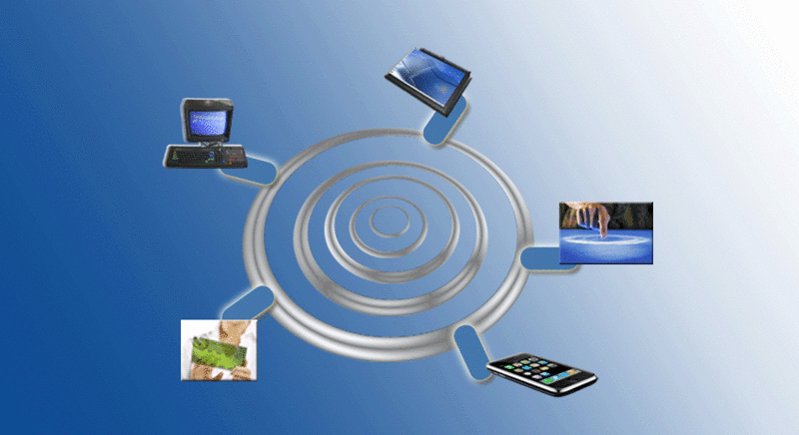
Composing Pervasive Systems
State-of-the art survey in middleware & data interoperability shows that no current approach meets today’s interoperability challenge
Need for emergent middleware where connectors are synthesized on the fly

Slide 89
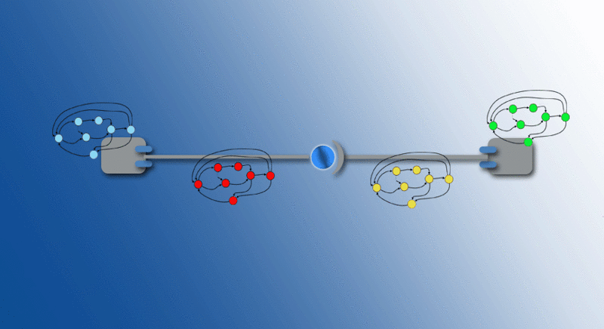
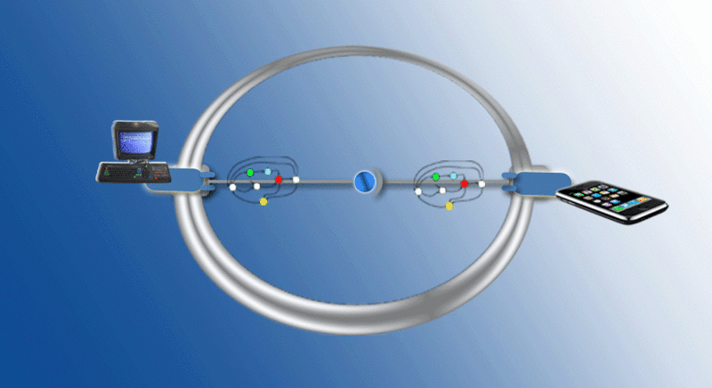
Synthesizing CONNECTors for Pervasive Systems
  CONNECTors implementing emergent middleware that mediate interactions among pervasive networked systems
  Formalization of interoperability based on matching and mapping relationships between interaction protocols run by networked systems
  Dealing with application- and middleware-layer connectors
  Further challenge of enforcing non-functional properties

Slide 90
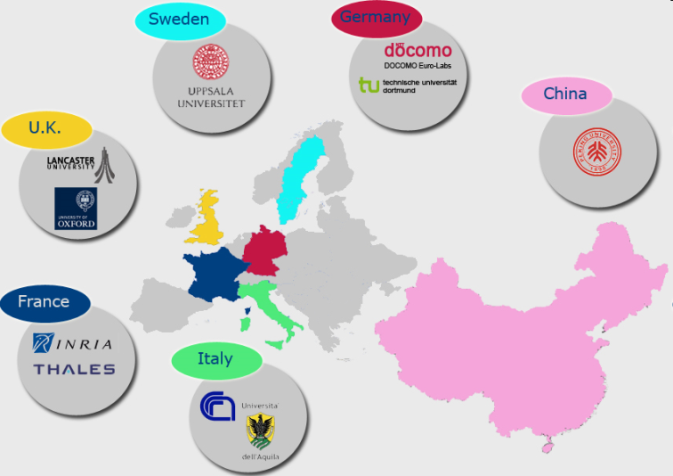

Thank you and
Thanks to CONNECT colleagues
(A. Bennaceur, G. Blair, N. Georgantas, P. Grace, P. Inverardi, R. Saadi, R. Spalazzese, …)

